Slide 1
CompTIA Security + 701

Slide 2
Domain 1: General Security Concepts

Slide 3

Identify security concepts to protect data, ensure availability, and mitigate cyber threats effectively
Compare and contrast various types of security controls to optimize protection against cyber threats
Interpret personnel security to safeguard networks against threats
Discover the importance of change management processes and their impact on security to maintain operational stability
Identify the importance of using appropriate cryptographic solutions to secure data and communications effectively
Notes:
Trainer Notes:
Summarize the points given on the slide and set an expectation about learning these pointers in this lesson.

Slide 4
Introduction to Security Concepts

Slide 5

What Is Information Security?
Information security, often called InfoSec, is the practice of protecting information by mitigating information risks.
It is about safeguarding data from unauthorized access, use, disclosure, disruption, modification, or destruction.
Information can be anything valuable, including customer data, financial records, intellectual property, personal details, and even classified government information.
Notes:
Trainer Notes:
What is Information Security?
Information can be anything valuable, including customer data, financial records, intellectual property, personal details, and even classified government information.
Information Security, often called InfoSec, is the practice of protecting information by mitigating information risks.
It's about safeguarding data from unauthorized access, use, disclosure, disruption, modification, or destruction.

Slide 6

Why Information Security?
With digital transformation and integration comes a heightened risk of cyber threats.
Cybersecurity is not just an IT issue; it is also a business and personal concern.
From identity theft to financial fraud, the repercussions of a security breach can be far-reaching and devastating.
The advent of artificial intelligence and deepfakes has added fuel to the fire and worsened the situation.
Notes:
Trainer Notes:
Why Information Security?
With this digital transformation and integration comes a heightened risk of cyber threats
Cybersecurity is not just an IT issue; it's a business and personal concern.
From identity theft to financial fraud, the repercussions of a security breach can be far-reaching and devastating.
The advent of Artificial Intelligence and deep fakes have added fuel to the fire and worsened the situation

Slide 7

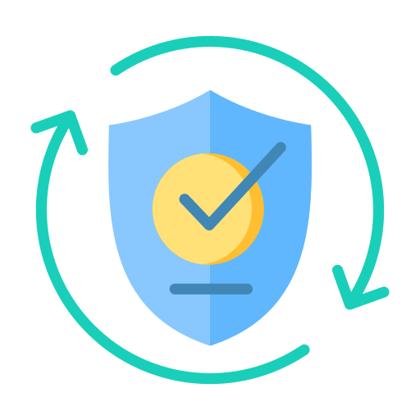




Factors Impacting Information Security
Nature of business
Security culture
Legal and regulatory compliance
Management support
Risk appetite
Industry threats
Notes:
Trainer Notes
Please explain different factors impacting cyber security
Nature of Business- Type of Business organization is in
Security Culture- People, Process of the organization
Legal and Regulatory Compliance – Different type of regulations, standards, organization has to abide by for e.g. ISO 27001,PCI DSS
Management Support- Management support is vital for cyber security of the organization
Risk Appetite- Capacity of organization to accept the risk
Industry threats: Latest industry threats also impact the organization security i.e. ransomware, deepfakes

Slide 8



Cybersecurity
Cybersecurity is the process of securing sensitive data and critical systems from cyber threats.
It refers to anything intended to protect enterprises from intentional attacks, breaches, incidents, and consequences.
It can also be defined as protecting information assets by addressing threats to information processed, stored, and transported by internetworked information systems.
Notes:
Discuss cybersecurity
Cyber security, also referred to as information technology (IT) security or electronic information security, is the practice of protecting computer systems, networks, and data from unauthorized access, use, disclosure, disruption, modification, or destruction. In simpler terms, it's all about keeping your digital information safe from harm.
Cybersecurity refers to anything intended to protect enterprises from intentional attacks, breaches, incidents, and consequences
It can also be defined as the protection of information assets by addressing threats to information processed, stored, and transported by internetworked information systems

Slide 9

Goal of Cybersecurity
The primary objective of cybersecurity is to preserve the confidentiality, integrity, and availability of an organization's critical assets from attack, damage, or unauthorized access.
Notes:
Trainer Notes
The goals of cybersecurity is to protect the confidentiality, integrity, and availability (CIA Triad) of an organization's critical assets (such as networks, computers, programs, and data) from attack, damage or unauthorized access.

Slide 10

Why Is Cybersecurity Important?
Due to technological advancement, the rate of cybercrime is increasing.
As most of the business happens online, there is an increasing demand to protect this data.
The presence of crime syndicates, cyber armies, and financial frauds has also highlighted the importance of cybersecurity.
Notes:
Trainer Notes:
Let’s deep-dive into why cybersecurity important.
Due to technological advancement, the rate of cybercrime is increasing
As most of the business happens online these days, there is an increasing demand to protect this data
Presence of crime syndicates
Cyber armies
Financial fraud

Slide 11
Difference Between Information Security and Cybersecurity
Information Security
Cybersecurity
Cybersecurity is a component of information security.
It can be defined as the protection of information assets by addressing threats to information processed, stored, and transported by internetworked information systems.
Information security deals with information regardless of its format.
It encompasses paper documents, digital data, and intellectual property.
Notes:
Trainer Notes:
Let’s go through the differences between Information Security and Cybersecurity.
Information security deals with information regardless of its format. Where as, cybersecurity can be defined as the protection of information assets by addressing threats to information processed, stored, and transported by internetworked information systems.
Information security encompasses paper documents, digital data, and intellectual property. And Cybersecurity is a component of information security.
Cybersecurity is a component of information security.
It can be defined as the protection of information assets by addressing threats to information processed, stored, and transported by internetworked information systems.

Slide 12







Risks of Security on Business
Reputational and financial loss
Business interruption loss
Loss of customer confidence
Legal action against company
Intellectual property loss
Data breach
Notes:
Explain Risk of Security on business
Reputation and Finance Loss- Cybersecurity can lead to a loss in reputation and financial loss for company
Business Interruption Loss- Attacks like Ransomware DDOS can lead to the interruption for business
Loss of customer confidence: Cybersecurity attacks like data breach, services not being available can lead to a dent in customer confidence
Legal Action against the company: There are contractual and legal provisions for fines against the company in case of a cybersecurity breach
Intellectual Property Loss- Stealing Intellectual properties, i.e. copyright, a trade secret can lead to monetary losses as well as reputational loss
Data Breach: Unauthorized access of data by unauthorized party

Slide 13

Terrifying Cybercrime Statistics
Recent trends that make Cybersecurity more important:
During 2023, 5 billion data breaches were reported, compromising around 867 million records.
Google blocked over 2.8 million bad apps from entering the Play Store in 2023.
Ransomware attacks on the healthcare industry will quadruple.
Cybercrime is expected to cost 23.84 trillion by 2025.
There will be 350 billion passwords worldwide by 2025.
More than 60% of fraud originates from mobile devices.
Personal data sells for as little as $0.20.
90% of hackers use encryption.
Notes:
Trainer Notes:
Let’s go through Recent trends which make Cybersecurity more important:
During 2023, 5 billion data breaches were reported, compromising around 867 million records
Google blocked over 2.8 million bad apps from entering the Play Store in 2023
Ransomware attacks on the healthcare industry will quadruple
Cybercrime to cost 23.84 trillion by 2025
350 billion passwords worldwide by 2025
More than 60% of fraud originates from mobile devices
Personal data sells for as little as $0.20
90% of hackers use encryption

Slide 14
Approaches to Cybersecurity
Compliance-based
Ad hoc
Relies on regulations or standards to determine security implementation
Implements security with no rationale or criteria
Risk-based
Relies on identifying the unique risk a particular organization faces and designing and implementing security controls to address that risk
Notes:
Trainer Notes:
Approaches to Cybersecurity are:
Compliance based
Risk Based
Ad hoc
Let’s go through them one after the other
Compliance based: Relies on regulations or standards to determine security implementation
Risk Based: This approach relies on identifying the unique risk a particular organization faces and designing and implementing security controls to address that risk
Ad hoc: This approach simply implements security with no rationale or criteria

Slide 15
CIA

Slide 16

CIA Triad
This stands for confidentiality, integrity, and availability, which are the primary goals of cybersecurity.
Confidentiality
CIA
Integrity
Availability
Notes:
Discuss CIA Triad
The CIA triad stands for confidentiality, integrity, and availability, which are the primary goals of cybersecurity.

Slide 17

CIA Triad: Confidentiality
Confidentiality means private or confidential information should not be disclosed to unauthorized individuals.
Confidentiality
CIA
Integrity
Availability
Notes:
Explain confidentiality with real-world scenarios
Confidentiality means private or confidential information should not be disclosed to unauthorized individuals. Confidentiality refers to keeping information secret and restricting unauthorized access to it. It involves a set of rules or promises that limit access and control the disclosure of certain types of information. For example , we implement access control on our laptop to ensure that no unauthorized person access the laptop, we encrypt data or mail while transmitting to protect against access by unauthorized people

Slide 18

CIA Triad: Confidentiality
Intentional attacks
Accidental leakage
Man-in-the-middle attack, packet sniffing, and hacking
Untrained employees
Threats to confidentiality
Authentication and authorization failures
Hardware or software failures
Access to a least-privileged entity
Improper media sanitization
Notes:
Explain various threats to confidentiality
Intentional attacks- Where hacker or adversaries deliberately tries to read data in an unauthorized way i.e. installing sniffer in network, hacking
Accidental Leakage- Where employee leaked data in ignorance i.e. uploading sensitive data without protection or encryption
Authentication and authorization failure- Where you have given more information or access than what is required . For example, a person need read access and you have provided write access
Hardware or software failure- EOL device is being given in scrap without sanitizing it, this can leak your sensitive information

Slide 19



CIA Triad: Confidentiality
The following are some countermeasures to ensure confidentiality:
Encryption
Access control
Administrative policies
Converts information to an unreadable format
Prevents users from accessing confidential information without permission
Confidentiality policy and non-disclosure agreement (NDA) act as deterrent control
Notes:
Discuss various measures to protect confidentiality
Encryption-Process of converting data in a form which can only be read by authorized individuals
Access Control- Access control is all about regulating who or what can access specific resources. It's a core security principle used in both physical security and information security
Administrative- Administrative controls are essentially policies, procedures, and work practices that aim to reduce risks and improve safety. They focus on changing how people work rather than physically altering the environment or using personal protective equipment (PPE)

Slide 20

CIA Triad: Integrity
Integrity means that information or systems should be protected from intentional, unauthorized, or accidental changes.
Confidentiality
CIA
Integrity
Availability
Notes:
Explain integrity with real-world scenarios
Integrity means information or systems should be protected from intentional, unauthorized, or accidental changes.

Slide 21





CIA Triad: Integrity
Threats to integrity are:
Intentional alteration (virus attack, database hack)
Environmental factors (electromagnetic interference)
Accidental modifications (lack of input validation and training)
System malfunction (improper software configuration)
Notes:
Explain various threats to integrity
Intentional Alterations- People or hacker deliberately tries to alter data in an unauthorized manner
Environmental Factors- Environmental can also have negative impact on integrity. For example, it is always suggested to not pass cables near microwave or electric motor
Accidental modification- Data can be modified accidentally due to error or typo.
System malfunctions- Improper configuration or misconfigurations can also lead to unauthorized modifications.

Slide 22



CIA Triad: Integrity
The following are some countermeasures to ensure integrity:
Cryptographic hash
Checksums
Database integrity
Hash value of a file can be used to figure out if the file has been modified.
Checksums can detect errors and reconstruct missing data.
Referential and entity integrity ensure logical consistency.
Notes:
Discuss various measures to protect confidentiality
Cryptography Hash- Hash is the mathematical algorithm which takes variable data as an input and gives you fix length digest as an output. This can be used for ensuring integrity
Checksums-A checksum, like hashing, is a technique used for data integrity verification. Checksums are specifically designed to detect errors that may have been introduced during data transmission or storage
Database Integrity-Database integrity refers to the overall accuracy, consistency, and reliability of data stored in a database. It ensures that the data adheres to a set of predefined rules and maintains its validity over time.

Slide 23

CIA Triad: Availability
Availability means systems or information must be available on demand according to agreed-upon parameters.
Confidentiality
CIA
Integrity
Availability
Notes:
Explain availability with real-world scenarios
Availability means systems or information must be available on-demand according to agreed-upon parameters.

Slide 24
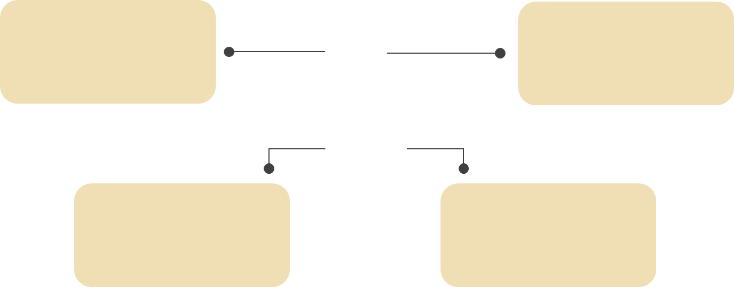

CIA Triad: Availability
Threats to availability are:
Supply system failures (power outage, Internet downtime)
Malicious attackers
(DDoS, ransomware)
Environmental issues
(fire, earthquake,
tornadoes)
Device or system failures (system crash)
Notes:
Explain various threats to availability
Malicious attackers- Hackers can compromise your system and make system unavailable to legitimate users
Supply System Failures-Internet outage or power outage can make the system unavailable
Device or system failure-System crashes or device failure can have a negative impact on availability
Environmental Issues- Natural calamities like fire, earthquake, covid , can make system unavailable

Slide 25


CIA Triad: Availability
The following are some countermeasures to ensure availability:
High availability
Backup procedures
Security devices
Ensure system availability at all times.
Ensure data restoration after a disaster
Prevent DoS/DDoS attacks by deploying intrusion prevention system (IPS) and web application firewall (WAF)
Notes:
Discuss various measures to protect confidentiality
High Availability-Can be provided by redundant system, clustering or redundant ISP link
Backup Procedures-Regular backup of data can provide availability of data or system
Security Devices- Security device i.e. Firewalls, IPS, can protect your network against attack targeting availability

Slide 26
Non-Repudiation

Slide 27


Non-Repudiation
Non-repudiation, in the context of cryptography and information security, refers to a service that provides proof that a particular action or event cannot be denied by anyone.
This prevents denial of actions, ensuring accountability and reliability in electronic transactions and communications.
Non-repudiation ensures proof of the origin and integrity of data exchanged between parties.
Notes:
Explain Non-Repudiation
Non-repudiation, in the context of cryptography and information security, refers to a service that provides proof that someone cannot deny a particular action or event
Non-repudiation prevents denial of actions, ensuring accountability and reliability in electronic transactions and communications.
Non-repudiation ensures proof of the origin and integrity of data exchanged between parties.
Non-repudiation ensure person can't deny his action, for example when someone implement wrong change, proper logging can ensure that can't deny his action, ability to not let people deny his or her action is what non-repudiation is.
Repudiation is ability of person to deny his actions

Slide 28

Tools for Non-Repudiation
Digital signature: Utilizes cryptographic identifiers to confirm the sender’s identity and ensure the integrity of the content
Audit trail: Involves maintaining chronological records of actions, which are crucial for tracing events and assigning accountability to the parties involved
.
Secure timestamping: Involves a trusted third-party service that creates a verifiable record of the exact time a digital record was created
Notes:
Explain Tools for Non Repudiation which can ensure non repudiation
Digital Signature
A digital signature, in the realm of cybersecurity, is like a fancy electronic stamp of authenticity for digital information. It acts as a verification tool that ensures the following:
Origin: It confirms that the information originated from a specific, known source (the signer).
Integrity: It guarantees that the information hasn't been tampered with or altered in any way since it was signed.
Audit Trail-
An audit trail, also referred to as an audit log, is a chronological record that tracks the activity surrounding a specific process, system, or event. It serves as a documentary record providing evidence of the sequence of actions that have taken place
Secure Timestamping
An audit trail, also referred to as an audit log, is a chronological record that tracks the activity surrounding a specific process, system, or event. It serves as a documentary record providing evidence of the sequence of actions that have taken place

Slide 29
AAA (Authentication, Authorization, and Accounting)

Slide 30
AAA
In computer security, AAA stands for Authentication, Authorization, and Accounting.
Authentication
It is a framework that controls user access to networks and resources, ensuring only authorized users can access specific resources and monitor their activities.
AAA
Accounting
Authorization
Notes:
Trainer Notes
Explain what is AAA- AAA stands for authentication, authorization and accounting
In computer security, AAA stands for Authentication, Authorization, and Accounting.
It's a framework that controls user access to networks and resources, ensuring only authorized users can access specific resources and monitor their activities.

Slide 31


Identification
The process of an individual claiming or professing an identity is known as identification.
To begin the authentication, authorization, and accountability procedures, a subject must submit an identity to the system.
Notes:
Trainer Notes
A subject must provide an identity to a system to start the authentication, authorization, and accountability processes.
Identification is the process of a subject claiming or professing an identity.
A core principle with authentication is that all subjects must have unique identities.
Providing an identity might entail typing a username; swiping a smartcard; waving a token device; speaking a phrase; or positioning your face, hand, or finger in front of a camera or in proximity to a scanning device.

Slide 32


Authentication
Authentication is the process of comparing one or more criteria to a database of legitimate identities such as user accounts, to validate the subject's identity.
An example of identification and authentication is a username and password. Users identify themselves with usernames and authenticate with passwords.
Notes:
Trainer Notes
Authentication is the process of verifying the subject's identity by comparing one or more factors against a database of valid identities, such as user accounts.
A simple example of identification and authentication is username and password. Users identify themselves with usernames and authenticate (or prove their identity) with passwords.

Slide 33


Authorization
Authorization is the process of granting access to an object after the subject has been properly identified and authenticated.
Example: CRUD operations include create, read, update, and delete
Notes:
Trainer Notes
Authorization is the process of granting access to an object after the subject has been properly identified and authenticated.

Slide 34


Accounting
Accounting is the ability of a system to associate users and processes with their actions.
Example: Keeping a record of user activity like time of login, IP address, activities performed, and so on
Notes:
Trainer Notes
The concept of accountability refers to the capability of a system to associate users and processes with their actions (what they did).
Accounting is the ability of a system to associate users and processes with their actions.

Slide 35

AAA: Summary
Identification
Providing identity
Authentication
Verifying identity
Authorization
Granting access
Accounting
Tracking activity
Notes:
Trainer Notes
Explain in role of AAA concept
The process of an individual claiming or professing an identity is known as identification.
Authentication is the process of comparing one or more criteria to a database of legitimate identities such as user accounts, to validate the subject's identity
Authorization is the process of granting access to an object after the subject has been properly identified and authenticated

Slide 36


Multi-Factor Authentication (MFA)
Multi-factor authentication is a type of authentication that requires the use of more than one different authentication factor to be successful.
Notes:
Trainer Notes
Multi-factor authentication is a type of authentication that necessitates the use of more than one different authentication factor in order to be successful.
It can be performed using a multi-factor authenticator or by a combination of authenticators that provide different factors.

Slide 37
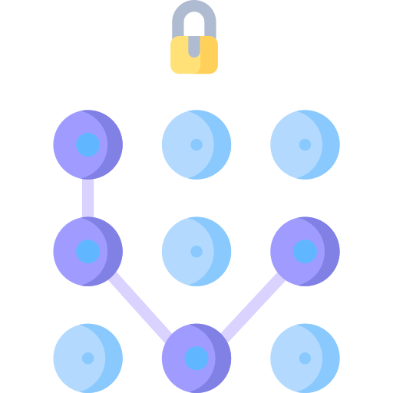


Multi-Factor Authentication (MFA)
Based on the type of authentication, MFA can be categorized into:
Something you know
Something you have
Something you are
Notes:
Trainer Notes
Explain these three methods to achieve multi-factor authentication
Something you know- pin, passwords
Something you have- RSA tokens, smart cards
Something you are- Biometrics, speech recognition system

Slide 38


MFA: Types
Two-factor authentication
Three-factor authentication
Uses a combination of any two of three authentication factors available
Uses all three authentication factors
Notes:
Explain difference between Two-factor authentication and Three-factor authentication
Two-factor authentication is a combination of any two factors of three authentication factors available. For example, when you go to atm, you have your card, that is something you have and you have to enter PIN, which is something you know
Three Factor: Using all the three authentication factors, something you know, something you have and something you are. For example, when you visit the office, you have to use a smart card, and biometric and enter a passcode at entry for authentication

Slide 39
Multi-Factor Authentication (MFA)
Known as authentication by knowledge
Something that only the user knows
Example: Password, PIN, or answers to challenge questions
Least expensive method to implement
Something you know
Something you have
Something you are
Notes:
Trainer Notes
Known as authentication by knowledge
Certain knowledge only known to the user
Examples - password, PIN, or answers to challenge questions
This is usually the least expensive method to implement

Slide 40
Multi-Factor Authentication (MFA)
Something you know
Known as authentication by ownership
Some physical objects in the possession of the user
Example: Token or smart card
Something you have
Something you are
Notes:
Trainer Notes
Known as authentication by ownership
Some physical object in the possession of the user
Examples - token or smart card

Slide 41
Multi-Factor Authentication (MFA)
Something you know
Known as authentication by characteristics
Some physical characteristics of a user, like biometrics
Example: Biometrics or a fingerprint
Most expensive and secure method
Something you have
Something you are
Notes:
Trainer Notes
Known as authentication by knowledge
Certain knowledge only known to the user
Examples - password, PIN, or answers to challenge questions
This is usually the least expensive method to implement

Slide 42
AAA Protocols
The AAA protocol, which stands for authentication, authorization, and accounting, is a framework used to manage access and security in computer networks.
It essentially regulates who can access network resources (authentication), what they're allowed to do once they're in (authorization), and tracks their activity (accounting).
AAA protocols are typically implemented on a centralized server, which can manage access control for multiple network devices.
This simplifies administration and ensures consistent enforcement of security policies.
AAA
Notes:
Trainer Notes
Explain AAA protocols
The AAA protocol, short for Authentication, Authorization, and Accounting, is a security framework used in computer networks to control access and user activity. It essentially functions like a three-step verification process that ensures only the right people have access to the right things on the network, and their actions are logged.
Authentication: This is the first hurdle. Users or devices trying to access the network need to prove their identity. Common methods include usernames and passwords, fingerprint scanners, facial recognition, or even digital certificates.
Authorization: Once someone is authenticated (proven who they are), authorization determines what they can actually do on the network. Imagine it as a bouncer checking your ID at a club, then seeing if you have the right access level for a specific area. Authorization relies on pre-defined rules (like access control lists) that dictate what resources (files, applications, servers) a user can access and what actions they can perform (read, edit, delete, etc.).
Accounting: This final stage keeps track of what users are doing on the network. It's like having a logbook that records who accessed what resources, when they accessed them, and for how long

Slide 43
AAA Protocols
Radius
TACACS+
Diameter
RADIUS - Remote Authentication Dial-in User Service
TACACS+ - Terminal Access Controller Access-Control System Plus
Notes:
Trainer Notes
Explain these three methods to achieve central authentication where every user is authenticated centrally.
RADIUS, TACACS+ and DIAMETER are explained in further slides

Slide 44


Remote Authentication Dial-in User Service (RADIUS)
RADIUS is a networking protocol created in 1991 to offer centralized authentication, authorization, and accounting (AAA) management for users that connect to and utilize a network service.
Notes:
Trainer Notes
RADIUS is a networking protocol developed in 1991, that provides centralized authentication, authorization, and accounting (AAA) management for users who connect and use a network service.

Slide 45
Remote Authentication Dial-in User Service (RADIUS)
It is a client or server protocol running in the application layer.
Attributes of RADIUS:
Serves often as the back-end choice for 802.1X authentication
Encrypts only the password
Uses TCP as the transport layer with TLS for security since 2012
Uses UDP as the transport layer
Notes:
Trainer Notes
RADIUS is a client/server protocol that runs in the application layer.
RADIUS encrypts only the password.
RADIUS is often the back-end of choice for 802.1X authentication.
RADIUS typically uses UDP as the transport layer.
Since 2012, RADIUS can also use TCP as the transport layer with TLS for security.
(TCP-TCP, or Transmission Control Protocol, is a fundamental protocol that forms the backbone of internet communication. TCP operates at the Transport layer of the TCP/IP suite (a set of protocols governing internet communication). It establishes a connection-oriented communication channel between two devices on a network
UDP-UDP, or User Datagram Protocol, is another important protocol in the TCP/IP suite, but it takes a different approach to data transmission compared to TCP. Unlike TCP, which focuses on guaranteed delivery, UDP prioritizes speed and efficiency. In contrast to TCP's connection-oriented approach, UDP is connectionless. There's no handshaking process to establish a connection before sending data
TLS-n contrast to TCP's connection-oriented approach, UDP is connectionless. There's no handshaking process to establish a connection before sending data
802.1x- n contrast to TCP's connection-oriented approach, UDP is connectionless. There's no handshaking process to establish a connection before sending data)

Slide 46


Remote Authentication Dial-In User Service (RADIUS)
Remote user database (Authorization server)
RADIUS protocol
Remote user
Access request
Access
accept
or reject
Remote user
Network
access server
RADIUS
server
Remote user
Notes:
Trainer Notes:
Step 1- User makes a request to access network access server which can be a router switch or a firewall.
Step 2- Network access server prompt a username and password from user
Step 3- User provides username and password to network access server.
Step 4- Network access server sends a username and password to radius server for validation.
Step 5: Radius server send a confirmation/deny request to network access server.
Step 6: Depends on deny /approve response by radius server, users are allowed or deny access to network access server

Slide 47


Terminal Access Controller Access-Control System Plus (TACACS+)
TACACS+ is a CISCO networking protocol that manages authentication, authorization, and accounting (AAA) through a centralized server.
Notes:
Terminal Access Controller Access Control System Plus (TACACS+) is a networking protocol developed by CISCO that provides authentication, authorization, and accounting (AAA) management through a centralized server.
Cisco released it as an open standard in 1993.

Slide 48
Terminal Access Controller Access-Control System Plus (TACACS+)
It is a completely new protocol incompatible with TACACS and XTACACS.
Intentional alteration (virus attack, database hack)
It separates the tasks of authentication, authorization, and accounting.
It uses TCP to provide a high-quality connection.
Accidental modifications (lack of input validation, lack of training)
It also encrypts packets sent and received from the TACACS+ server.
System malfunction (improper software configuration)
Notes:
TACACS+ splits the authentication, authorization, and accounting into separate functions, allowing systems administrators greater control over and visibility into each of these processes.
TACACS+ is an entirely new protocol and is not compatible with its predecessors, TACACS and XTACACS.
It uses TCP to provide a higher-quality connection.
It also provides encryption of its packets to and from the TACACS+ server.
(XTACACS=XTACACS, which stands for Extended Terminal Access Controller Access Control System, is a protocol used for network access control. It's an extension of the original TACACS (Terminal Access Controller Access Control System) protocol and offers additional features for enhanced security and administration. It is obsolete nowadays)

Slide 49

Diameter
It is a protocol that supports all forms of remote connectivity.
It uses 32 bits for the attribute-value pair (AVP) field.
It uses TCP port 3868.
Diameter security uses existing encryption standards, including IPsec or TLS.
It is a peer-based protocol.
The server or client initiates communication.
It has better error detection, correction, and failover functionality than RADIUS.
Notes:
Supports all forms of remote connectivity
Uses 32 bits for the Attribute Value Pair (AVP) field
Uses TCP port 3868
Diameter security uses existing encryption standards, including IPsec or TLS
Peer-based protocol
Server or client initiates communication
Better error detection, correction, and failover functionality than RADIUS
(What is TLS? TLS, which stands for Transport Layer Security, is a cryptographic protocol that ensures the privacy and security of data communication over the internet. It's like an invisible security shield that encrypts information traveling between your browser and a website, protecting it from being intercepted, tampered with, or accessed by unauthorized users.
What is IPSEC-IPSec, short for Internet Protocol Security, is a set of protocols that provides security for communication over Internet Protocol (IP) networks. It works by encrypting and authenticating data packets traveling across these networks.)

Slide 50
Benefits of AAA
Centralized management
Intentional alteration (virus attack, database hack)
Improved security
Scalability
Accidental modifications (lack of input validation, lack of training)
Auditing
System malfunction (improper software configuration)
Notes:
Trainer Notes
Explained Benefits of AAA
Centralized Management – User Management is managed centrally .
Scalability- Systems can be scaled up and down quickly as all changes are managed effectively
Auditing- Auditing is more effective if everything is controlled centrally.
Improved Security- When everything is centrally controlled, security is more effective

Slide 51
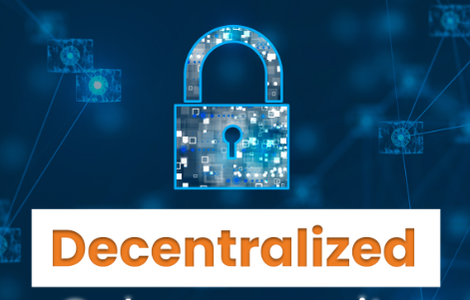
Decentralized Access Control (DAC)
DAC is a concept in cybersecurity that moves away from centralized control of access permissions
It provides access control decisions to people closer to the resources.
Functional manager assigns access control rights to employees.
Changes can happen faster.
Conflict of interest possibility can arise.
It does not provide uniformity and fairness across the organization.
Certain actions can overlap.
Notes:
Trainer notes
Explained what is Decentralized Access Control
Decentralized access control (DAC) is a concept in cybersecurity that moves away from centralized control of access permissions. Imagine it like giving everyone their own key to a specific door, instead of having one master key controlled by a single person. In a decentralized access control system, users manage their own access rights and delegate permissions to others.
Comparison to Centralized Access Control (CAC):
Traditional access control models often rely on a central authority (server or administrator) to manage user permissions. This creates a single point of failure and can be cumbersome to manage, especially for large and dynamic groups

Slide 52



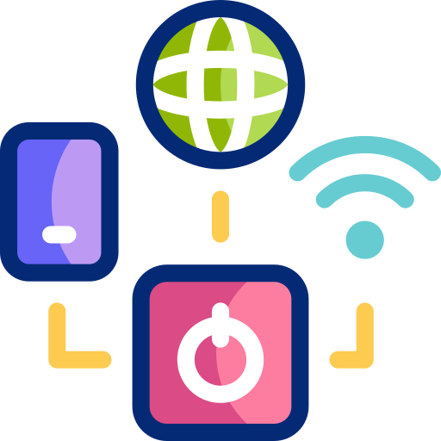
Decentralized Access Control
Site administrators are responsible for managing their sites independently. A sample scenario is as follows:
Site D
Site C
Site A
Site B
Notes:
Trainer Notes:
There are 4 sites A, B, C, and D and individual administrators of these sites are responsible for managing, and administrating their own sites independently of others, unlike centralized control where one administrator is responsible for managing all the sites.
Decision can be taken faster but it can lead to conflict of interest and inconsistency

Slide 53
Gap Analysis

Slide 54
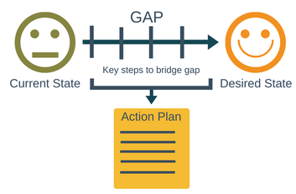
Gap Analysis
A security gap analysis systematically assesses the differences between an organization's current security posture and its desired state, evaluating practices against standards, regulations, and industry best practices.
Notes:
Explain What is Gap Analysis
A cybersecurity gap analysis is a systematic process that evaluates an organization's current cybersecurity posture and identifies areas where improvements are needed. A security gap analysis is a methodical process for assessing the differences between an organization's current security posture and its desired security state.
It essentially compares your existing security measures against industry standards, best practices, or your own specific security goals.

Slide 55
Goals of Gap Analysis
Assess compliance gaps with relevant security standards or regulations
Intentional alteration (virus attack, database hack)
Identify weaknesses and vulnerabilities in the existing security controls
Prioritize security risks based on likelihood and impact
Accidental modifications (lack of input validation, lack of training)
Develop a roadmap for addressing security gaps and improving the overall security posture
System malfunction (improper software configuration)
Notes:
Trainer Notes
Explain objectives of Gap Analysis
Assess compliance gaps with relevant security standards or regulations- Identify the weakness and gaps in present compliance and what is expected
Identify weaknesses and vulnerabilities in your existing security controls- Assess the status of controls implemented by regularly assessing the controls
Prioritize security risks based on likelihood and impact- There can be many weakness , you can identify. We need to prioritize based on severity and impact
Develop a roadmap for addressing security gaps and improving your overall security posture.- Finalize the steps required for achieving the desired state based on gaps, vulnerability identified during previous steps

Slide 56
Steps in Gap Analysis
Define the desired security state
Evaluate the current security controls
Identify gaps and vulnerabilities
Assess risk
Develop an action plan
Notes:
Trainer note:
Each of these steps are explained in detail in the upcoming slides.

Slide 57

Step 1: Define the Desired State
This involves outlining your organization's security goals and objectives.
Consider industry standards, regulations, and best practices that may be relevant.
Notes:
Trainer Notes
Phase 1 Define desired state- Find out the security objectives and goals that you want to achieve.
This involves outlining your organization's security goals and objectives. Consider industry standards, regulations, and best practices that may be relevant

Slide 58


Step 2: Evaluate the Security Controls
This stage involves taking inventory of the existing security measures across different areas as follows:
Network security
Remote access capabilities
Endpoint security
Security awareness and training
Access controls
Incident response
Data security
Notes:
Define Phase 2 : Evaluate the existing controls
This stage involves taking inventory of your existing security measures across different areas
Network Security
Endpoint Security
Access Controls
Data Security
Incident Response
Remote Access Capability
Security awareness and Training

Slide 59
Step 3: Identify Gaps and Vulnerabilities
Compare the desired security state with the current controls. This will reveal areas where the defenses are lacking or not aligned with the goals.
The following are some identified gaps:
Weak password policies
Unpatched systems
Lack of multifactor authentication
Unencrypted sensitive data
Notes:
Explain Phase 3 Identify gaps and vulnerabilities between current state and existing state
Compare your desired security state with your current controls. This will reveal areas where your defenses are lacking or not aligned with your goals
Users are using weak passwords which can be easily compromised or cracked
Systems are not updated with latest patches and updates
Single factor authentication are used instead of multifactor authentication which can be easily compromised
Sensitive data is stored in clear text instead of encrypted form which is a weakness

Slide 60

Step 4: Assess Risk
Analyze the potential impact and likelihood of exploiting identified vulnerabilities. Prioritize the most critical gaps that pose the greatest risk to the organization.
Notes:
Explain Risk Assessment
Analyze the potential impact and likelihood of identified vulnerabilities being exploited. Prioritize the most critical gaps that pose the greatest risk to your organization.

Slide 61

Step 5: Develop an Action Plan
Create a roadmap to address the identified security gaps.
This plan should include:
Specific actions to be taken
Resources required
Timeline for implementation
Notes:
Discuss Phase 4 : Develop an action plan to fill the gap between existing state and goals needs to achieved. Also create a roadmap where you define the following strategies
Specific actions to be taken
Resources required
Timeline for implementation

Slide 62


Benefits of Security Gap Analysis
Improved security posture:
By identifying and addressing gaps, you can significantly strengthen the overall security defenses
Enhanced risk management:
Prioritizing vulnerabilities allows to focus resources on the areas that matter most
Compliance readiness:
Regular gap analysis ensures you are on track to meet the security requirements of regulations or standards
Better decision-making:
Data-driven insights from the analysis help make informed security investments
Notes:
Trainer Notes:
Defined Benefits of Gap analysis in details
Improved Security Posture
Enhanced Risk Management
Compliance Readiness
Better Decision Making

Slide 63

Tools and Techniques for Security Gap Analysis
Vulnerability scanning tools
Security questionnaires and checklists
Security rating platforms
Penetration testing tools
System malfunction (improper software configuration)
Notes:
Vulnerability scanning tools are essential cybersecurity programs that automate the process of identifying weaknesses and security holes (vulnerabilities) in computer systems, networks, and applications. These tools function like digital security inspectors, crawling through systems and applications to discover potential security risks. Example : Nessus, Qualysguard
Security rating platforms are online services that assess the security posture of organizations or internet-connected devices. Imagine them as credit bureaus for cybersecurity, assigning a score or rating that reflects an organization's overall cybersecurity hygiene. Example Bitsight, security scorecard
Security questionnaires and checklists are fundamental tools used to assess the security posture of an organization or individual. They act as a roadmap to identify potential security risks and ensure best practices are followed
Penetration testing tools are specialized software applications used to simulate cyberattacks and identify vulnerabilities in computer systems, networks, and web applications. These tools act like ethical hacking kits, allowing security professionals to discover weaknesses before malicious actors exploit them. Example Metaexpoit, burp proxy

Slide 64
Zero Trust Architecture and Defense in Depth

Slide 65

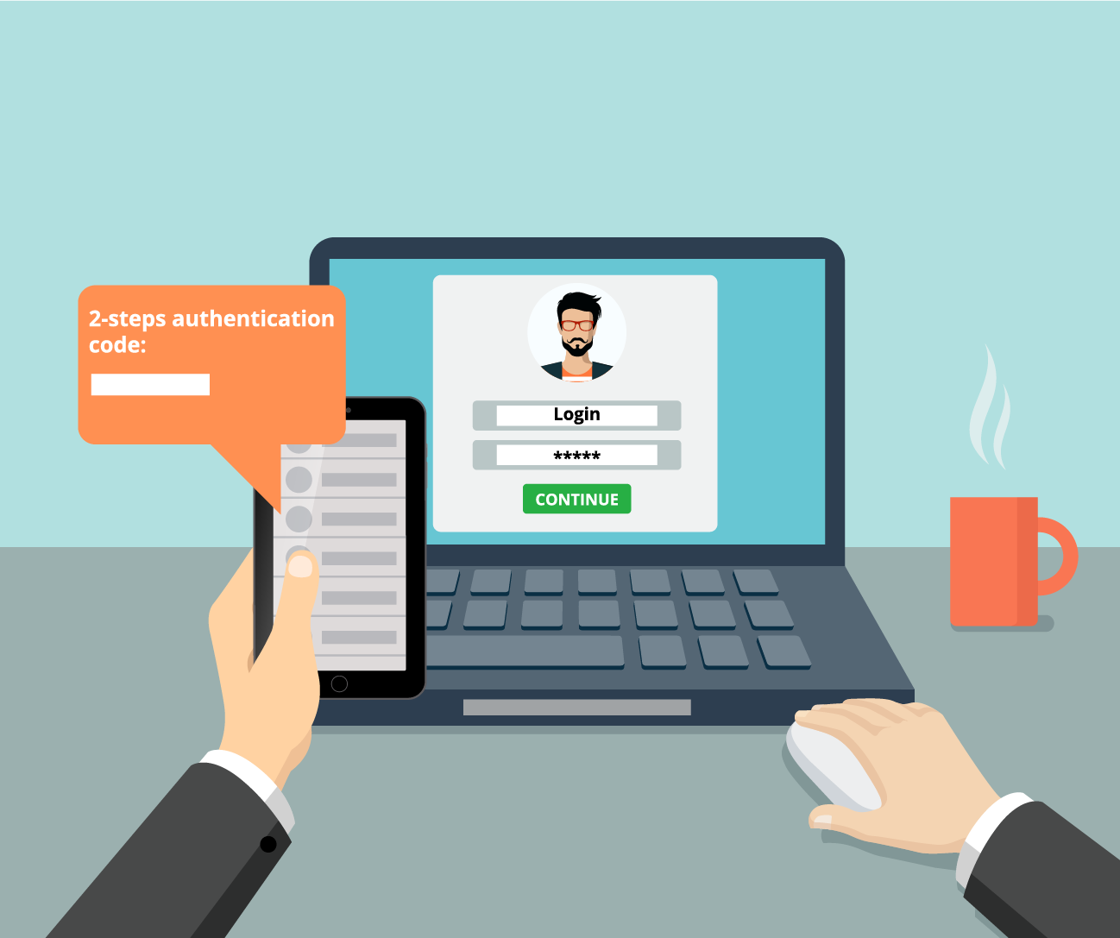
Zero Trust Network
Zero trust network is a security model based on the principle of ‘trust nothing and verify everything.’
Devices should not be trusted by default, even if connected to a managed corporate network or were previously verified.
Every person and device accessing a private network must undergo identity verification, whether inside or outside the network perimeter.
Notes:
Trainer Notes
Explain Zero-Trust Network
The zero-trust security model (also known as parameter less security) is based on the principle of trust nothing and verify everything.
The main concept behind zero-trust is that devices should not be trusted by default.
They cannot be trusted even if they are connected to a managed corporate network, such as the corporate LAN and even if they were previously verified.
It is a holistic approach to network security wherein every person and device trying to access resources on a private network must go through identity verification, whether it is inside or outside the network perimeter.
Devices should not be trusted by default, even if connected to a managed corporate network or previously verified.
Every person and device trying to access resources on a private network must go through identity verification, whether inside or outside the network perimeter.

Slide 66

Defense in Depth
Defense in Depth (DiD) is an approach to cybersecurity in which a series of defensive mechanisms are layered to protect valuable data and information.
Policies, procedures, and awareness
Physical
Network
This multi-layered strategy enhances overall system security and addresses various attack vectors.
Computer
Application
Device
Notes:
Trainer Notes: Define Defense in Depth in details
Defense in Depth (DiD) layers multiple defensive mechanisms to protect data, ensuring security through redundant measures if a control fails or a vulnerability is exploited.
Defense in Depth (DiD) is an approach to cybersecurity in which a series of defensive mechanisms are layered to protect valuable data and information.
Defense-in-depth is an information assurance strategy that provides multiple, redundant defensive measures in case a security control fails, or a vulnerability is exploited
This multi-layered approach with intentional redundancies increases the security of a system as a whole and addresses many different attack vectors.

Slide 67
Core Tenets of Zero Trust Architecture
Least privilege
Microsegmentation
Continuous verification
Data encryption
Context-aware authentication
Identity and access management
Multifactor authentication
Notes:
Trainer Notes:
Explain the Core Tenets of Zero Trust Architecture
Least Privilege- Only give that many privileges required for a person to do the job.
Continuous Verification- Verification should be continuous throughout the session, not only one time in the beginning
Context-Aware Authentication: Check for environments, i.e. systems, environment, location, IP etc.
Multifactor authentication: Use Multifactor authentication wherever possible
Identity and Access Management: Strictly follow IAM to identify, authenticate, and authorize processes and users.
Data Encryption: Encrypt the data wherever there is a need to encrypt.
Microsegmentation is a cybersecurity approach that involves dividing a computer network into smaller, more secure zones

Slide 68
Zero Trust Control Planes
These are parts of the network architecture responsible for routing and traffic control and plays a crucial role in the zero trust model by enabling intelligent decisions.
The following are the components of control planes:
Adaptive identity
Policy enforcement point
Threat scope reduction
Policy engine
Policy-driven access control
Notes:
Trainer Notes
Explain Control Planes and their components, Components of Control planes are discussed further in the slides
The control plane is a part of the network architecture that deals with routing and traffic control.
In the Zero Trust model, the control plane plays a crucial role in making intelligent decisions based on policies and security protocols.

Slide 69

Adaptive Identity
Adaptive identity is a crucial concept, moving beyond static verification and acknowledging that trust is not a one-time occurrence.
Considers contextual factors like user location, device type, time of access, and behavior patterns
Continuously monitors user activity and device health for suspicious behavior
Notes:
Trainer Notes
Explain Adaptive Identity
Adaptive identity is a crucial concept, moving beyond static verification and acknowledging that trust is not a one-time occurrence.
Adaptive identity considers various contextual factors when evaluating access requests. This could include user location, device type, time of access, and even user behavior patterns.
The Adaptive Identity system continuously monitors the user's activity and device health for any signs of suspicious behavior.

Slide 70


Threat Scope Reductions
Zero trust security aims to reduce the impact of security threats by limiting the attack surface and blast radius.
The scope of potential threats is reduced by limiting the privileges of users, systems, and processes, minimizing points of attack.
This is achieved through least privilege access, microsegmentation, continuous verification, and deny-all by default.
Notes:
Trainer Notes
Explain Threat scope reduction
Zero Trust security aims to reduce the impact of security threats by limiting the attack surface and blast radius.
The scope of potential threats is reduced by limiting the privileges of users, systems, and processes to minimize points of attack.
This can be achieved through least privilege access, micro segmentation, continuous verification, and deny all by default.

Slide 71

Policy Driven Access Control
Access to network resources is granted or denied based on predefined policies that consider factors like user role, data type, and device security status.
This is achieved through centralized policy management, implementing the least privilege principle, dynamic access control, integration with adaptive identity, and reducing the attack surface.
Notes:
Trainer Notes
Explain Policy Driven access control.
It is a system that grants or denies access to network resources based on predefined policies.
These policies consider various factors, including the user’s role, the type of data requested, and the device’s security status from which the request is made.
This can be achieved through
a) Centralized Policy Management
b) Least Privilege principal
c) Dynamic access control
d) Integration with adaptive identity.
e) Reduced Attack Surface

Slide 72

Policy Engine
The policy engine determines access to critical network resources on a per-user basis.
It operates based on policies set by the organization's security team.
The engine uses context from SIEM data, threat intelligence, user attributes, and device information.
It communicates decisions to a policy administrator for execution.
Notes:
Trainer Notes
Explain Policy Engine
The policy engine determines who gains access to critical network resources per-user.
It operates based on policies written by the organization’s security team, which lays down the access rules.
Context is crucial, with data from SIEM, threat intelligence, user attributes, and device information informing decisions.
Once the policy engine evaluates all the parameters, it communicates its decision to a policy administrator, who executes it on the ground.

Slide 73


Policy Enforcement Point
The Policy Enforcement Point (PEP) is crucial in access control, ensuring security by implementing decisions and rules set by the Policy Engine:
Acts as the gatekeeper, enforcing access control decisions made by the Policy Engine.
Functions like a security checkpoint, ensuring only authorized actions get through and preventing breaches.
Notes:
Trainer Notes
Explain Policy Enforcement Point
Policy Enforcement Point (PEP) acts as the gatekeeper, enforcing the access control decisions made by the Policy Engine in the control plane.
It's essentially the muscle that implements the rules the brain sets.
The policy enforcement point assumes the role of a vigilant gatekeeper.
It’s like a security checkpoint that follows the rules set by the policy administrator and double-checked by the policy engine.
This checkpoint ensures that only authorized actions get through and prevents potential breaches.

Slide 74

Zero Trust Data Planes
The data plane in cybersecurity is the operational core that moves and forwards data packets within a network, handling routing, switching, and packet forwarding based on predefined rules.
In a Zero Trust framework, the data plane enforces control plane policies, ensuring data packets are routed, inspected, and modified based on security protocols.
Notes:
Trainer Notes
Explain Data Planes
The data plane in cybersecurity is the operational core responsible for the actual movement and forwarding of data packets within a network.
It focuses on executing tasks such as routing, switching, and packet forwarding based on predefined rules and policies.
In a Zero Trust security framework, the data plane enforces policies determined by the control plane and ensures that data packets are properly routed, inspected, and potentially blocked or modified based on the security protocols and policies in place.

Slide 75
Data Planes: Components
The following are the components of data planes:
Subjects or systems
Internal network zone
External network zone
1
3
5
2
4
Implicit trust zones
Demilitarized zone
Notes:
Trainer Notes
Explain Data Planes Components, details of components are discussed in next slides
Subject- Subjects in the data plane are the entities that initiate data communication, while systems represent the collective infrastructure, resources, and devices that are responsible for processing and forwarding data packets as they traverse the network
Implicit Trust Zones-This refers to areas within a network or system where certain levels of trust are assumed without explicit verification.
Internal Network Zones- Devices and resources within the company's internal network are considered trustworthy because they are protected by the organization’s firewall.
DMZ-The DMZ is an area that is neither fully trusted nor entirely untrusted. It’s an intermediate zone that allows controlled access to certain services from the external network.
External Zone -External networks, such as the internet, are typically treated as untrusted zones due to the inherent risks associated with them

Slide 76
Subjects or Systems
Subjects
Systems
Entities that initiate data communication
Can be users, applications, or devices
Generate data packets that need to be transmitted
Collective infrastructure, resources, and devices responsible for processing and forwarding data packets
Includes routers, switches, firewalls, load balancers, and other network equipment
Subjects and systems work in tandem to ensure efficient and secure data transmission within the network architecture.
Notes:
Trainer Notes
Explain what is subject/Systems
Subjects in the data plane are the entities that initiate data communication. At the same time, systems represent the collective infrastructure, resources, and devices that are responsible for processing and forwarding data packets as they traverse the network.
These systems include routers, switches, firewalls, load balancers, and other network equipment that transmit and manage data traffic.
Subjects and systems work in tandem to ensure efficient and secure data transmission within the network architecture.

Slide 77

Implicit Trust Zone
An implicit trust zone refers to areas within a network or system where certain levels of trust are assumed without explicit verification.
Importance:
Simplifies communication within the zone
Reduces the need for constant authentication and verification
Enhances operational efficiency
Established through predefined rules and configurations
Ideal for trusted environments like internal corporate networks or secure cloud segments
Notes:
Trainer Notes
Explain Implicit Trust Zones
This refers to areas within a network or system where certain levels of trust are assumed without explicit verification.
These zones are designed to simplify and expedite communication and interactions between components within those zones.
Implicit trust zones are established based on predefined rules, configurations, or assumptions about the security and integrity of the components involved.
An implicit trust zone implies that the components within that zone are considered trustworthy and authorized to communicate with each other without stringent authentication or verification processes.

Slide 78

Internal Network Zones
An internal network zone refers to a segment within a company's network where devices and resources are considered trustworthy.
Characteristics:
Protected by the organization's firewall
Known as the local area network (LAN)
Typically houses critical infrastructure like domain controllers and database servers
Notes:
Trainer Notes
Explain Internal network zones
Devices and resources within the company's internal network are considered trustworthy because they are protected by the organization's firewall. This area is also referred to as the local area network (LAN), and it's where the domain controller and database servers are located.

Slide 79

Demilitarized Zones
The DMZ is an area that is neither fully trusted nor entirely untrusted. It’s an intermediate zone that allows controlled access to certain services from the external network.
Characteristics:
Communication between the DMZ and the internal network might be subject to more stringent controls.
It is also known as a screened subnet, where resources accessed by untrusted and trusted networks reside.
Notes:
Trainer Notes
Explain Demilitarized zones
The DMZ is an area that is neither fully trusted nor entirely untrusted. It’s an intermediate zone that allows controlled access to certain services from the external network. Communication between the DMZ and the internal network might be subject to more stringent controls. This is also commonly known as a screened subnet, where resources accessed by untrusted and trusted networks reside.

Slide 80

External Zones
External networks, such as the Internet, are typically treated as untrusted zones due to their inherent risks.
Characteristics:
Communication from the external network into the internal network usually requires strong security measures.
Also known as the wide area network (WAN) — an untrusted network.
Notes:
Trainer Notes
Explain External Zones
External networks, such as the internet, are typically treated as untrusted zones due to the inherent risks associated with them. Communication from the external network into the internal network usually requires strong security measures. This is also known as the wide area network—an untrusted network.

Slide 81
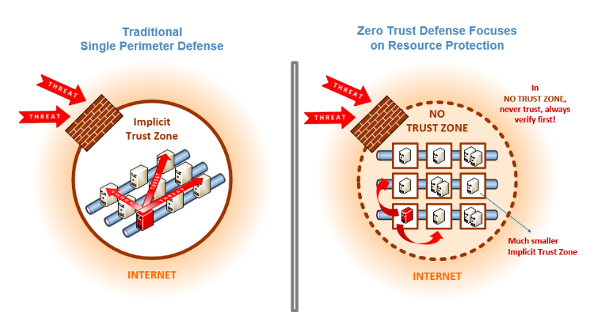
Zero Trust vs. Defense in Depth
The following are the key distinctions between the traditional Defense in Depth and the modern Zero Trust security models.
Notes:
Trainer Notes: Explain the difference between Zero trust and Defense in depth
Zero trust is based on concept of trusting only verifies everything, even if it is insider.it has no explicit trust zone, instead of it is having compartmentalized small trust zone to limit the impact. There is no hard and core defined parameter
Defense in depth is an old model which is based on concept that internal people and process needs to implicitly trusted and more security controls are deployed on traffic coming from outside. There is a clear boundary segregating internal and external traffic

Slide 82
Physical Security

Slide 83
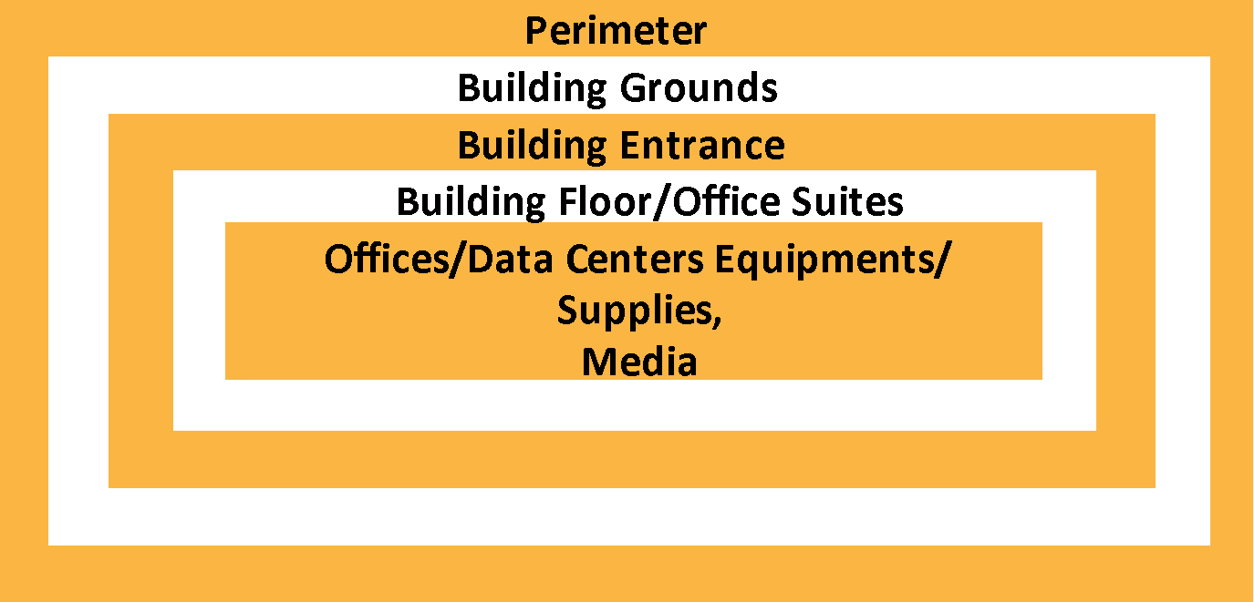
Site and Facility Design Criteria
Physical security is a fundamental component of a security strategy, serving as the foundation for all subsequent safeguards including those related to personnel and information systems.
The primary objective of this security framework is to protect life, property, and the continuity of operations.
Security professionals examine all construction aspects and apply a layered security strategy from the site perimeter to individual desktop computers.
Notes:
Trainer Notes:
Physical security is an essential part of a security plan and forms the basis of all other security measures, including personnel and information.
The most important goal in planning a site is the protection of life, property, and operations.
It is a standard operational procedure for a security professional to review all aspects of construction.
Layered approach is a strategy that includes examining physical security measures starting at the site perimeter and working down to the desktop computer.

Slide 84

Crime Prevention Through Environmental Design (CPTED)
CPTED is a multi-disciplinary approach to deterring criminal behavior through environmental design. Examples: Streets, parks, museums, government buildings, houses, and commercial complexes
INFORMAL
SURVEILLANCE
The three environmental strategies of CPTED are:
LIGHTING
Territoriality
DEFINED SPACE
Surveillance
DEFINED PERMEABILITY
Access Control
LEGIBILITY
Notes:
Trainer Notes:
CPTED is a crime reduction technique.
Examples: Streets, parks, museums, government buildings, houses, and commercial complexes.
The three environmental strategies of CPTED are:
Territoriality: These make users feel safe and make the potential offender aware of a substantial risk of apprehension.
Surveillance: It creates the perception that people can be seen.
Access Control: It limits the opportunities for crime.

Slide 85
Support Facilities
Ensuring the proper management and maintenance of support facilities is crucial for maintaining system integrity and operational efficiency. Key factors include:
Let IT managers know who handles heating, ventilation, and air conditioning
HVAC
Turn off all power, drain water, place affected equipment in an air-conditioned area, and wipe with water displacement spray
Water
Install surge protectors and UPS, use backup sources for critical systems, and install anti-static carpet
Electricity
Keep computers away from windows and high surfaces, use shock absorbers and anchors, and ensure no objects fall on them
Earthquakes
Switch off systems, unplug them, and store backup tapes away from the building's steel supports
Lightning
Notes:
Trainer Notes:
Explain the factors involved in support facilities given on the slide.

Slide 86

Data Center Security: Guidelines
Place data centers, server rooms, and wiring closets at the facility's core
Position wiring closets directly above or below each other in multistory buildings
Ensure access to data centers is through a single door; use additional doors as one-way exits
Avoid placing data centers in basements or upper floors
Construct the data processing center as a single room, not multiple rooms
Maintain positive air pressure in data centers to prevent contaminants; install water detectors under raised floors and on dropped ceilings
Implement HVAC systems for temperature and humidity control
Notes:
Trainer Notes:
Explain the pointers given on the slide regarding Data Centre Security

Slide 87
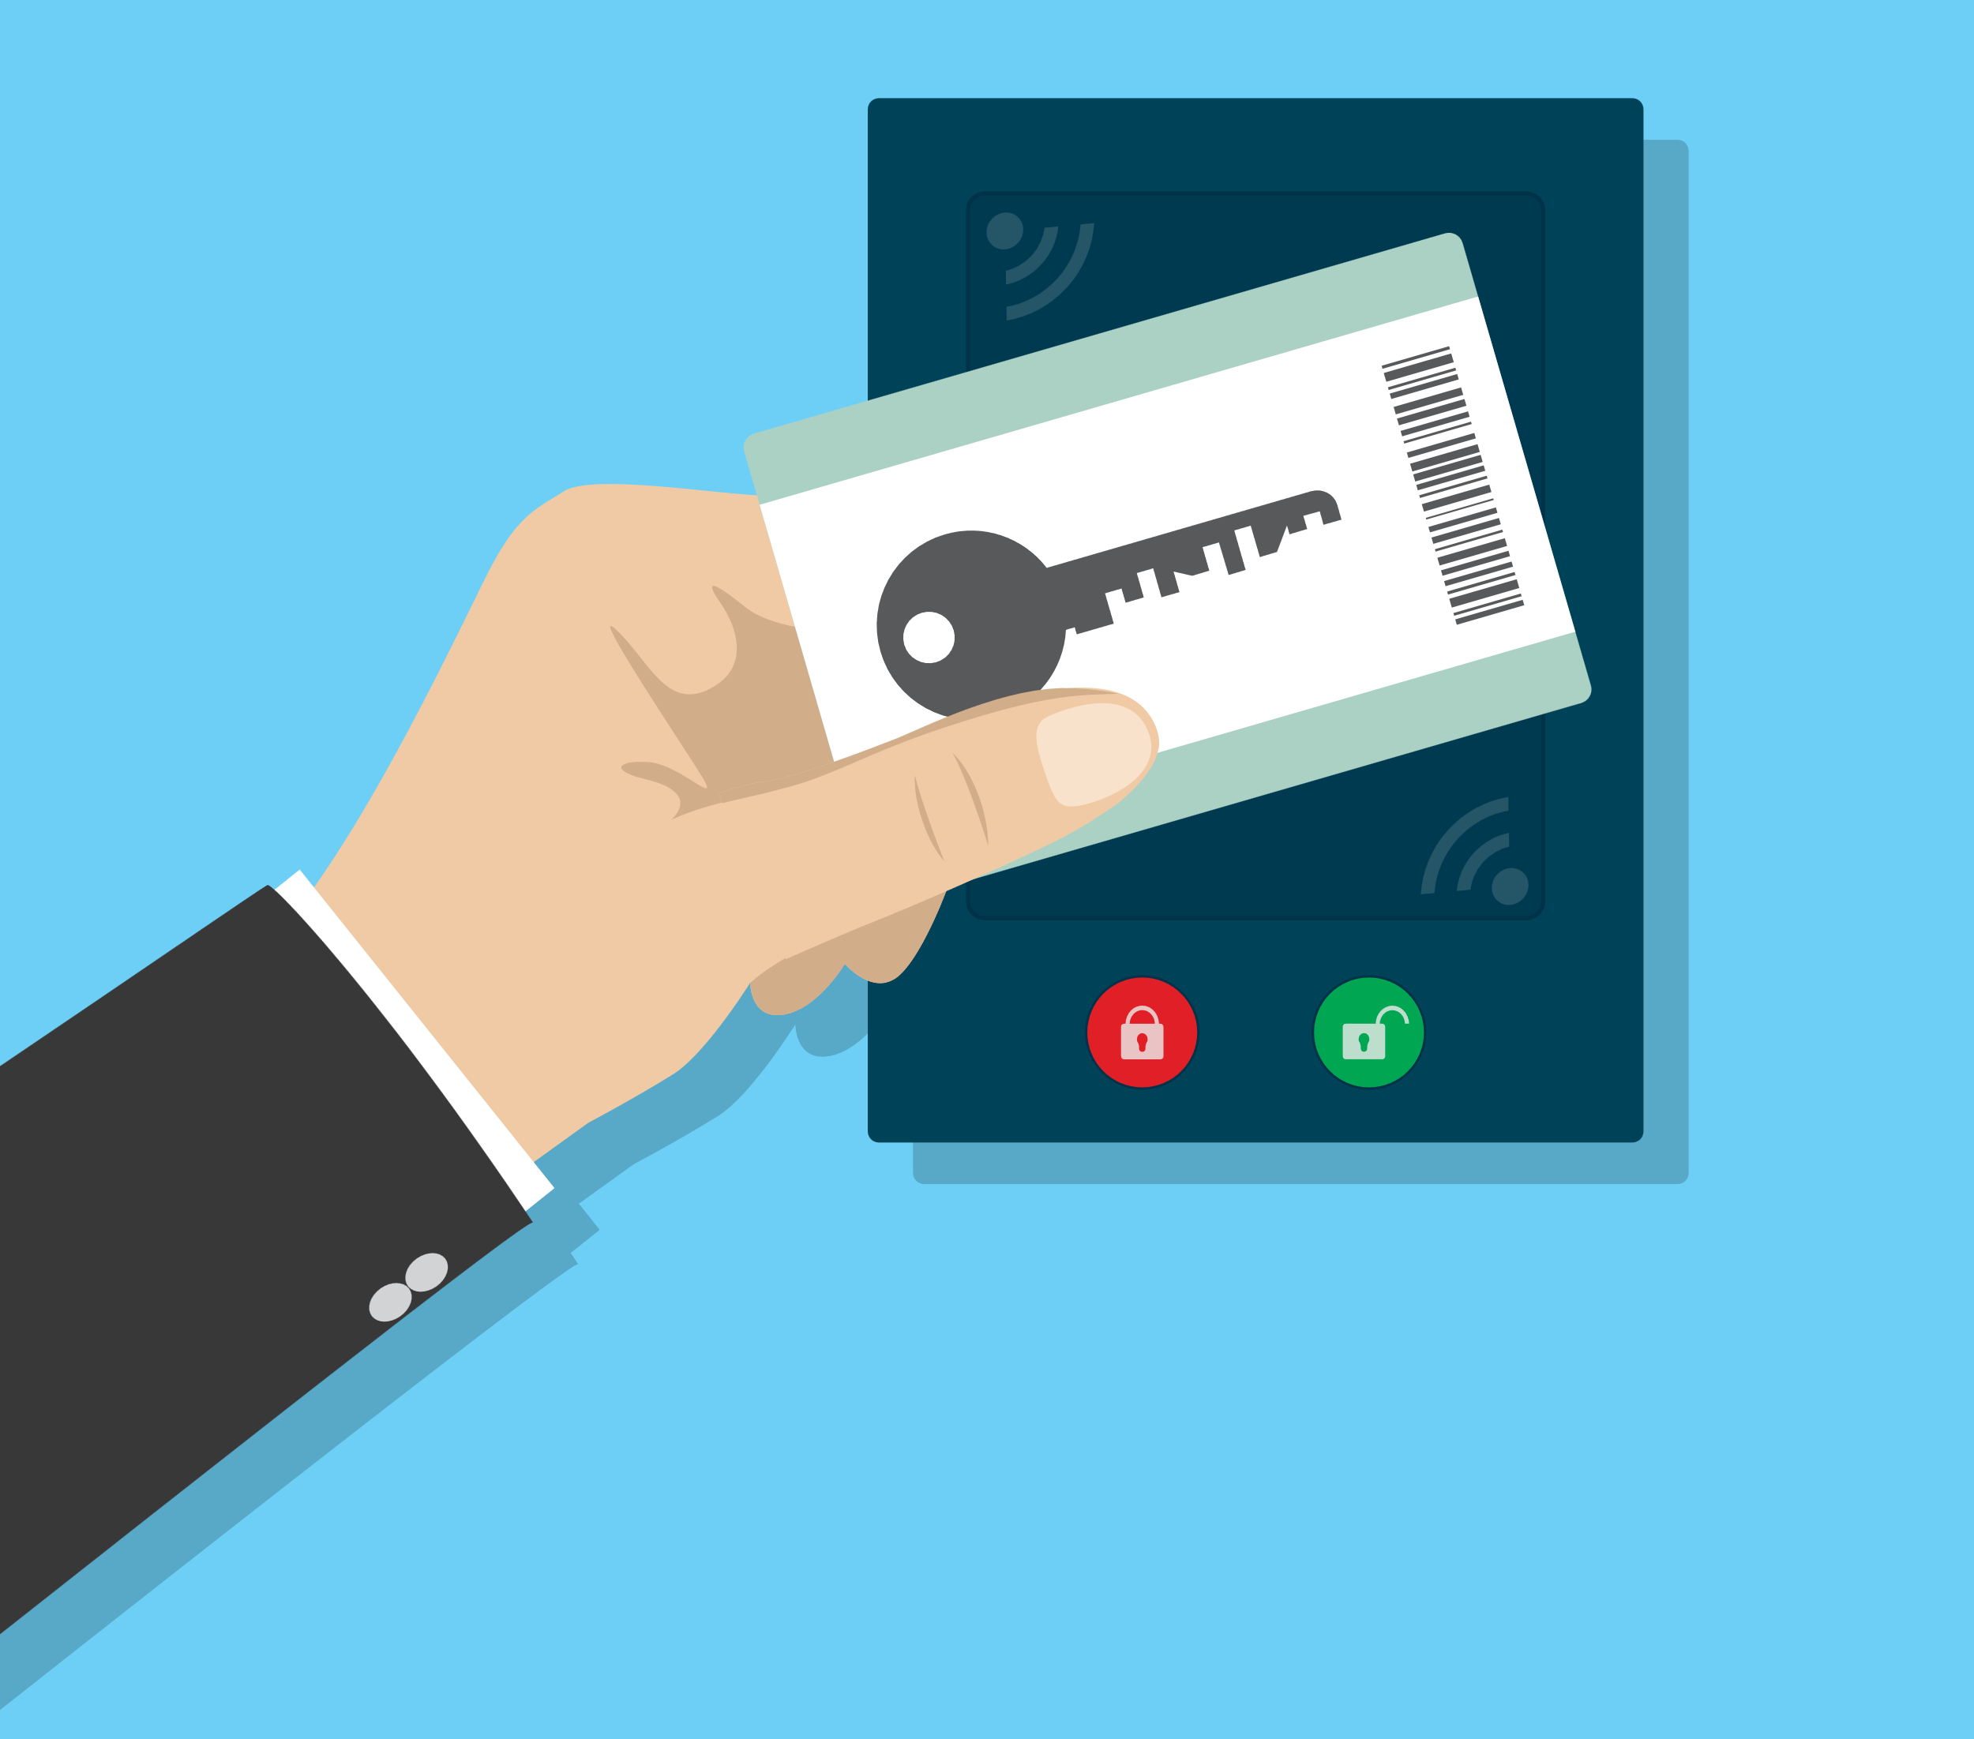
Personnel Access Control
Effective personnel access control is essential for organizational security. The differences between piggybacking and tailgating are:
Piggybacking
Piggybacking is when another person follows through a door with the permission of the person who has received access.
Tailgating
Tailgating is when another person, whether an employee or not, passes through a secure door without the knowledge of the person who has gained legitimate access through the secure door.
Notes:
Trainer Notes:
Piggybacking
Piggybacking is when another person follows through a door with the permission of the person who has received access.
Tailgating
Tailgating is when another person, whether an employee or not, passes through a secure door without the knowledge of the person who has gained legitimate access through the secure door.

Slide 88
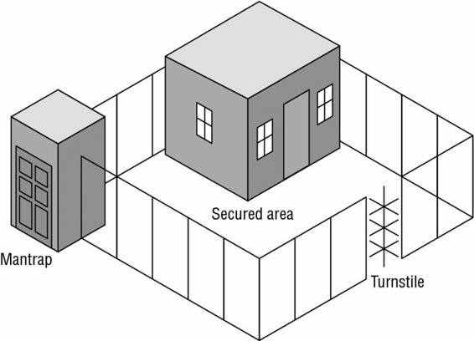
Mantraps and Turnstiles
It is a double set of doors often protected by a guard or some other physical layout that prevents piggybacking and can trap individuals at the discretion of security personnel.
Mantraps
It is a form of gate that prevents more than one person at a time from gaining entry and often restricts movement in one direction, serving as the equivalent of a secured revolving door.
Turnstiles
Notes:
Trainer Notes:
Turnstiles
A turnstile is a form of a gate that prevents more than one person at a time from gaining entry and often restricts movement in one direction.
It is the equivalent of a secured revolving door.
Mantraps
It is a double set of doors that is often protected by a guard or some other physical layout that prevents piggybacking and can trap individuals at the discretion of security personnel.

Slide 89
Access Control
Smart card
Memory card
Proximity reader
Security ID with an embedded magnetic strip, bar code, or integrated circuit chip
Can process information or store a reasonable amount of data in memory
Can be used in multifactor authentication to improve security
Vulnerable to physical security attacks
Machine-readable ID cards with memory sticks
Can hold a small amount of data in memory but cannot process it
Are easy to copy or duplicate
A passive device or transponder that can be used to control physical access
A passive device, typically worn by an individual, that alters the magnetic field generated by the reader when detected and processed
Notes:
Trainer Notes:
Smart card
Security ID with an embedded magnetic strip, bar code, or integrated circuit chip
Can process information or store a reasonable amount of data in memory
Can be used in multifactor authentication to improve security
Vulnerable to physical security attacks
Memory card
Machine readable ID cards with memory sticks
Can hold a small amount of data in memory but cannot process it
Are easy to copy or duplicate
Proximity reader
A passive device or transponder that can be used to control physical access
A passive device, typically worn by an individual, that alters the magnetic field generated by the reader when detected and processed.

Slide 90


Fire Prevention, Detection, and Suppression
Fire Prevention
Training employees for fire safety
Supplying the right equipment and ensuring their working conditions
Storing combustible materials properly
Fire Detection
Placing fire detectors at strategic points to detect smoke or fire
Fire Suppression Systems
Using a suppression agent to put out a fire
Notes:
Trainer Notes:
Fire Prevention
Training employees for fire safety
Supplying the right equipment and ensuring their working conditions
Storing combustible materials in a proper manner
Fire Detection
Placing fire detectors at strategic points to detect smoke or fire
Fire Suppression Systems
Using a suppression agent to put out a fire

Slide 91




Stages of Fire
The different stages of fire progression are:
Incipient stage
Smoke stage
Flame stage
Heat stage
In the initial stage, only air ionization, no smoke
Smoke is visible from the point of ignition
Flame can be seen with the naked eye
Fire is considerably
higher
The earlier the fire is detected, the easier it is to be extinguished.
Notes:
Trainer Notes:
The earlier the fire is detected, the easier it is to be extinguished.
Stage 1: Incipient stage
Initial stage, only air ionization, no smoke
Stage 2: Smoke stage
Smoke is visible from the point of ignition
Stage 3: Flame stage
Flame can be seen with naked eye
Stage 4: Heat stage
Fire is considerably higher

Slide 92

Fire Detection Devices
Smoke-Activated
Good early warning devices
Photoelectric device
Detects a variation in light intensity and produces a beam of light, and if the light is obstructed, an alarm is produced
Heat-Activated
Fixed temperate: Alarm is generated when a particular temperature is reached
Rate-of-raise: Alarm is generated when the temperature rises over time
Notes:
Trainer Notes:
Smoke Activated
Good early warning devices
Photoelectric device
Detects a variation in light intensity and produces a beam of light and if the light is obstructed, an alarm is produced.

Slide 93





Environmental Controls: Fire
The following are the classes of fires:
Class A Fires
Class B Fires
Class C Fires
Class D Fires
Class K Fires
Notes:
Trainer Notes:
The following are the classes of fires:
Class A Fires
Class B Fires
Class C Fires
Class D Fires
Class K Fires

Slide 94
Environmental Controls: Fire
The table given below indicates the types of fires and the corresponding extinguishing methods.
Class | Description (Fuel) | Extinguishing Method
A | Common combustibles, such as paper, wood, and clothing | Water, Foam
B | Burnable fuels, such as gasoline or oil | Inert Gas, CO2
C | Electrical fires, such as computers and electronics | Inert Gas, CO2 (Note: Most important step - Turn off the electricity first)
D | Special fires, such as chemical or metal | Dry Powder (May require total immersion or other special techniques)
K | Commercial kitchens | Wet chemical
Notes:
Trainer Notes:
The table given below indicates the types of fires and the corresponding extinguishing methods.
Explain the table given on the slide.

Slide 95
Water-Based Suppression System
Always full of water, usually discharged by temperature control sensors
Also called closed-head systems
Wet Pipe
Water is not stored in the pipe, instead, it contains compressed air
Opening the water valve causes water to fill the pipes and discharge
Dry Pipe
Combination of wet and dry pipe
Water is not held in the pipes until the fire is detected
Released only after the sprinkler head activation triggers are melted by sufficient heat
Preaction
Another form of dry pipe system that uses larger pipes and can deliver a significantly larger volume of water
Deluge
Notes:
Trainer Notes:
Wet Pipe
Always full of water, usually discharged by temperature control sensors.
Also called closed head systems
Dry Pipe
Water is not stored in the pipe, instead contains compressed air.
Opening the water valve causes water to fill the pipes and discharge.
Preaction
Combination of wet and dry pipe
Water is not held in the pipes until the fire is detected.
Released only after the sprinkler head activation triggers are melted by sufficient heat.
Deluge
Another form of dry pipe system that uses larger pipes and can deliver a significantly larger volume of water.

Slide 96
Gas Suppression
Gas suppression is more efficient than water suppression as it quickly reduces oxygen levels, effectively extinguishing fires without collateral damage to sensitive equipment.
These systems remove oxygen and should not be used in occupied areas to ensure safety.
Usage safety
Halon is banned due to its severe environmental impact.
Environmental concerns
FM200, NAF-S-III, Argon, Inergen
Eco-friendly alternatives
Notes:
Trainer Notes:
Gas Suppression
It is more effective than water suppression systems.
Gas discharge systems remove oxygen from the air and should not be used in environments where people are located.
Halon is an effective gas suppression system, but as it degrades the environment, it is banned.
Effective replacements for Halon are:
FM200: Offers effective suppression with minimal environmental impact. NAF-S-III: Reduces fire risks while protecting the ozone layer. Argon: An inert gas, safe and leaves no residues. Inergen: Lowers oxygen levels to extinguish fires while maintaining a breathable atmosphere.

Slide 97
Motion Detectors
Infrared
Heat-based
Wave pattern
Monitors significant changes in infrared lighting patterns within a monitored area
Monitors significant changes in heat levels within a monitored area
Emits and detects changes in ultrasonic waves within a monitored area
Capacitance
Photoelectric
Passive audio
Monitors changes in the electrical or magnetic fields surrounding a monitored object
Monitors changes in visible light levels within a monitored area
Listens for abnormal sounds within a monitored area
Notes:
Trainer Notes:
Explain different motion detectors given on the slide.

Slide 98



Alarm Types
Deterrent
Alarms that trigger deterrent actions
The goal is to make intrusion attempts more difficult.
Repellent
Alarms that trigger sound or light
The goal is to discourage intruders.
Notification
Alarms that trigger notifications to security analyst
Silent from an attacker's perspective, but it gives warning signals to the security team.
Notes:
Trainer Notes:
Deterrent
Alarms that trigger deterrent actions
The goal is to make intrusion attempts more difficult.
Repellent
Alarms that trigger sound or light
The goal is to discourage intruders.
Notification
Alarms that trigger notifications to security analyst
Silent from an attacker's perspective, but it gives warning signals to the security team.

Slide 99

Emanation Security: Protecting Against Electronic Emanations
Hardware and electronic devices can emit unintentional electronic signals that, if intercepted, may disclose sensitive information.
TEMPEST is a set of standards that protects against electronic eavesdropping by securing electromagnetic emissions.
Notes:
Trainer Notes:
Hardware or electronic devices emit electronic signals which if captured can reveal useful information
TEMPEST is used to protect against emanation leaks.

Slide 100
Emanation Security: Protecting Against Electronic Emanations
Various methods are deployed to mitigate risks associated with electronic emanations each tailored to specific security needs:
Faraday cage
White noise
Control zone
Encloses a metal mesh that absorbs EM signals surrounding the area
Masks and conceals real emanations by broadcasting simulated traffic
Defines areas to manage emanations, utilizing tools like Faraday cages or white noise
Notes:
Trainer Notes:
Controls against Electronic Emanation:
Faraday Cage
A closed enclosure with external metal mesh that fully surrounds the enclosure, absorbing EM signals.
White Noise
Broadcasts false traffic to mask and hide the presence of real emanations.
Control Zone
Implementation of zones so that the emanations are controlled within the environment.
Can use faraday cage or white noise in those zones

Slide 101
HVAC
Effective Heating, Ventilation, and Air Conditioning (HVAC) management maintains ideal temperature and humidity in data centers, enhancing the reliability and efficiency of electronic equipment.
HVAC standards for data center stability and efficiency
Temperature is maintained between 68 to 77°F (20-25°C) for ideal operational conditions.
Humidity levels are kept between 40% and 55% to prevent static electricity buildup and corrosion.
Positive pressure and proper drainage systems are employed to stabilize environmental conditions.
By carefully controlling temperature and humidity, HVAC systems protect sensitive electronic equipment and enhance overall efficiency.
Notes:
Trainer Notes:
Heating, Ventilation, and Air-Conditioning (HVAC)
Temperature and humidity are maintained within reasonable limits.
Positive pressure and drainage are employed.
Recommended humidity levels are 40 to 55%.
Low humidity causes static electricity.
High humidity may cause corrosion.
Recommended set point temperature range for a data center is 68 to 77°F (20–25°C).

Slide 102
Power Supply
A reliable power supply is critical for any data center. The following are common threats to the power system:
Power excess
Power loss
Surge: Prolonged high voltage
Spike: Momentary high voltage
Blackout: Prolonged, complete loss of electric power
Fault: Momentary power outage
Power degradation
Brownout: Prolonged reduction in voltage
Sag or dip: Momentary reduction in voltage
Notes:
Trainer Notes:
A reliable power supply is critical for any data center. The following are common threats to the power system:
Power Excess
Surge: Prolonged high voltage
Spike: Momentary high voltage
Power Loss
Blackout: Prolonged, complete loss of electric power
Fault: Momentary power outage
Power Degradation
Brownout: Prolonged reduction in voltage
Sag or dip: Momentary reduction in voltage

Slide 103

Security Training and Awareness
Physical security awareness and training are very critical. It should include:
Training on operating emergency power systems
Training on operating fire extinguishers
Evacuation routes should be prominently displayed
Fire drills
Notes:
Trainer Notes:
Physical security awareness and training are very critical. It should include:
Training on operating emergency power systems
Training on operating fire extinguishers
Evacuation routes should be prominently displayed
Fire drills

Slide 104
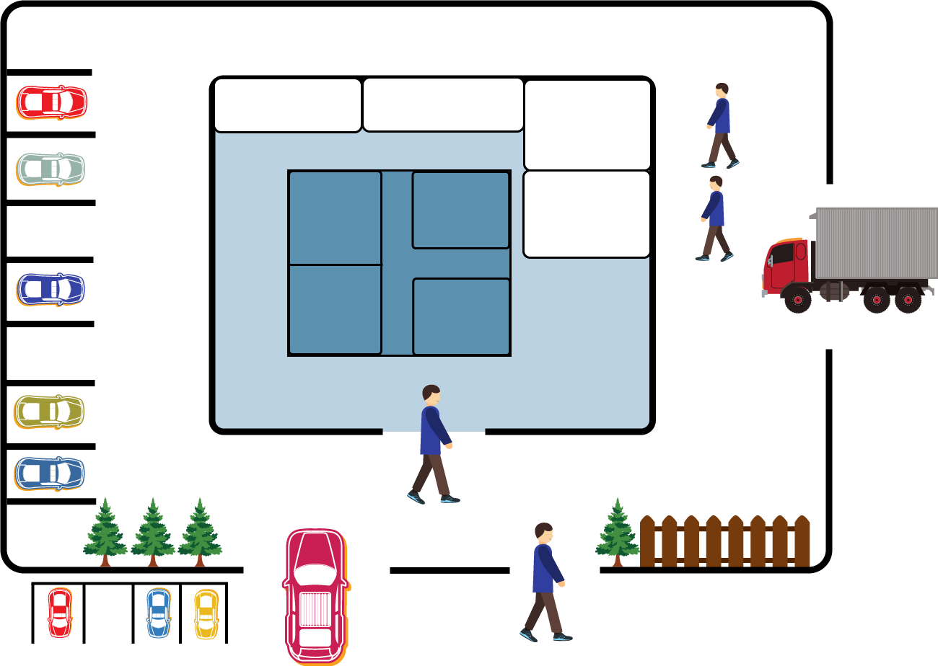

Perimeter Security Controls
Perimeter defenses are critical for preventing, detecting, and correcting unauthorized access into the facility.
Offices
Data vault
Mech. room
Key features
Deliveries and services
Rack
Delivery
Employs the defense-in-depth concept for enhanced security
Features layered architectural barriers where the core area is most protected
Designs security systems with multiple barriers known as rings of protection
Reduces the likelihood of successful attacks through layered design
Room
Employee Parking
Data Center
Buildings
Common area
Employee car entrance
Foot entrance for visitors
Grounds
Fence
Visitor parking
Depth of Security
Concentric areas to protect data center
= Access Point
Darker = More Secure
Notes:
Trainer Notes:
Perimeter defenses help prevent, detect, and correct unauthorized physical access and control access into the facility.
It employs the defense-in-depth concept.
With layered architecture for barriers, the center or the most protected area has the highest level of security.
Security systems are designed utilizing multiple barriers called rings of protection.
The layered design can reduce the likelihood of a successful attack.

Slide 105
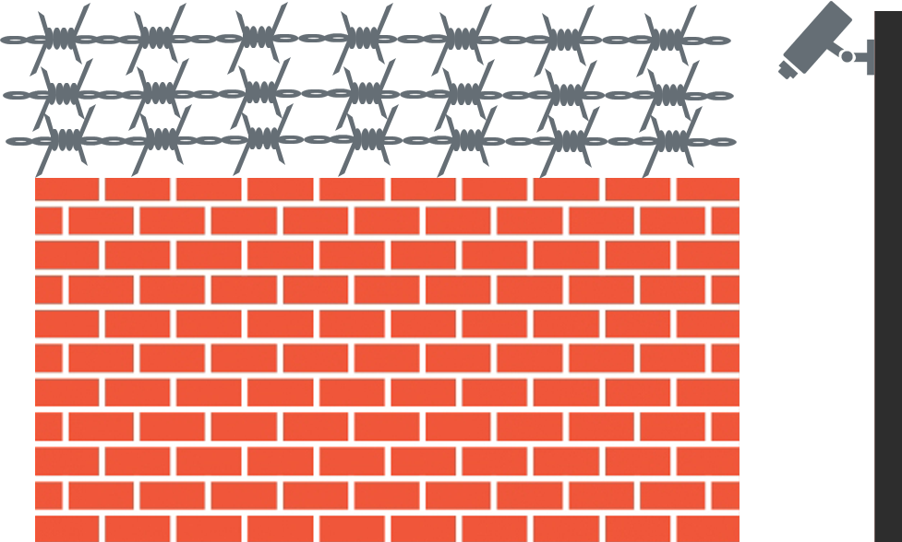
Barriers
Barriers strategically define and outline how an area should be architecturally designed and to obstruct or deny unauthorized access effectively.
Objectives of barriers include:
Keep intruders out
Cause delays in intrusion
Control access points
Enable surveillance
Provide safe evacuation routes
Notes:
Trainer Notes:
Barriers define how an area should be designed in order to obstruct or deny access.
Objectives of barriers include:
Keep intruders out
Cause delays in intrusion

Slide 106
Fences
Fences serve as crucial perimeter identifiers meticulously designed and strategically installed to effectively deter and prevent unauthorized access by keeping intruders out.
Height | Effectiveness
3-4 ft | Deters casual trespassers
6-8 ft | Too difficult to climb easily
8 ft plus 3 strands of barbed or razor wire | Deters determined trespassers
The various types of fences include:
Chain link
Barbed wire
Barbed tape
Concertina wire
Selecting the appropriate fence type and height is essential for maximizing perimeter security and effectively managing the specific risks associated with unauthorized entry.
Notes:
Trainer Notes:
Fences are perimeter identifiers that are designed and installed to keep intruders out.
The various types of fences include:
Chain link
Barbed wire
Barbed tape
Concertina wire

Slide 107


Walls and Bollards
Walls and bollards serve as crucial man-made barriers designed to enhance physical security by obstructing unauthorized access.
Walls
Walls are more permanent and sturdy barriers, generally resulting in higher installation costs.
Common materials include cinder blocks, masonry, brick, and stone.
Bollards
Bollards are robust concrete pillars used to restrict vehicle access while permitting pedestrian movement, often employed to control traffic.
Notes:
Trainer Notes:
Walls are man-made barriers but are usually more expensive to install than fences.
Common types of walls are:
Cinder block
Masonry
Brick
Stone
Bollards are small concrete pillars outside a building.
Example: Traffic bollard

Slide 108
Perimeter Intrusion Detection
Perimeter sensors alert security when any intruders attempt to gain access across the open space or attempt to breach the fence line.
Open-terrain sensors include:
Infrared
Microwave systems
Time-domain reflectometry (TDR) systems
Video content analysis and motion path analysis
Notes:
Trainer Notes:
Perimeter sensors alert security when any intruders attempt to gain access across the open space or attempt to breach the fence line.
Open-terrain sensors include:
Infrared
Microwave systems
Time-domain reflectometry (TDR) systems
Video content analysis and motion path analysis
Infrared Sensors
There are two kinds of infrared sensors
Passive infrared sensors are designed for human body detection.
A system registers changes in temperature as a means of detecting unauthorized intrusions and relays the information to a processor.
The processor measures the change according to detection parameters.
If any deviation is found, a signal to the unit’s alarm is sent.
Active infrared sensors transmit an infrared signal via a transmitter.
An Interruption of the normal infrared signal indicates that something has blocked the path.
Microwave Systems
The signals can pass through concrete and steel.
Microwave sensors come in two configurations.
Bistatic sensor sends an invisible volumetric detection field that fills the space between a transmitter and receiver.
Monostatic microwave sensors use a single sensing unit that incorporates both the transmitting and the receiving functions.
Time Domain Reflectometry (TDR) Systems
They send induced radio frequency (RF) signals down a cable that is attached to the fence fabric.
A signal path flaw can be converted into an alarm signal.
Intrusion point is identified by computing the time to the intrusion point and return.
Armored cable are used which cannot be severed easily.
Video Content Analysis and Motion Path Analysis
It is the latest technology for intrusion detection.
Uses video content analysis and motion path analysis.
Example: Closed-circuit television or (CCTV)

Slide 109

Importance of Lighting in Security
Effective lighting is pivotal in security, ensuring visibility and deterrence throughout low-light hours.
Improves visibility: Allows security personnel to clearly assess surroundings during nighttime
Enhances surveillance: Boosts the performance of CCTV, providing clearer footage under all conditions
Deters intruders: Acts as a psychological deterrent, reducing potential security breaches
Cost-effective: Maintains minimal upkeep costs, offering a sustainable security enhancement
Notes:
Trainer Notes:
Lighting plays a vital role in the security function.
Provides security personnel the ability to visually assess their surroundings at night
Helps notice and identify individuals at night
Increases the effectiveness of guard forces and CCTV
Reduces the need for security personnel
Provides real and psychological deterrents against intruders
Provides illumination where natural light is insufficient
Is inexpensive to maintain

Slide 110




Types of Lighting Systems
The following are the main types of lighting systems, each serving distinct functions within a security framework:
Continuous Light
Emergency light
Standby light
Movable light
Notes:
Trainer Notes:
Lighting Systems
Continuous Light
Standby light
Movable light
Emergency light

Slide 111

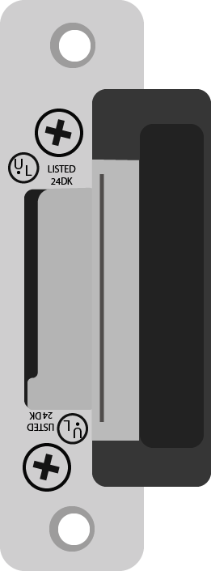


Access Control
To control panel
An access control system (ACS) allows only authorized personnel into a controlled area to reduce the risk of crime.
Door Contact
Basic components of an ACS include:
Card readers
Electric locks
Alarms
Computer systems
Reader (card, keypad or biometric)
Exit button
Electric Strike
Notes:
Trainer Notes:
The primary function of an access control system (ACS) is to allow only authorized personnel inside a controlled area.
The goal of an access control program is to limit the opportunity for a crime to be committed.
The basic components of an ACS include:
Card readers
Electric locks
Alarms
Computer systems

Slide 112
Types of Access Control Systems
Access cards
Types include magnetic stripes/ proximity cards/ smart cards
Biometrics
Methods encompass fingerprint, facial image, hand geometry, voice recognition, iris patterns, retina scanning, signature dynamics, and keystroke dynamics
Closed circuit televisions
Comprise cameras, recorders, switches, keyboards, and monitors that enable the observation and recording of security events
CCTV color
camera
Provides additional details, such as the color of a vehicle or a subject's clothing
Notes:
Trainer Notes:
Types of Access Control Systems
Access cards
The different types of access cards are magnetic stripe, proximity card, and smart card.
Biometrics
The types of biometrics include fingerprint, facial image, hand geometry, voice recognition, iris patterns, retina scanning, signature dynamics, and keystroke dynamics.
Closed circuit television
The types of biometrics include fingerprint, facial image, hand geometry, voice recognition, iris patterns, retina scanning, signature dynamics, and keystroke dynamics.
CCTV color cameras
CCTV color cameras offer additional information, such as the color of a vehicle or a subject’s clothing.

Slide 113
Types of Access Control Systems
Digital video recorder (DVR) and monitor displays
Camera footage is downloaded to a hard drive for historical information storage.
Security patrols
Guards or officers patrol and inspect properties to safeguard against fire, theft, vandalism, terrorism, and illegal activities.
Guard dogs
Guard dogs serve as a physical control that provides detective, preventive, and deterrent security measures.
Notes:
Trainer Notes:
Digital video recorder (DVR) and monitor displays
It is used to download camera footage to a hard drive for storage of historical information.
Guards
Security guards or officers patrol and inspect a property to protect it against fire, theft, vandalism, terrorism, and illegal activity.
Guard dogs
Guard dogs are a form of physical control that can serve as detective, preventive, and deterrent controls.

Slide 114
Deceptive Technologies

Slide 115

Deceptive Technologies
These are cybersecurity solutions designed to outsmart attackers by creating a web of illusions within your network.
This technology can assist in:
Early threat detection
Reduced dwell time
Improved incident response
Wasting attacker resources
Notes:
Trainer Notes
Explain Deceptive Technologies
Deceptive technologies are a type of cybersecurity solution designed to outsmart attackers by creating a web of illusions within your network.
This can assist in
Early Threat Detection
Reduced Dwell time
Improved Incident response
Wasting attacker resources

Slide 116
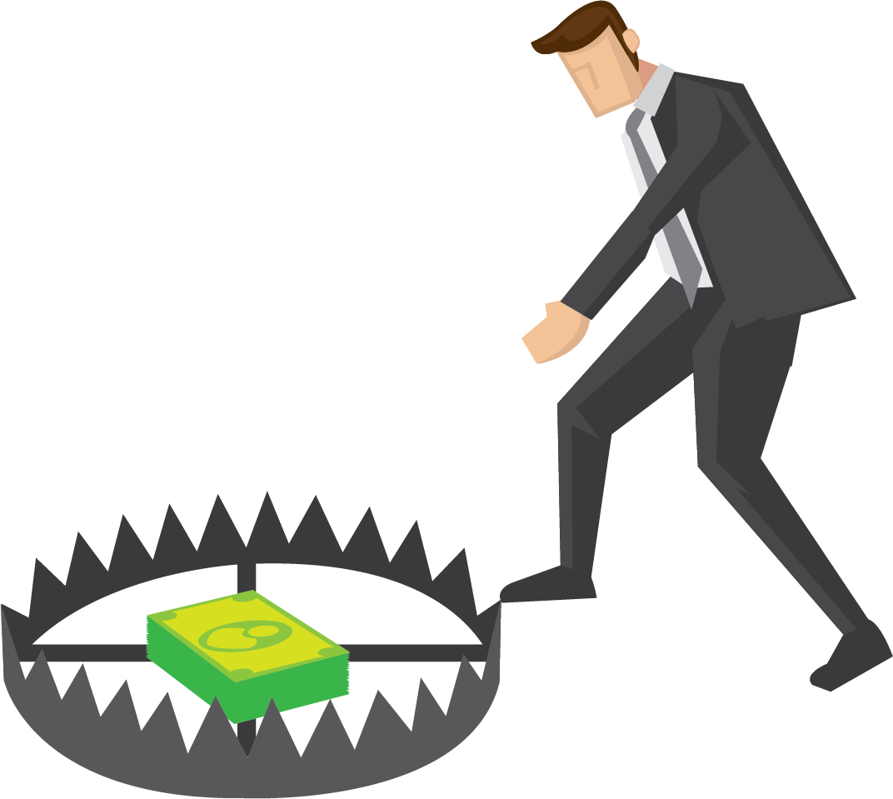
Honeypot
Honeypot is a network-attached system set up as a decoy to lure cyber attackers and detect, deflect, and study hacking attempts to gain unauthorized access to information systems.
Notes:
Trainer Notes
Explain Honeypot
Honeypot is a network-attached system set up as a decoy to lure cyber attackers and detect, deflect, and study hacking attempts to gain unauthorized access to information systems.

Slide 117

Features of Honeypot
It is not hardened or locked down and has services enabled and open ports.
It is designed to confuse attackers into believing it is a production server.
Honeypot is a decoy system intended to mimic likely targets for cyberattacks.
It is a decoy system intended to mimic likely targets for cyberattacks.
It does not contain anything sensitive or valuable data.
It does not contain any sensitive or valuable data.
It is designed to confuse the attacker into thinking that it is a production server.
It is not hardened or locked down with enabled services and open ports.
Notes:
Trainer Notes
Explain the features of Honeytokens
Honeypot is a decoy system intended to mimic likely targets for cyberattacks.
It is not hardened or locked down and has services enabled and open ports.
It is designed to confuse the attacker into thinking that it is a production server.
It does not contain anything sensitive or valuable data.

Slide 118

Honeynet
A honeynet is a set of multiple honeypots linked together as a network or subnet that simulates a larger network installation.
Notes:
Honeynet is a decoy network that contains one or more honeypots. A honeynet is a decoy network designed to lure hackers in and study their behavior. Imagine it like a cleverly disguised mousetrap for cybercriminals. Honeynets are set up to look like real networks, containing systems and data that appear valuable to attackers. They might mimic production servers, development environments, or even personal computers.

Slide 119

Honeytokens
Honeytokens are fictitious words or records added to legitimate databases to detect unauthorized attempts to access information.
They are characterized by properties that make them appear as genuine data items.
Notes:
Trainer Notes
Explain Honeytokens
Honeytokens are fictitious words or records that are added to legitimate databases in order to detect unauthorized attempts to use information.
Honeytokens are characterized by properties that make them appear as genuine data items.

Slide 120

Honey file
Honey files are not software applications or services but decoy files used for security purpose.
These files are decoy files intentionally placed on a network file share to lure attackers trying to steal data.
Notes:
Trainer Notes
Explain Honey Files
Honey file is not a software application or service, but rather a decoy file used for security purposes.
Honey files are essentially fake files placed on a network file share. They are designed to look attractive to attackers trying to steal data.

Slide 121
Types of Security Controls

Slide 122
Asset
An asset is any resource that gives value to an organization.
An asset can be tangible or intangible.
This includes people, hardware, software, data, information, or reputation.
Notes:
Trainer Notes:
An asset is any resource that has value to an organization.
An asset can either be tangible or intangible.
Tangible assets are those assets that we can touch, feel and see whereas an intangible asset does not have a physical existence.
These include people, hardware, software, data, information, reputation, etc.

Slide 123

Vulnerability
Vulnerability refers to a condition in the system that, either intentionally or accidentally, causes a security weakness. This compromises the security of the system.
Examples: Unpatched software, buffer overflow, lack of awareness training
Notes:
Trainer Notes
Vulnerability refers to condition in the system that intentionally or by accident causes a security disability. This compromises the security of the system.

Slide 124
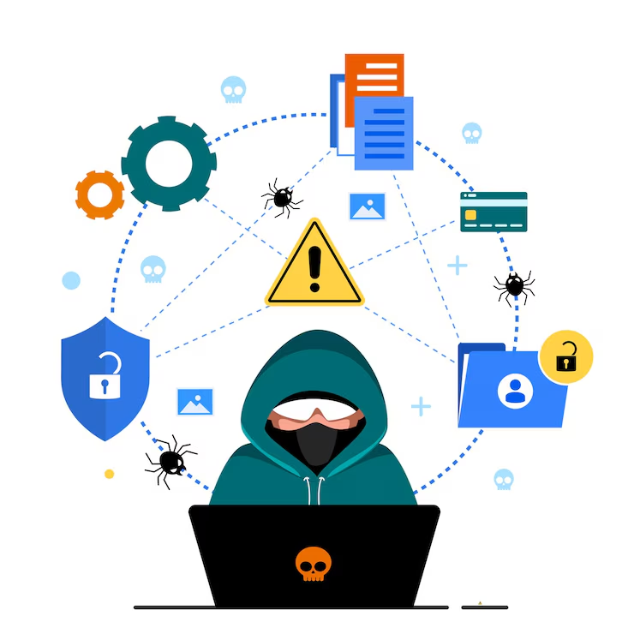
Threat
A threat is anything that has the potential to cause harm to a system or data.
Intentional threats:
These are malicious attempts to harm the system or steal data.
Natural threats:
Floods, earthquakes, fires, and other natural disasters can damage computer hardware and destroy data.
Unintentional threats:
These are accidental events that can cause damage, even if they are not malicious.
Notes:
Trainer Notes
A potential threat is a threat actor or a potential threat agent.
Different types of Threats
Intentional Threats- These are malicious attempts to harm the system or steal data.
Unintentional Threats- These are accidental events that can still cause damage, even if they are not malicious. It is not deliberate attempts, sometimes inadvertently or by mistake it can cause damage. For example, Typo, accidentally input malicious data.
Natural Threats- Floods, earthquakes, fires, and other natural disasters can damage computer hardware and destroy data.

Slide 125

Threat Agents
A threat agent, also known as a threat actor, is an individual, group, or organization that can initiate an attack on a system or data.
Examples: Hackers, cybercriminals
Notes:
Trainer Notes
Explain Threat Agents
A threat agent, also known as a threat actor, is an individual, group, or organization that has the potential to initiate an attack on a system or data. Example Hackers, Cybercriminals

Slide 126
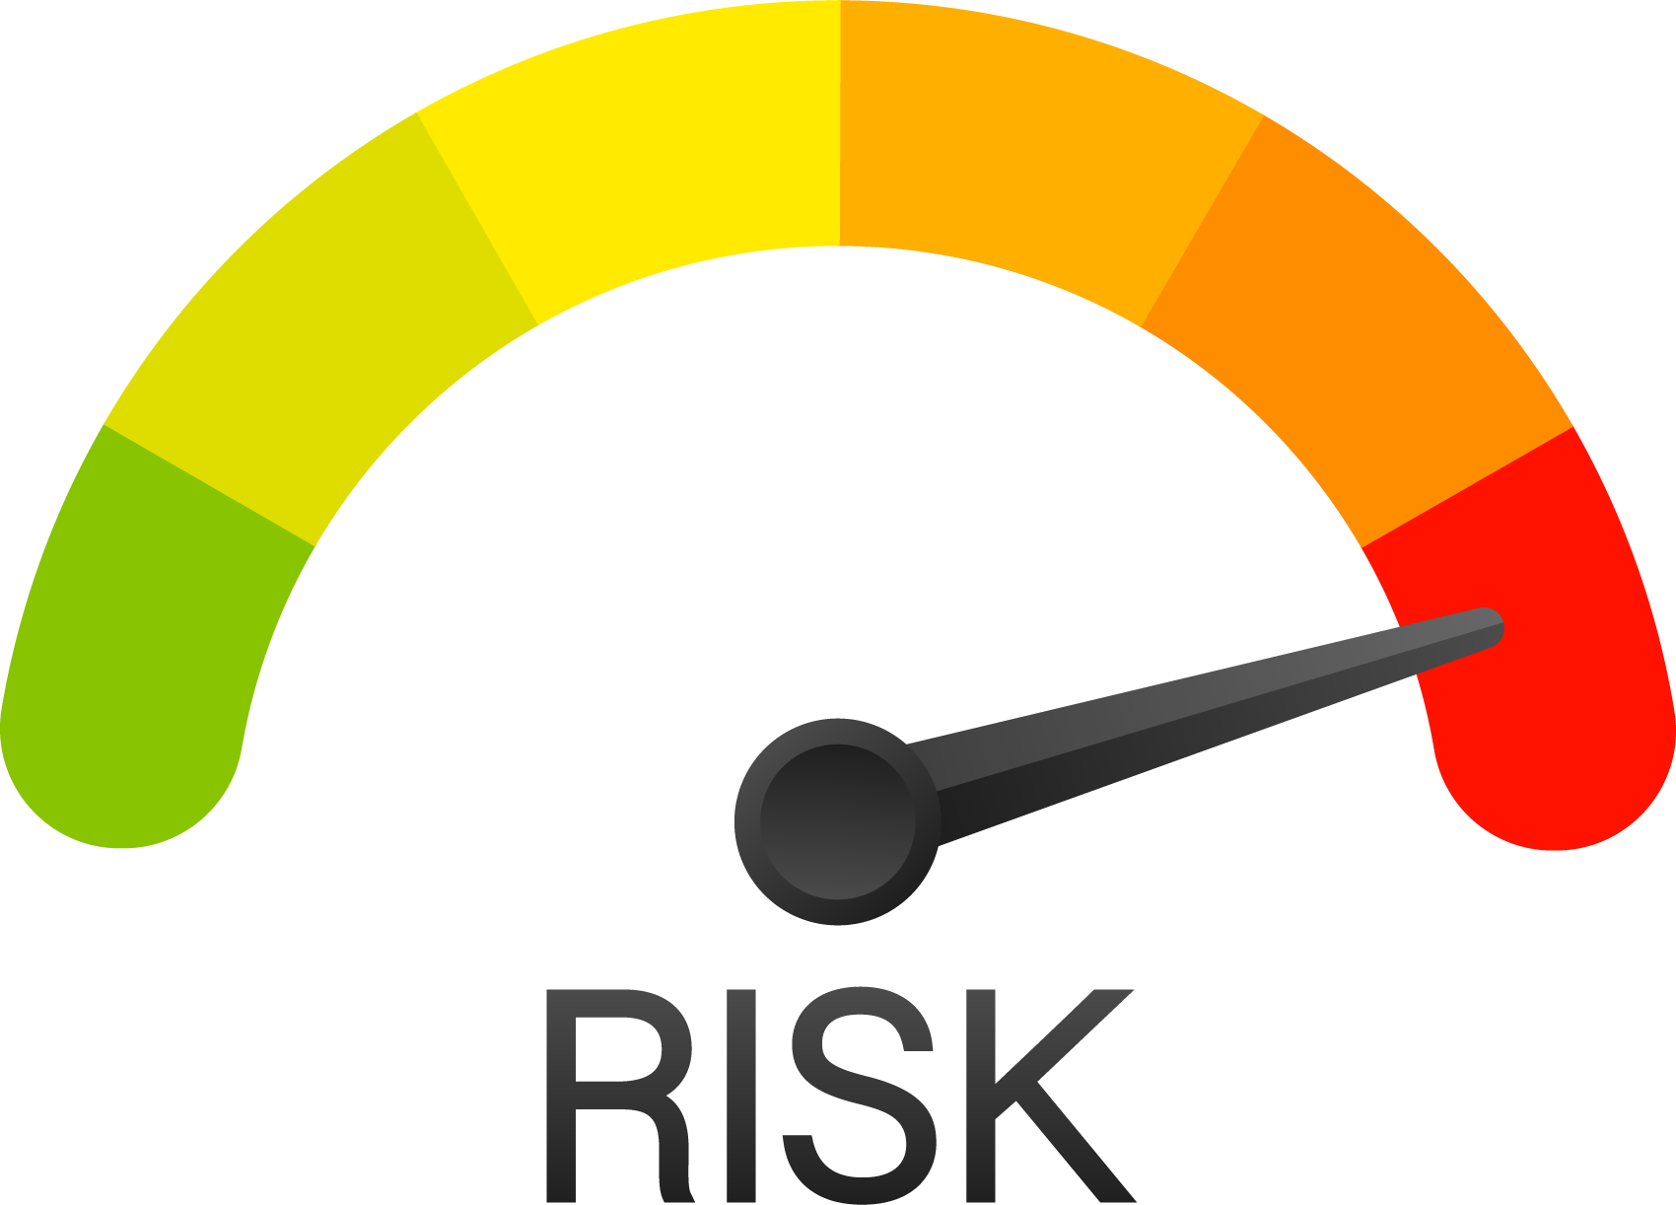

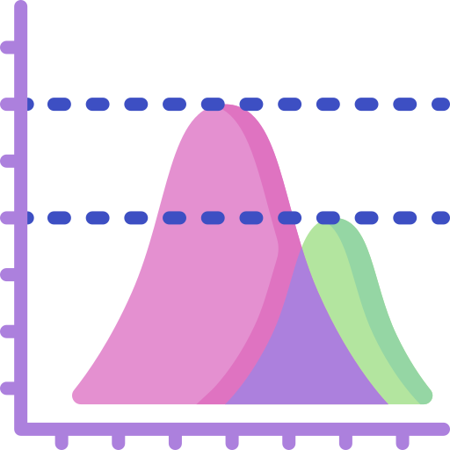
Risk
Risk is defined by the International Systems Audit and Control Association as the combination of the probability of an event and its consequences.
Key terms associated with risk are:
Impact
Likelihood
Magnitude of damage emerging from a threat exploiting a vulnerability
Probability of a threat exploiting a particular vulnerability
Notes:
Trainer Notes
Explain to the learners that risks may be of different types. Different business and industries may have different types of risks associated with their assets and all of them need to be protected against.

Slide 127
Examples of Risks
Threat agent | Threat | Vulnerability | Risk scenarios
Fire | Destruction of operating facility | Faulty fire detection or suppression equipment | Loss of life or property
Clueless user | Sharing of sensitive data using social engineering | Lack of security awareness training | Financial loss or reputation loss
Malicious insider | Data theft | Lack of adequate access controls on data | Legal risk, financial loss
Hacker | Unauthorized hacking | Unpatched server | Server unavailability, financial loss
Notes:
Compare the various Risks caused by different Threat Agents.

Slide 128

Security Controls
Controls are necessary to protect the confidentiality, integrity, and availability of assets.
Security controls are put into place to reduce the risk an organization faces.
Notes:
Define Security Controls and its importance
Security controls are like safeguards or countermeasures used to protect your valuable assets, which can be data, systems, or even physical property, from security risks. These controls can be implemented in various forms to prevent, detect, and mitigate cyberattacks.

Slide 129


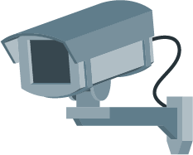
Control Categories
Administrative controls
Technical controls
Physical controls
Notes:
Mention each type of Control Categories
Administrative
Technical
Physical
These are further discussed in the upcoming slides.

Slide 130
Administrative Controls
Administrative controls are managerial controls focusing on personal and business practices.
These are the policies and procedures defined by an organization's security policy and other regulations or requirements.
Examples: Security documentation, risk management, personnel security, and training
Notes:
Explain Administrative Controls with examples
Administrative controls are managerial controls with a focus on personal and business practices.
These are the policies and procedures defined by an organization's security policy and other regulations or requirements.
Examples of administrative controls are security documentation, risk management, personnel security, and training.

Slide 131
Technical Controls
Technical controls, also known as logical controls, are implemented as systems such as hardware, software, or firmware.
Examples: Firewalls, IPS, antivirus software, and encryption
Notes:
Explain Technical Controls with examples
Technical controls, also known as logical controls, are implemented as systems (hardware, software, or firmware).
For example, firewalls, IPS, antivirus software, and encryption are technical controls.

Slide 132
Physical Controls
Physical controls are implemented to protect facilities, personnel, and other physical resources.
Examples: Security guards, CCTV, locks, doors, fencing, and lighting
Notes:
Explain Physical Controls with examples
Physical controls are implemented to protect facilities, personnel, and other physical resources.
Examples of physical controls are security guards, CCTV, locks, doors, fencing, and lighting.

Slide 133





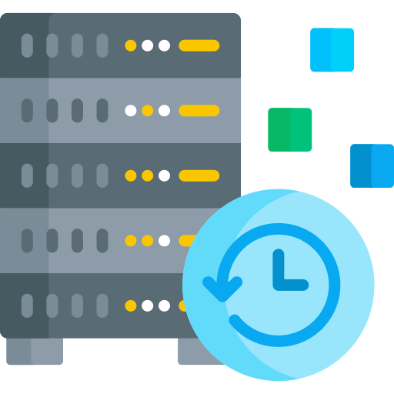
Control Types
Preventive
Deterrent
Detective
Corrective
Recovery
Compensative
Notes:
Mention each type of Control Types
Preventive
Deterrent
Detective
Corrective
Recovery
Compensative

Slide 134
Preventive Control
Preventive or preventative controls are intended to stop an incident from occurring.
Preventative control operates before an attack and eliminates or reduces the likelihood of a successful attack.
Walls and locks can stop people from entering an area in an unauthorized manner.
Notes:
Trainer Notes
Preventive or preventative controls are intended to stop an incident from occurring.
Preventative control operates before an attack can take place and eliminates or reduces the likelihood of a successful attack.
Walls and locks can stop people from entering an area unauthorizedly.
Other examples can include data leak prevention systems (DLP) and intrusion prevention systems (IPS).

Slide 135
Deterrent Control
Deterrent controls are intended to discourage a potential attacker.
These may include warning signs, policies, NDAs, and legal penalties against trespasses or intrusions.
Notes:
Trainer Notes
Explain Deterrent controls with examples
Deterrent controls are intended to discourage a potential attacker.
These could include warning signs, policies, NDAs, and legal penalties against trespass or intrusion.

Slide 136
Detective Control
Detective controls are intended to discover or detect unwanted or unauthorized activity.
These can include security guards, logs, intrusion detection systems (IDS), and the security team reviewing the outputs of a security information and event management (SIEM) system.
Notes:
Trainer Notes
Explain Detective controls with examples
Detective controls are intended to discover or detect unwanted or unauthorized activity.
These can include security guards, logs, intrusion detection systems (IDS), and the security team reviewing the outputs of a security information and event management (SIEM) system.

Slide 137
Corrective Control
Corrective controls are intended to correct any problems resulting from a security incident.
They reduce or eliminate the opportunity for the unwanted event to recur.
Example: Fire extinguishers to put off fire or patching a system to fix vulnerabilities
Notes:
Trainer Notes
Explain Corrective controls with examples
Corrective controls are intended to correct any problems resulting from a security incident.
They reduce or eliminate the opportunity for the unwanted event to recur.
Examples are fire extinguisher to put off fire or patching a system to fix vulnerabilities.

Slide 138
Recovery Control
Recovery controls are intended to bring the environment back to regular operations.
These include backups and disaster recovery plans.
Notes:
Trainer Notes
Explain Recovery controls with examples
Recovery controls are intended to bring the environment back to regular operations.
These can include backups and disaster recovery plans.

Slide 139
Compensative Control
A compensative control, also known as an alternative control, is implemented to fulfill a security requirement deemed too difficult or impractical to implement currently.
Example:
In a small firm, a single user has access to and performs the tasks of accepting cash payments and recording the payments.
Due to the nature of the business and for efficiency, the same user performs both tasks.
To prevent fraud, supervision is required.
Therefore, compensative control is required.
Example: A second user must perform a reconciliation, reviewing the cash against the recorded transactions.
Notes:
Trainer Notes
A compensative control is just an alternative control that provides similar protection as the original control but has to be used because it is more affordable or the original control is not feasible.
Explain Compensative controls with examples
For example, in a small firm, a single user has access to and performs the tasks of accepting cash payments and recording the payments.
Due to the nature of the business and for efficiency, the same user performs both tasks.
To prevent fraud, supervision is required.
So compensating control is required. Example, you may specify that a second user must perform a reconciliation, reviewing the cash against the recorded transactions.

Slide 140

Compensative Control
Compensative control must meet the following four criteria:
Have the intent and rigor of the original requirement
Provide a similar level of defense as the original requirement
1
2
Be above and beyond other requirements
Be commensurate with the risk imposed by ignoring the original requirement
3
4
Notes:
Trainer Notes
Explain the criteria's required for Compensating control
Have the intent and rigor of the original requirement
Provide a similar level of defense as the original requirement
Be above and beyond other requirements
Be commensurate with the risk imposed by ignoring the original requirement

Slide 141


Control Selection
The selection of security controls will depend on the nature of the business, the complexity of the environment, and the assets' value.
Security control must make good business sense, which means it should be cost-effective. Its benefits must outweigh its costs.
Notes:
Explain control selection with example
Selecting the right security controls is crucial for creating a robust and effective security posture. Here's a framework to guide you through the process:
Understanding Your Needs:
Identify Assets: First, you need to understand the critical assets you need to protect. This could include data, systems, applications, devices, and intellectual property.
Evaluate Threats: Identify potential threats and vulnerabilities that could exploit your assets. Consider cyberattacks, natural disasters, human error, and insider threats.
Analyze Risks: Assess the likelihood and impact of each threat on your assets. Prioritize risks based on their severity to focus your security efforts
The selection of security controls will depend on the nature of the business, the complexity of the environment, and the assets' value.

Slide 142
Control Matrix
 | Preventive | Detective | Deterrent | Corrective | Recovery
Administrative | Separation of duties | Audit | Disciplinary policy | Employee disciplinary actions | Disaster recovery plan
Technical | Firewall | IDS | Warning banner on login | Vulnerability patches | Data backup
Physical | Walls, fences, gates | CCTV | Beware of dog sign | Fire suppression systems | Disaster recovery site
Notes:
Trainer Notes
Discuss control matrix

Slide 143

Multiple Control Facilities
Control can provide several functionalities depending on their implementation and operation.
Example:
Surveillance cameras can be considered a deterrent control since cameras discourage a potential attacker from doing an unauthorized action.
It is also considered a detective control.
It is also a compensative control since it provides an additional detection method for security guards.
Notes:
Trainer Notes
Control can provide several functionalities, depending on their implementation and operation.
Surveillance cameras can be considered a deterrent control since cameras discourage a potential attacker from doing an unauthorized action.
It is also considered a detective control. For example, when security guards monitor cameras or cameras are combined with motion-sensing capabilities triggering an alarm.
It is also a compensating control since it provides an additional detection method for security guards.

Slide 144
Importance of Change Management Processes and the Impact to Security

Slide 145

Business Process Impacting Security Operations
A business process is a series of tasks used by an organization to achieve a goal or deliver a product or service.
Each process can affect security.
For example, an ineffective approval process can lead to poorly vetted changes and new vulnerabilities. Performance baselines are used to measure the impact of changes on security.
Notes:
Explain Honeynet

Slide 146

Change Management
Changes to the system are tracked and approved through change control procedures, which involve identifying, controlling, and auditing all changes made to the system.
Change control:
Ensures changes are implemented in an orderly manner through formalized testing
Ensures awareness is created among users about the impending change
Analyzes the effect of the change on the system after implementation
Reduces the negative impact of the change on the computing services and resources
Notes:
Trainer Notes:
Changes to the system are tracked and approved through change control procedures. It includes identifying, controlling, and auditing all changes made to the system.
Change control:
Ensures the implementation of change in an orderly manner through formalized testing
Ensures creation of awareness regarding the impending change among the users
Analyzes the effect of the change on the system after implementation
Reduces the negative impact of the change on the computing services and resources

Slide 147
Change Management Process
The procedures for change control process implementation and support include:
A request is sent to the responsible individual or group who administers and approves changes.
1. Request for
a change to
be introduced
Mandatory vacation
After proper analysis and justification, the change is approved.
2. Change approval
Mandatory vacation
The change control log is updated and documented.
3. Change intended cataloging
Mandatory vacation
Notes:
Trainer Notes:
The procedures for change control process implementation and support are:
Request for a change to be introduced
Request is sent to the responsible individual or group who administers and approves changes
2. Change approval
After proper analysis and justification for change, it is approved
3. Change intended cataloging
Change control log is updated and documented

Slide 148
Change Management Process
The procedures for change control process implementation and support include:
Change is formally tested.
4. Change testing
Change is scheduled and implemented.
5. Change scheduling and implementation
6. Report to the appropriate parties about the change
Change is summarized and reported to the management.
Notes:
Trainer Notes:
4. Change testing
Change is formally tested
5. Change scheduling and implementation
Change is scheduled and implemented
6.Report to the appropriate parties about the change
Change is summarized and reported to the management

Slide 149
Change Types
Standard change
A pre-authorized, low-risk, and low-impact change that is well-understood, fully documented, and can be implemented without needing additional authorization is considered a standard change.
Normal change
A change must follow the entire change process. It should be scheduled, assessed, and authorized following a standard process. This includes both minor (low to medium impact) and major (high impact) changes.
Notes:
Trainer Notes:
According to ITIL, changes can be broadly divided into 4 types
Standard change
a standard change is a pre-approved modification that follows a well-defined and documented process
Examples include OS upgrade, patch deployment, changing printer’s cartridge etc.
Normal:
Example: Moving on-premises services to the cloud
Normal Change-a normal change falls somewhere between a standard change and an emergency change. It's not as pre-approved and routine as a standard change, but it's not as urgent and critical as an emergency change either. A change that must follow the entire change process.

Slide 150
Change Types
Emergency change
A high-impact and urgent change that must be implemented as soon as possible without strictly following the standard process is known as an emergency change.
Expedited Changes
Expedited changes are a specific type of request that require faster approval and implementation than a standard change.
They are used for situations that require urgent implementation of a change but do not meet the criteria for an emergency change.
Notes:
Trainer Notes:
According to ITIL, changes can be broadly divided into 4 types
Emergency Change- an emergency change is a critical modification that needs to be implemented as soon as possible to address a pressing issue or prevent a potential disaster. Imagine it's like fixing a burst pipe in your house - you need to take immediate action to minimize damage
Expedited Change- an expedited change falls between a normal change and an emergency change. It addresses a situation that requires a quicker implementation timeline compared to a normal change, but isn't as urgent or critical as an emergency.

Slide 151

Change Advisory Board
A Change Advisory Board (CAB) is a group of individuals from different departments within an organization responsible for reviewing and approving proposed changes.
The primary objective of a CAB is to ensure that any changes made to the organization, such as IT infrastructure and processes, are implemented smoothly and with minimal disruption.
Typically, the CAB includes representatives from IT, operations, finance, HR, and other relevant departments, although the specific members can vary based on the organization's size and structure.
Notes:
Trainer Notes
Change Advisory Board: A Change Advisory Board (CAB) is a group of individuals within an organization responsible for reviewing and approving proposed changes to IT infrastructure, applications, or business processes. They essentially act as a gatekeeper, ensuring that any modifications are implemented smoothly, securely, and with minimal disruption

Slide 152
Change Advisory Board
Reviewing proposed changes to assess potential risks and impacts on different areas of the business
Approving or rejecting proposed changes
Responsibilities
Monitoring the implementation of approved changes and addressing any issues that arise
Notes:
Trainer Notes:
Define the responsibilities of Change Advisory board
Reviewing Change Requests: The CAB meticulously examines all proposed changes, including those submitted by IT, business units, or other departments. They analyze the impact, feasibility, and potential risks associated with each change.
Approved or reject the changes based on analysis , discussion , justification provided in change
Monitoring the change after the implementation to ensure that is successful or any issues are faced

Slide 153
Change Advisory Board
Mitigates risks associated with organizational changes
Improves communication and collaboration between different departments
Promotes a more controlled and orderly approach to change management
Advantages
Ensures that changes are aligned with the organization's overall goals and objectives
Notes:
Advantages of Change advisory board
Reduced Risks: The CAB plays a vital role in identifying and mitigating potential risks associated with proposed changes.
Enhanced Communication: The CAB acts as a central hub for communication throughout the change lifecycle.
Efficient Change Management: The CAB helps streamline the change management process by ensuring a controlled and well-managed approach.
Alignment with Business Goals: By including business unit representatives, the CAB ensures that proposed changes align with the organization's overall strategic goals and objectives

Slide 154
Change Management System Activities
Test analysis: Whenever a new security measure or change is implemented, it is wise to test it first.
Impact analysis - Before implementing any changes, it is important to analyze how they could affect the organization.
Backout plan: A backout plan serves as a safety net during risky activities; it outlines how to undo a change if issues arise.
Maintenance window: A maintenance window is a pre-scheduled time for performing repairs and maintenance tasks.
Standard operating procedure: A standard operating procedure is similar to a rulebook that guides how tasks and processes should be performed.
Notes:
Trainer Notes:
Explain activities flowing out of Change management
Impact Analysis - Before implementing any changes, it is important to analyze how they could affect the organization.
Test Analysis: Whenever a new security measure or change is implemented, it is wise to test it first.
Backout plan: A backout plan is like having a safety net when conducting a risky activity, it’s a plan to undo a change if things go wrong.
Standard operating procedure: A standard operating procedure (SOP) is similar to a rulebook that provides guidance on how things should be done.
Maintenance window: A maintenance window is a pre-scheduled time designated for performing repairs and maintenance tasks.

Slide 155

Technical Implications
Technical implications refer to the potential consequences of a technology-related decision or event in cybersecurity.
They can involve changes to network infrastructure, security protocols, or additional server capacity after implementing new software or systems.
It is essential to understand all technical implications of any new or existing system to ensure that functionality and security are maintained.

Slide 156
Technical Implications of Change Management
Downtime
Downtime adversely affects revenue. To minimize this, we will implement a business continuity plan to prevent it.
Service restart
Shutting down or rebooting systems can disrupt legitimate user access to computing resources and hinder incident response and recovery efforts.
Application restart
Application restart vulnerabilities refer to potential security weaknesses that may arise when an application is restarted. Inadequate restart procedures can lead to data inconsistencies or corruption.
Notes:
Trainer Notes:
Downtime -Downtime refers to a period when a system, machine, or network is unavailable or unusable. This can be due to various reasons, planned or unplanned. This has adverse impact on revenue
Service Restart- Downtime refers to a period when a system, machine, or network is unavailable or unusable. This can be due to various reasons, planned or unplanned.Shutting down or rebooting systems can disrupt legitimate user access to computing resources and hinder incident response and recovery efforts.
Application Restart-Application restart vulnerabilities refer to potential security weaknesses that may arise when an application is restarted. Inadequate restart procedures can lead to data inconsistencies or corruption. The application will be unavailable during the restart process. Unsaved data within the application might be lost if it hasn't been autosaved or persisted elsewhere

Slide 157
Technical Implications of Change Management
Legacy application
These are software that has been used for a long time, often with outdated security and no vendor support.
Dependencies
Services, such as the IP Helper service, depend on other services or system components to run before they can start running.
Notes:
Trainer Notes:
Legacy Application- A legacy application is an old or outdated computer program that is still in use within an organization. These applications might have been developed years or even decades ago, using older programming languages and technologies. May not have features or capabilities found in modern applications, potentially hindering efficiency or integration with newer systems.
Dependencies- Services, such as the IP Helper service, depend on other services or system components to run before it can start running.

Slide 158
Whitelist or Blacklist or Restricted Activities
An allow list grants access only to specified users and can be used on a firewall or by AppLocker to control which applications and files can run.
A whitelist ensures that only approved applications can be installed or run.
Any application absent on an allow list or whitelist will be denied access.
Whitelists or Allow lists
A deny list or blocklist prevents access to specified users and can be used on a firewall to deny access.
A blocklist prevents harmful applications from running; it requires you to specify which applications should be denied.
A blocklist also prevents unauthorized users from gaining access to your network.
Blacklist or Deny lists
Notes:
White List-A whitelist, also sometimes called an allowlist, is a cybersecurity strategy that creates a list of approved entities. An allow list grants access only to those on a list; this could be used on a firewall or by AppLocker that decides which applications and files can run.
Blacklist-a blacklist, also referred to as a disallowlist, blocklist, or denylist, is a fundamental access control mechanism. It functions by creating a list of entities that are explicitly denied access to a particular system, network, or resource

Slide 159
Whitelist or Blacklist or Restricted Activities
Restricted activities prevent actions that could potentially lead to vulnerabilities or disruptions.
These activities include unauthorized software installations, unauthorized system modifications, direct access to critical servers, and unauthorized access to sensitive data or data transfers.
Restricted activities
Notes:
Trainer Notes:
Restricted activities - Restricted activities prevent actions that could potentially lead to vulnerabilities or disruptions. These activities include unauthorized software installations, unauthorized system modifications, direct access to critical servers, and access to sensitive data or unauthorized data transfers.

Slide 160

Documentation
Documentation plays a critical role in successful change management.
Comprehensive documentation of changes promotes transparency, accountability, and a clear understanding of the modifications being made.
Well-documented changes facilitate tracking of modifications, making it easier to identify the individuals responsible for the changes and the reasons behind the modifications.
This, in turn, enhances security by minimizing the risk of unauthorized or unaccounted alterations.
Notes:
Trainer Notes:
Explain Documentation
Documentation is a critical pillar of successful change management. It serves several important purposes throughout the change lifecycle, from planning and implementation to ongoing support and future reference.
Benefits of Documentation:
Improved Communication: Clear and concise documentation ensures everyone involved in the change (stakeholders, employees, IT personnel) has a common understanding of the change details, objectives, timelines, and potential impacts. This fosters better communication and collaboration throughout the process
Reduced Risks: Through comprehensive documentation, potential risks associated with the change can be identified and mitigated early on.
Enhanced Decision-Making: Well-documented change requests and plans provide a clear picture of the change for decision-makers.

Slide 161
Change Management Documentation
Change management framework:
This document outlines the overall approach your organization takes to change management.
Change request forms:
These forms capture details about proposed changes, including the nature of the change, its rationale, potential impacts, and resource requirements.
Change approval process:
This document outlines the steps involved in getting a change proposal approved, including who needs to review it and the criteria they will use.
Notes:
Trainer Notes:
Explain different types of document record
Change management framework-Explain the change management framework , your organization is following
Change request forms-Details of change request forms and changes are captured
Change approval process- Capture the logs of change approval process from beginning till change is logged till it is completed and closed

Slide 162
Change Management Documentation
Implementation plans:
These plans detail the specific steps involved in implementing a change, including timelines, responsibilities, training needs, and communication strategies.
Change impact assessments:
These assessments evaluate the potential impact of a change on different areas of the business, such as costs, resources, and employee morale.
Metrics and evaluation criteria:
These documents define how the success of a change initiative will be measured, including factors such as user adoption rates and cost savings.
Notes:
Trainer Notes:
Explain different types of document record
Implementation Plan: These plans detail the specific steps involved in implementing a change, including timelines, responsibilities, training needs, and communication strategies.
Change Impact Assessment- These assessments evaluate the potential impact of a change on different areas of the business, such as costs, resources, and employee morale.
Metric and Evaluation criteria- These documents define how the success of a change initiative will be measured, including factors such as user adoption rates and cost savings.

Slide 163

Version Controls
Version control is a system that records changes to a file or set of files over time, enabling you to recall specific versions later.
It allows you to track modifications, pinpoint when and by whom changes were made, and, if necessary, revert to an earlier version.
Organizations that lack proper version control face challenges in tracking bug fixes and applying security patches.
Notes:
Explain Version controls
Version control plays a vital role in effective change management by providing a secure and traceable record of changes made to documents, plans, and other artifacts throughout the change lifecycle

Slide 164
Version Controls
It also makes it difficult for consumers to correlate, triage, and patch security vulnerabilities.
Proper version control is a best practice to maintain a secure and efficient operational environment.
Notes:
Version control plays a vital role in effective change management by providing a secure and traceable record of changes made to documents, plans, and other artifacts throughout the change lifecycle

Slide 165
Introduction to Cryptography

Slide 166


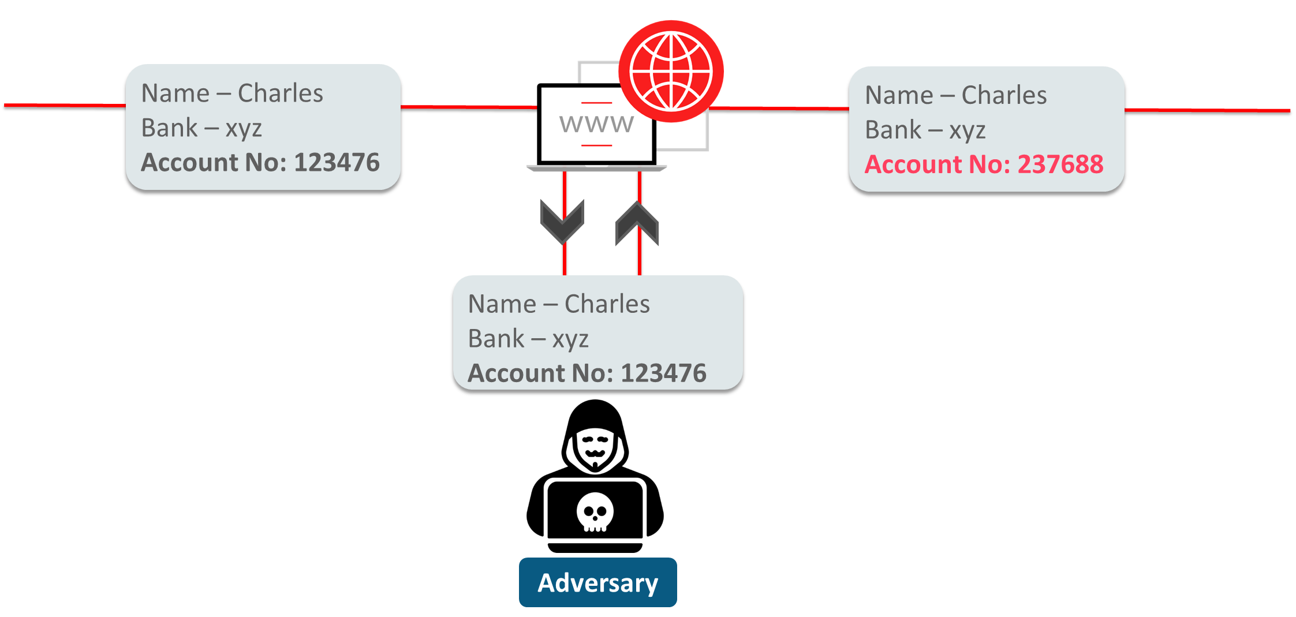
Scenario (Without Cryptography)
Consider an example where Charles requests Alice to lend him some money. He shares his bank account details with her through an insecure connection. An attacker intercepts the connection, retrieves the data, and modifies the account details.

Slide 167



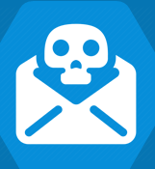

Problems Faced When Cryptography Was Not Used
Confidentiality: The adversaries gain access to account details due to insufficient protection, thereby compromising privacy.
Integrity: The adversaries replace the details with an erroneous account number and uses it to their advantage.
Problems
Authentication: When the data transmission channel is compromised, there is no way to confirm the identity of the sender and receiver, allowing adversaries to exploit this weakness.
Non-repudiation: It prevents deniability of actions carried out. However, in the current example, either the sender or recipient in the communication can deny sending or receiving the message.

Slide 168


What Is Cryptography?
Cryptography is the study of securing communication and data using algorithms to prevent exposure to unintended parties.
It is the science of transforming valuable information for secrecy.
Hi, welcome to XYZ post-graduate program on cybersecurity
Cryptographic algorithm
Kl, zhofrph wr Hgxuhnd'v srvw judgxdwh surjudp rq fbehuvhfxulwb
Original text
Coded text

Slide 169



Features of Cryptography
Confidentiality and privacy of data is maintained through encryption. The encrypted data is practically useless to an adversary without the decryption key.
Data confidentiality
The authenticity of the message is verified through digital signatures, which confirm the sender's identity.
Authentication
The integrity of a message is preserved using hashing algorithms, where the same message always results in the same hash.
Data integrity
Non-repudiation is ensured through digital signatures or digital certificates, preventing a user from denying sending the message.
Non-repudiation

Slide 170


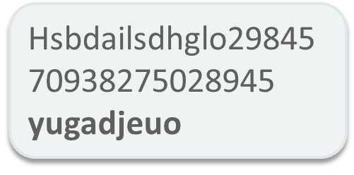

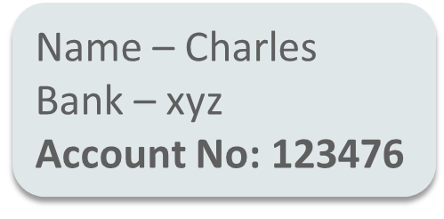


Solution Strategy to Solve the Problem
When your credentials and data are protected with cryptographic algorithms, even if a hacker breaches the security layer or hacks the server, the data remains unintelligible.
Adversary

Slide 171
Basic Definitions
Cryptography
The science of secret writing that enables an entity to store and transmit data accessible only to the intended individuals
Hardware or software implementation of cryptography that contains all the necessary software, protocols, algorithms, and keys
Cryptosystem
Cryptology
The study of both cryptography and cryptanalysis
Algorithm (Cipher)
A set of mathematical and logical rules used in cryptographic functions
Kerckhoffs's principle
The concept that an algorithm should be known and only the keys should be kept secret

Slide 172
Cryptography Around Us

Slide 173







WhatsApp
WhatsApp uses end-to-end encryption to transfer messages between two users.
End-to-end encryption ensures that the message encrypted at the sender’s end can only be decrypted at the receiver’s end.
How are you doing?
How are you doing?
Recipient’s public Key
Recipient’s private Key
WhatsApp Server
Sender
Receiver
Third parties or even WhatsApp cannot read the users' messages due to end-to-end encryption.

Slide 174


E-Banking
Online transactions
In 2002, financial institutions began using the AES algorithm for electronic transactions and creating security infrastructures to protect data stored in computer systems.
Automated Teller Machine (ATM)
All ATMs have encryption pads that encrypt the PIN code and send it to the bank, ensuring authorization and security.
One-time password
One-time password (OTP) is generated to facilitate two-level authentication.
The OTP is valid for only one transaction; the user sends it to the bank to authorize a transaction.
The OTP can only be decrypted by the bank’s terminal when the user enters the correct PIN.
87540563

Slide 175
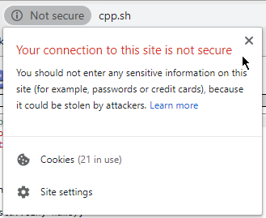

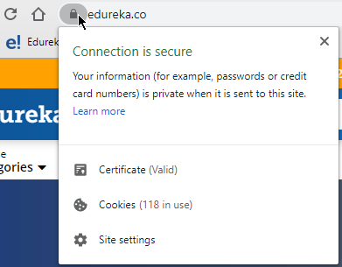


HTTPS
When you browse the internet while connected to a network, people connected to the same network can eavesdrop on your packets.
HTTPS indicates that your connection to the web browser is encrypted.
Lthps: efg@123.jvt
whzzdvyk: whzz43
Packets are encrypted, and only the server has the decryption key to respond to your request.
Svnpu Zbjjlzzmbs
Client
Server

Slide 176



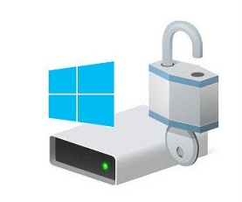

Disk Encryption
Disk encryption
This technology provides data at rest encryption. Symmetric encryption algorithms are used for encryption and decryption.
Full-Disk Encryption (FDE)
File-Based Encryption (FBE)
All contents of the disk are encrypted and converted into unreadable text with the help of symmetric ciphers (AES 256).
Each file (photos, notes, etc.) is encrypted individually using separate keys. Apple iOS uses FBE for data encryption on iPhones.
Popular FBE software - eCryptfs
Popular FDE software - BitLocker
Notes:
Trainer Notes
Explain Disk Encryption and types of encryption
Full Disk Encryptions
File Based Encryption

Slide 177


Storing Passwords
If passwords are stored in the form of plain text in a database, the admin or an attacker can access your password and use it for malicious intent.
For this reason, passwords are mapped to a fixed-length value (hash) by a cryptographic relationship.
A system will take the password on login, convert it to a fixed value, and compare this value to existing ones in the database for successful authentication.
It is nearly impossible to decrypt this stored hash value to retrieve the original plaintext password.
Ab?nZces3@d!
Password
Cryptographic algorithm
Fixed-length value
Notes:
Trainer Notes
Explain the application of cryptography in storing passwords.

Slide 178
Cryptography Fundamentals

Slide 179



Cryptography Methodology
Secure channel
Plaintext is converted to ciphertext using an encryption algorithm and a key.
Ciphertext is converted to plaintext with the help of a decryption algorithm and key.
The key is shared with the intended recipient through a secure channel.
Welcome to Introduction to Cryptography
Olssv Dvysk
Welcome to Introduction to Cryptography
Encryption algorithm
Encrypted message (ciphertext)
Ciphertext is sent over the internet
Decryption algorithm
Sender sends the plaintext
Recipient receives the decrypted text
Notes:
Trainer Notes:
Explain Cryptography with help of diagram
Plaintext is converted into cipher text by using encryption using keys and algorithms
Cipher text is converted into plain text at the other end using decryption process which is the reverse of encryption using the same key and algorithm

Slide 180
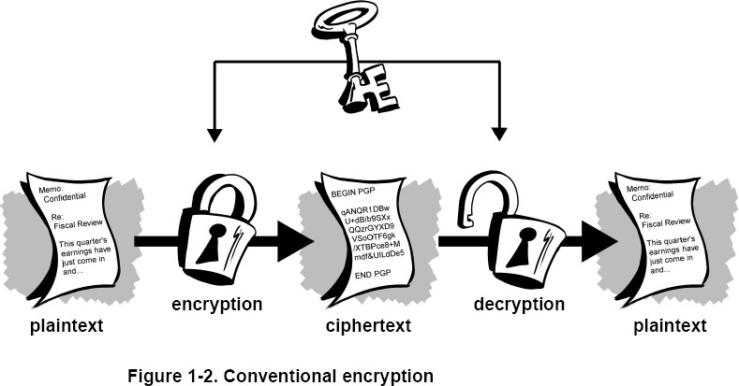
Conventional Encryption
Conventional encryption is illustrated below:
Notes:
Trainer Notes:
Conventional encryption is illustrated below:
Explain the image given on the screen.
Plaintext is converted into cypher text by using encryption at the Sender side
Cipher text is converted into plain text at the other end using a decryption process, which is the reverse of encryption

Slide 181
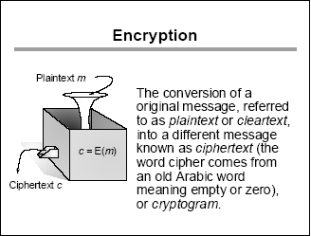
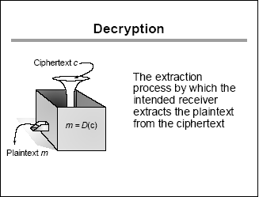
Encryption and Decryption
Encryption is converting plaintext into cipher text with the help of key and algorithm. Cipher text is something that is in an unreadable format.
Decryption is the process of converting ciphertext into plaintext using a key and algorithm. Ciphertext is the encrypted form of data that needs to be converted back into readable plaintext.
Notes:
Trainer Notes:
Explain the Encryption and Decryption

Slide 182
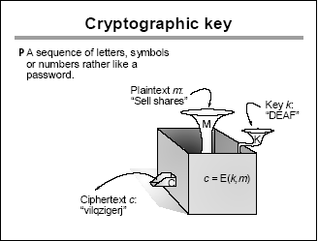
Cryptographic Key
A key is a piece of information that determines the functional output of a cryptographic algorithm.
Key clustering is when two different keys generate the same ciphertext from the same plaintext using the same algorithm.
Keyspace is a range of possible values used to construct keys.
Notes:
Trainer Notes:
A key is a piece of information that determines the functional output of a cryptographic algorithm.
Key clustering is an instance when two different keys generate the same ciphertext from the same plaintext using the same algorithm.
Keyspace is a range of possible values used to construct keys.

Slide 183

Strength of Cryptosystem
The strength of a cryptosystem refers to its ability to resist various attacks and keep the information it protects confidential, authentic, and tamper-proof. Key factors that determine the strength of a cryptosystem include:
How all work together
Strength of Cryptosystem
depends on:
Algorithm
Initialization vectors
Secrecy of the key
Length of the key
Notes:
Trainer Notes:
Strength of Cryptosystem-The strength of a cryptosystem refers to its ability to resist various attacks and keep the information it protects confidential, authentic, and tamper-proof. Here are some key factors that determine the strength of a cryptosystem:
Initialization vectors- Random numbers added to the encryption process to randomize the encryption process
Length of the key- Larger the length of the key, more strong the algorithm is
Secrecy of the key- How you are keeping your keys secure
Algorithm- Set of rules used for encryption, it shouldn’t be weak algorithm used
How all work together

Slide 184
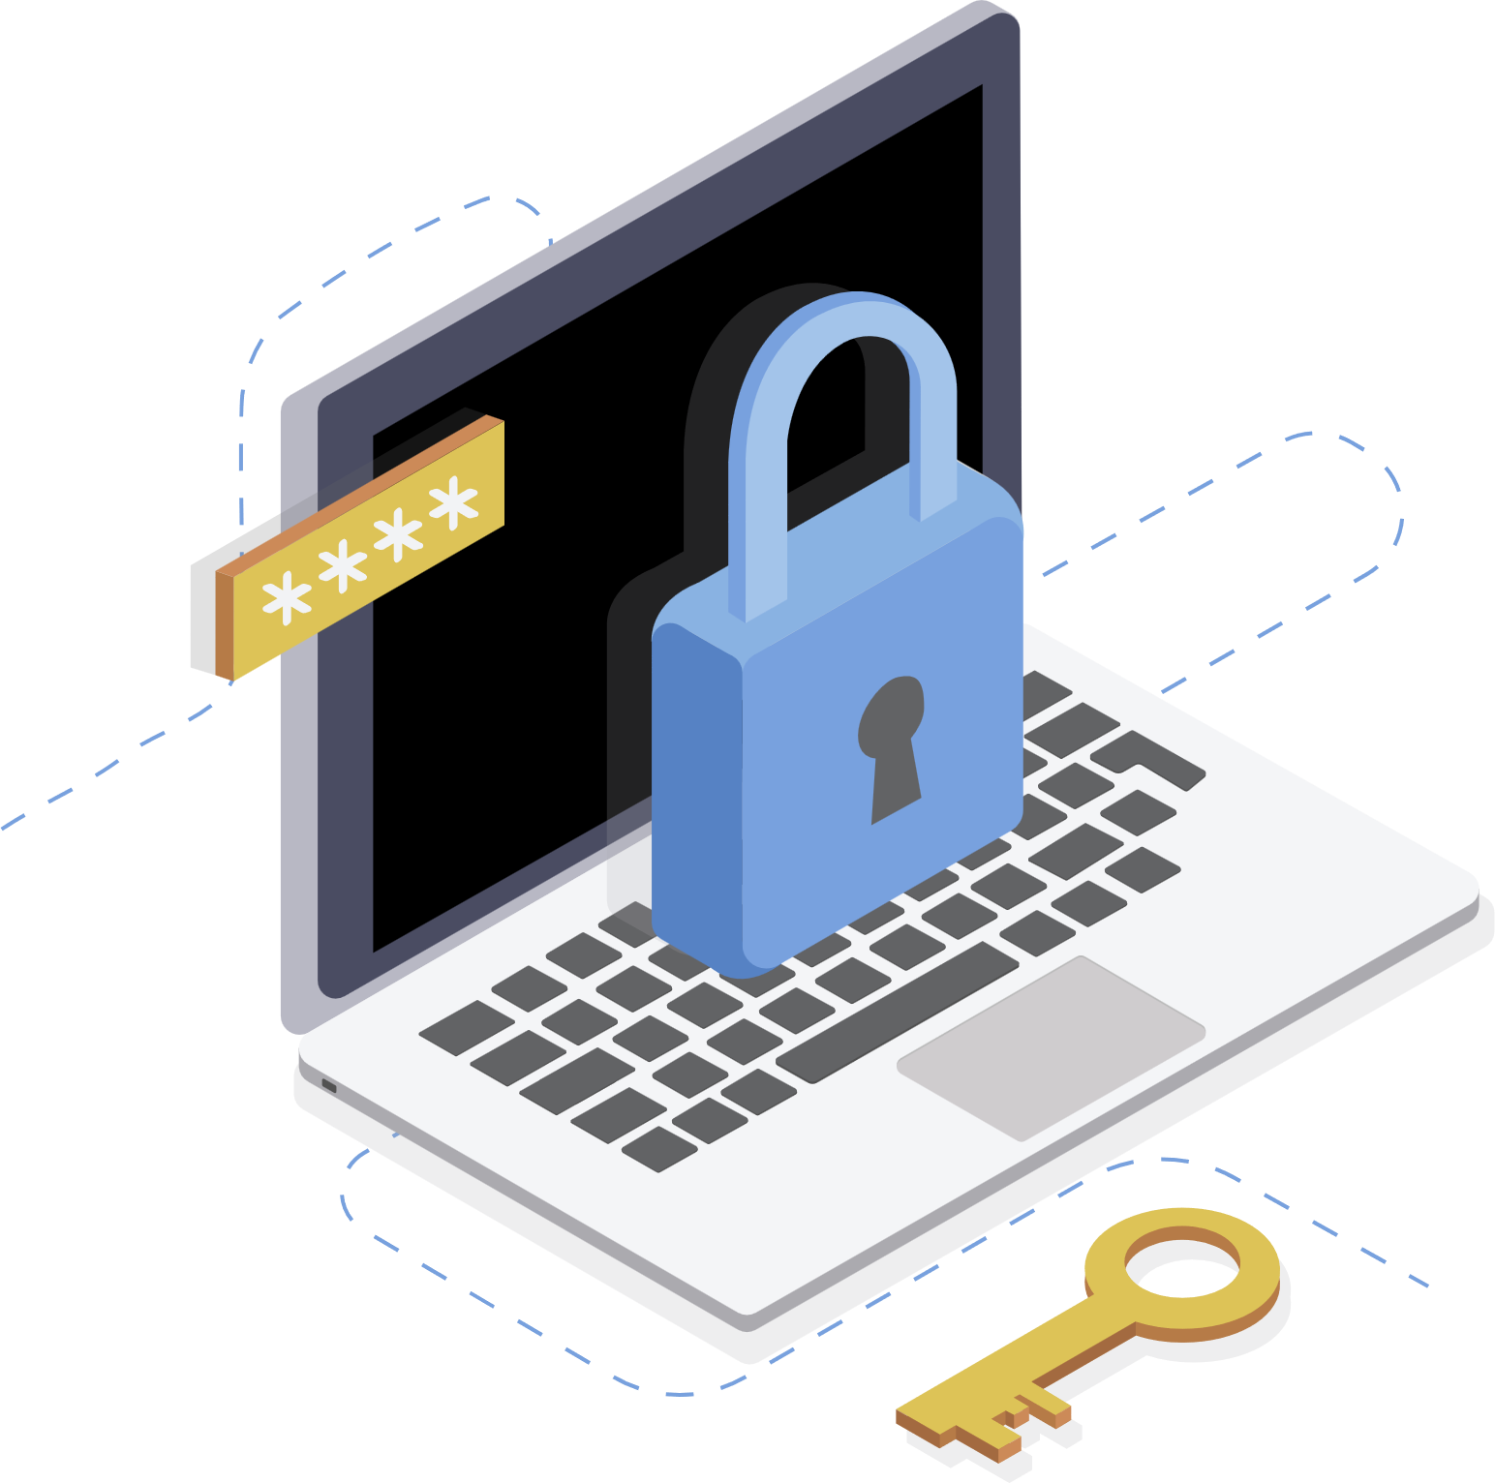
Strength of Cryptosystem
A good cryptosystem should be cost-efficient and less time-consuming.
A brute force attack is used to break a cryptosystem.
Work factor is an estimate of the effort and resources it would take an attacker to penetrate a cryptosystem.
Notes:
Trainer Notes:
Work factor is an estimate of the effort and resources it would take an attacker to penetrate a cryptosystem.
A good cryptosystem should be cost-efficient and less time-consuming.
A brute force attack is used to break a cryptosystem.

Slide 185

Cryptosystem Elements
Use an algorithm without known flaws
Use a large key size
Use all possible values within the key space as randomly as possible
Protect the actual key
Notes:
Trainer Notes:
Use an algorithm without flaws
Use a large key size
Use all possible values within the key space as randomly as possible
Protect the actual key

Slide 186


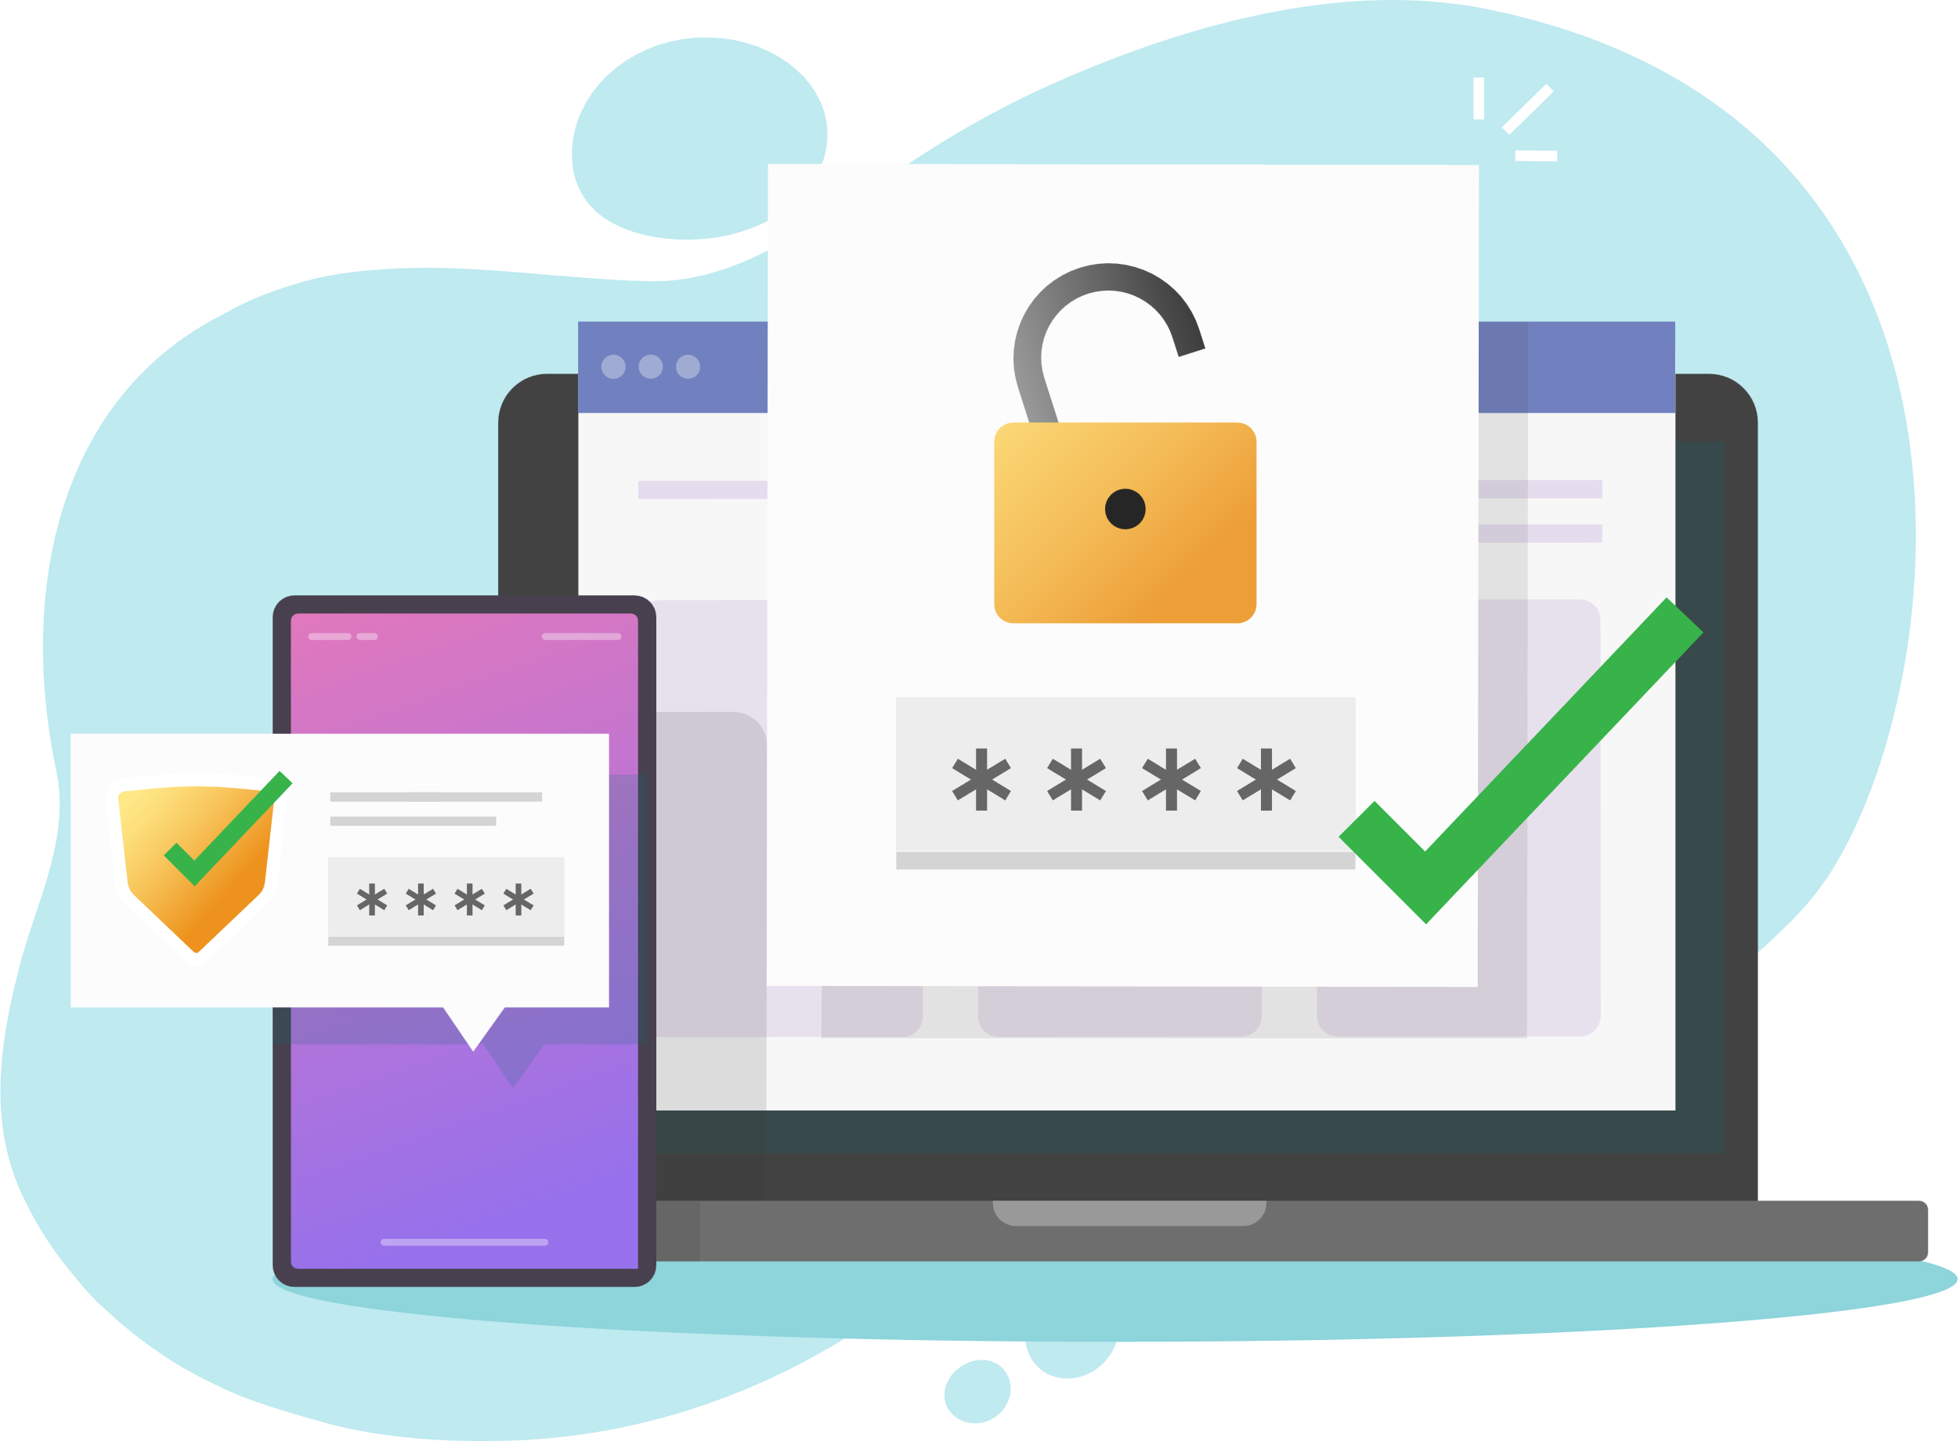

Cryptosystem Services
Cryptosystem services ensure:
Confidentiality
Integrity
Authentication
Non-repudiation
Renders the information unintelligible except by authorized entities
Ensures the data has not been altered in an unauthorized manner since it was created, transmitted, or stored
Verifies the identity of the user or the system that created the information
Ensures that the sender cannot deny sending the message
Notes:
Trainer Notes:
Use an algorithm without flaws
Use a large key size
Use all possible values within the key space as randomly as possible
Protect the actual key

Slide 187
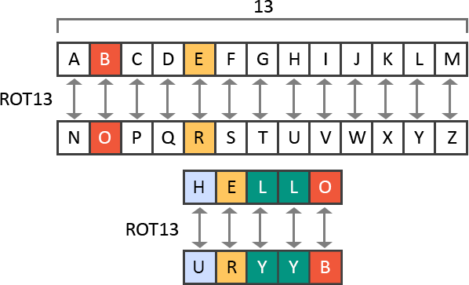
Cryptography Methods: Substitution Cipher
It works by substituting one letter for another letter based on a key.
Example: Caesar cipher or ROT13, in which the alphabet is rotated by 13 steps
The message HELLO becomes URYYB after the ROT13 substitution.
Substitution Cipher is generally used on blogs to filter certain words and in combination with other ciphers.
Notes:
Trainer Notes:
It works by substituting one letter for another letter based on a key.
Example: Caesar cipher or ROT13 in which the alphabet is rotated by 13 steps.
The message HELLO becomes URYYB after ROT13 substitution.
Substitution Cipher is generally used on blogs to filter certain words and in combination with other ciphers.

Slide 188

Cryptography Methods: Transposition Cipher
Transposes the original text with long sequences of complex substitutions and permutations
Uses a key to determine the positions the characters are moved to
Is used in combination with substitution cipher in standard ciphers
Notes:
Trainer Notes:
Transposes the original text with long sequences of complex substitutions and permutations
Uses a key to determine positions the characters are moved to
Is used in combination with substitution cipher in standard ciphers

Slide 189
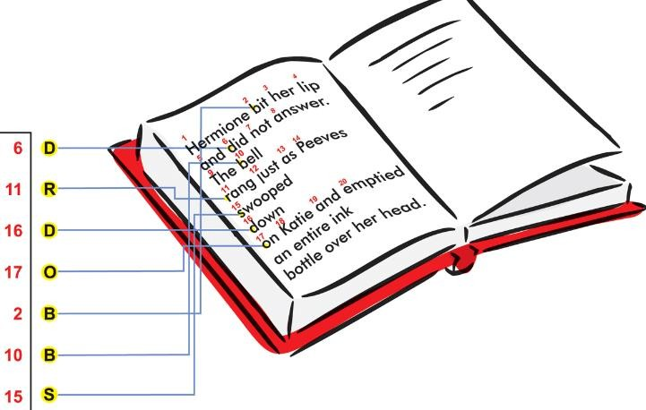
Cryptography Methods: Running Key Cipher
It could use a key that does not require an electronic algorithm and bit alterations but cleverly uses components in the physical world around you.
For instance, the algorithm could be a set of books agreed upon by the sender and receiver. The key in this type of cipher could be a book page, line number, or column count.
Notes:
Trainer Notes:
It could use a key that does not require an electronic algorithm and bit alterations, but cleverly uses components in the physical world around you.
For instance, the algorithm could be a set of books agreed upon by the sender and receiver. The key in this type of cipher could be a book page, line number, or column count.

Slide 190

Cryptography Methods: Running Key Cipher
For example, you get a message from your super-secret spy buddy, and the message reads CRYPTOGRAPHY 149l6c7.299l3c7.911l5c8.
This could mean for you to look at the 1st book in your predetermined series of books, the 49th page, the 6th line down the page, and the 7th column.
Notes:
Trainer Notes:
For example, you get a message from your super-secret spy buddy and the message reads CRYPTOGRAPHY 149l6c7.299l3c7.911l5c8.
This could mean for you to look at the 1st book in your predetermined series of books, the 49th page, the 6th line down the page, and the 7th column

Slide 191
Cryptography Methods: Concealment or Null Cipher
A concealment cipher is a message within a message. If your super-secret spy buddy and you decide the key value is every third word, then when you get a message from him, you will pick out every third word and write it down.
Example: Suppose he sends you a message that reads, The saying, The time is right is not cow language, so is now a dead subject
Because your key is every third word, you produce The right cow is dead
Notes:
Trainer Notes:
A concealment cipher is a message within a message. If your other super-secret spy buddy and you decide the key value is every third word, then when you get a message from him, you will pick out every third word and write it down.
Example: Suppose he sends you a message that reads, The saying, The time is right is not cow language, so is now a dead subject.
Because your key is every third word, you produce The right cow is dead.

Slide 192
XOR Function
XOR function returns a true value when only one of the input values is true.
A | B | XOR
0 | 0 | 0
0 | 1 | 1
1 | 0 | 1
1 | 1 | 0
If both values are false or both values are true, the output of the XOR function is false.
Notes:
Trainer Notes:
XOR function returns an actual value when only one of the input values is true.
It will give you true value only if one of the value is true. In the table in row 1 and 4 , both the value are false or true, that's why result is false
In row 2 and 4, one of the value is true and other is false , that's the result, value is true
Explain the table given on the slide.

Slide 193
MOD Function
The modulo function is quite simply the remainder value after a division operation is performed.
Number | Divisor | MOD Function
15 | 4 | 3
10 | 2 | 0
7 | 3 | 1
90 | 10 | 0
77 | 8 | 5
The modulo function is just as important to cryptography as logical operations.
Notes:
Trainer Notes:
The modulo function is quite simply the remainder value left over after a division operation is performed.
Explain the table given on the slide.

Slide 194
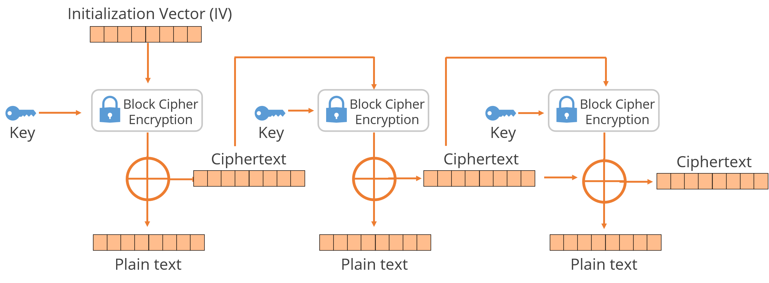
Initialization Vector (IV)
Random values are used with algorithms to ensure patterns are not created during the encryption process.
They are used with keys and need to be encrypted when being sent to the destination.
If IVs are not used, then two identical plaintext values encrypted with the same key will create the same ciphertext.
The IV and the key are both used by the algorithm to provide more randomness to the encryption process.
Notes:
Trainer Notes:
Random values are used with algorithms to ensure patterns are not created during the encryption process.
They are used with keys and need to be encrypted when being sent to the destination.
If IVs are not used, then two identical plaintext values that are encrypted with the same key will create the same ciphertext.
The IV and the key are both used by the algorithm to provide more randomness to the encryption process.

Slide 195
Steganography

Slide 196

Steganography
Steganography is the art of hiding the existence of a message.
It is used to insert digital watermarks on images to identify illegal copies.
It is used to send secret messages through emails.
It involves concealing the very existence of data by hiding it in other media such as picture, audio, and video files.
Notes:
Trainer Notes:
Steganography is the art of hiding the existence of a message.
It is used to insert digital watermarks on images to identify illegal copies.
It is used to send secret messages through emails.
It involves concealing the very existence of data by hiding it in some other media such as a picture, audio, and video file.

Slide 197
Types of Steganography
Audio steganography involves hiding secret information within an audio signal without altering its quality.
Audio steganography
Video steganography
Image steganography
Notes:
Trainer Notes:
Explain types of Steganography

Slide 198
Types of Steganography
Video steganography hides files within a cover video file. It's more secure than other methods due to video size and complexity. Frames are used to store data using the Least Significant Bit (LSB) steganography method.
Audio steganography
Video steganography
Image steganography
Notes:
Trainer Notes:
Explain types of Steganography

Slide 199
Types of Steganography
Image steganography is the art of hiding a secret message within an image file.
Audio steganography
Video steganography
Image steganography
Notes:
Trainer Notes:
Explain types of Steganography

Slide 200
Masking, Obfuscation, and Tokenization

Slide 201
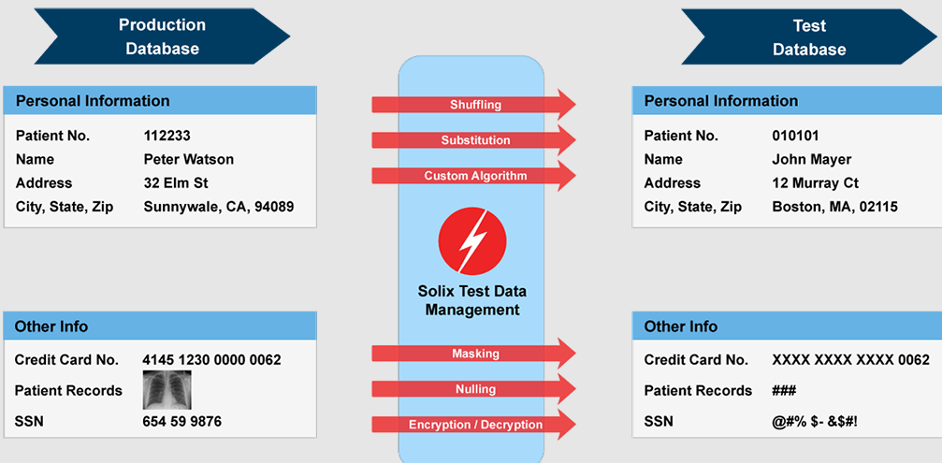
Data Masking or Obfuscation
Data masking
Data masking or obfuscation is the process of hiding, replacing, or omitting sensitive information from a specific data set.
Data masking is typically used to protect specific data sets such as PII or commercially sensitive data or to comply with certain regulations such as HIPAA or PCI DSS.
Data masking or obfuscation is also widely used for test platforms where suitable test data is unavailable.
Both techniques are typically applied when migrating tests or development environments to the cloud or when protecting production environments from threats such as data exposure by insiders or outsiders.
Notes:
Trainer Notes
Explain what is data masking
A Data masking or obfuscation, is the process of hiding, replacing, or omitting sensitive information from a specific data set.
Data masking is a data security technique used to obfuscate or hide the value of sensitive data while preserving its structure. It essentially creates a fake, but realistic, version of your original data. This masked data can then be used for purposes that don't require the real information, such as software development, user training, or sales demos

Slide 202
Data Masking Methods
Data Masking
Random substitution
Algorithm substitution
Shuffle
Masking
Deletion
Notes:
Trainer Notes:
Explain Different types of Data Masking Methods.
Details are further described in further detail in next slide

Slide 203
Data Masking Methods
The value is replaced (or appended) with a random value.
Random substitution
The idea of replacing (or appending) the value with an algorithm-generated value is called algorithmic substitution.
Algorithm substitution
This shuffles different values from the data set. It is usually from the same column.
Shuffle
Notes:
Trainer Notes:
Explain different types of Data Masking Methods in details

Slide 204
Data Masking Methods
This uses specific characters to hide certain parts of the data. It usually applies to credit card data formats: XXXX XXXX XX65 5432.
Masking
This simply uses a null value or deletes the data.
Deletion
Notes:
Trainer Notes:
Explain different types of Data Masking Methods in details

Slide 205
Types of Data Masking
Static data masking
Static data masking (SDM) permanently replaces sensitive data by altering data at rest within database copies.
Static Data Masking is designed to help organizations create a sanitized copy of their databases where all sensitive information has been altered in a way that makes the copy sharable with non-production users.
In static masking, a new copy of the data is created with the masked values.
Static masking is typically efficient when creating clean non-production environments.
Notes:
Trainer Notes
Explain different types of data masking
Static Data Masking
Static data masking (SDM) permanently replaces sensitive data by altering data at rest within database copies
Static Data Masking is designed to help organizations create a sanitized copy of their databases where all sensitive information has been altered in a way that makes the copy sharable with non-production users
In static masking, a new copy of the data is created with the masked values.
Static masking is typically efficient when creating clean nonproduction environments.

Slide 206
Types of Data Masking
Dynamic data masking
Dynamic data masking (DDM) aims to replace sensitive data in transit, leaving the original at-rest data intact and unaltered.
Dynamic masking, sometimes referred to as on-the-fly masking, adds a layer of masking between the application and the database.
This type of masking is efficient when protecting production environments.
It can hide the full credit card number from customer service representatives, but the data remains available for processing.
Notes:
Trainer Notes
Explain different types of data masking
Dynamic Masking
Dynamic data masking (DDM) aims to replace sensitive data in transit leaving the original at-rest data intact and unaltered.
Dynamic masking, sometimes called on-the-fly masking, adds a layer of masking between the application and the database.
This type of masking is efficient when protecting production environments
It can hide the full credit card number from customer service representatives, but the data remains available for processing

Slide 207
Protecting Privacy: Pseudonymization
Pseudonymization
It refers to the process of using pseudonyms to represent other data.
This approach prevents direct identification of an entity, such as a person.
For instance, in a medical record held by a doctor’s office, instead of including personal information, the patient could be referred to as Patient 23456. The doctor’s office would retain the personal information in a separate database linked to the patient’s pseudonym.
Name | Token/Pseudonym | Anonymized
Clyde | qOerd | Xxxxx
Marco | Loqfh | xxxxx
Lex | Mcv | Xxxxx
Les | Mcv | Xxxxx
Marco | Loqfh | xxxxx
Raul | BhQl | xxxxx
Clyde | qOerd | xxxxx
Notes:
Trainer Notes:
Pseudonymization
It refers to the process of using pseudonyms to represent other data.

Slide 208
Protecting Privacy: Data Anonymization
This includes information that relates specifically to an individual and can be used in isolation to uniquely identify that individual.
Examples include social security number, full name, email address, telephone number, health insurance number, medical record number, full-face photographs, or biometric records such as fingerprints.
Direct identifier
This includes information that can be combined with other information to identify specific individuals.
For example, a combination of gender, date of birth, geographic indicators, and other descriptors can be used to identify specific individuals.
Indirect identifier
Anonymization removes indirect identifiers to prevent data analysis tools or other intelligent mechanisms from collating or pulling data from multiple sources to identify sensitive information.
Data anonymization
Notes:
Trainer Notes:
Data Identifier
Direct identifiers include information that relate specifically to an individual and can be used in isolation to uniquely identify an individual.
Examples of direct identifiers include Social Security number, full name, email address, telephone number, health insurance number, medical record number, full-face photographs, or biometric record, such as fingerprints.
Indirect Identifier
Indirect identifiers include information that can be combined with other information to identify specific individuals.
For example, a combination of gender, date of birth, geographic indicators, and other descriptors.
Data Anonymization
Anonymization is the process of removing the indirect identifiers to prevent data analysis tools or other intelligent mechanisms from collating or pulling data from multiple sources to identify sensitive information.

Slide 209
Example : Anonymization
Example
Let's take an example of a person.
Direct Identifier: Adhaar card, Phone number, Credit card
Indirect Identifier: Place of birth, Company name, Designation
In today's world, even if you don’t have information about direct identifiers but a bunch of indirect identifiers, you can find information about a person using modernized tools.
Notes:
Trainer Notes

Slide 210
Protecting Privacy: Tokenization
Token
Database
Tokenization
It is the process of substituting a sensitive data element with a non-sensitive equivalent known as a token.
Tokenization is a technology that:
3
Replaces the original data with non-sensitive placeholders
Is used to safeguard sensitive data in a secure, protected, and regulated environment
Tokenization
Server
Authorized
Application
6
2
4
Application
Server
Database
1
5
Notes:
Trainer Notes:
Tokenization:
It is the process of substituting a sensitive data element with a non-sensitive equivalent referred to as a token.
Tokenization is a technology which:
Replaces the original data with non-sensitive placeholders
Is used to safeguard the sensitive data in a secure, protected, and regulated environment
Explain the image given on the screen.

Slide 211
Protecting Privacy: Tokenization
When sensitive data is needed, an authorized application or user can request it.
An application collects
or generates a piece
of sensitive data.
6
1
The application stores the token rather than the original data.
Data is sent to the tokenization server. It is not stored locally.
5
Key Features
2
The tokenization server generates the token. The sensitive data and the token are stored in the token database.
The tokenization server returns the token to the application.
4
3
Notes:
Trainer Notes:
An application collects or generates a piece of sensitive data.
Data is sent to the tokenization server. It is not stored locally.
The tokenization server generates the token. The sensitive data and the token are stored in the token database.
The tokenization server returns the token to the application.
The application stores the token rather than the original data.
When the sensitive data is needed, an authorized application or user can request it.

Slide 212
Example : Tokenization
Example
Let's take the example of Netflix, which collects credit cards from customers.
Netflix uses tokenization to secure credit card information.
The credit card details are sent to a tokenization database and replaced with a token.
Netflix stores the token instead of the actual credit card information.
When needed, Netflix uses the token to retrieve the credit card information from the tokenization database.
Notes:
Trainer Notes
Let's take the example of Netflix which collects credit card from customers.
Netflix uses tokenization to secure credit card information.
The credit card details are sent to a tokenization database and replaced with a token.
Netflix stores the token instead of the actual credit card information.
When needed, Netflix uses the token to retrieve the credit card information from the tokenization database.

Slide 213
Symmetric and Asymmetric Cryptography

Slide 214

Encryption Methods
Symmetric key algorithm
Asymmetric key algorithm
A symmetric key, also known as a secret key or private key, is a fundamental element in symmetric key cryptography.
It serves two purposes: encryption (scrambling plain text) and decryption.
Asymmetric key cryptography is also known as public-key cryptography.
It uses two keys: private keys, which are private, and public keys, which can be shared​.
Notes:
Trainer Notes:
Encryption Methods
Symmetric key, also known as a secret key or private key, is a fundamental element in symmetric key cryptography.
Asymmetric keys Asymmetric key cryptography, also known as public-key cryptography. It uses two keys private keys which is private and public keys can be shared
A single key serves two purposes: encryption (scrambling plain text) and decryption
Symmetric Key Algorithm
Asymmetric Key Algorithm

Slide 215
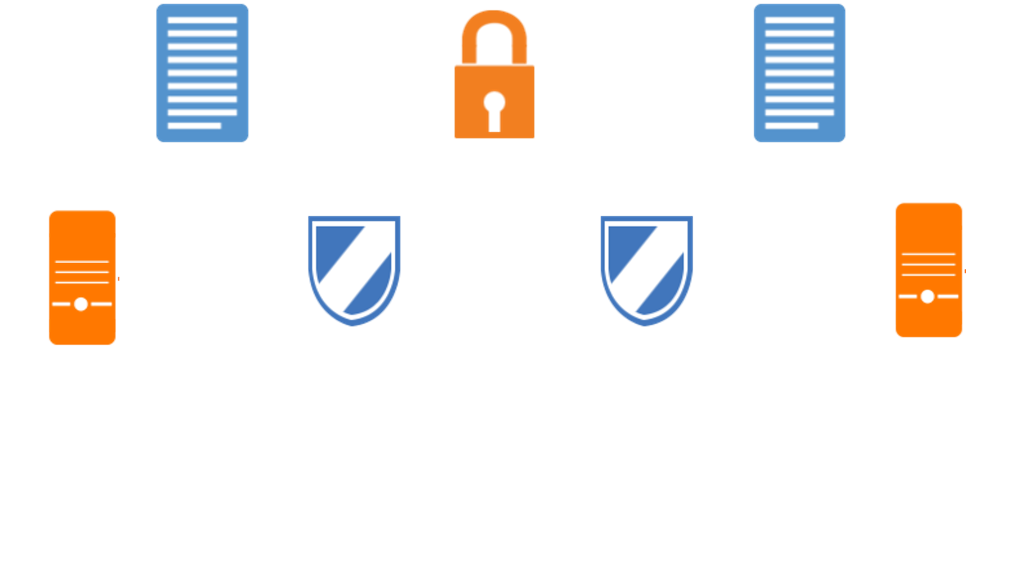

Introduction to Symmetric Cryptography
Performs both encryption and decryption of a message using only a single cryptographic key
Requires each pair of communicating users to have a copy of the key
Provides confidentiality because of the same key, but not authenticity or non-repudiation
Utilizes secret messages where confidentiality is the main criterion
Applies to wired and wireless networks
Involves n(n−1)/2 keys for secure communication
Demands keys to be securely shared between communicating parties
Includes examples such as Blowfish, AES, IDEA, RC4, RC5, RC6, DES, and 3DES
Plaintext
Ciphertext
Plaintext
Sender
Encrypt
Decrypt
Recipient
Same key is used to encrypt and decrypt messages
Shared secret key
Notes:
Trainer Notes:
Introduction to Symmetric Cryptography
Both encryption and decryption of a message performed using only a single cryptographic key
Each pair of communicating users must have a copy of the key
Can provide confidentiality because of the same key, but not authenticity or non-repudiation
Used to send secret messages where confidentiality is the main criterion
Used in wired and wireless networks
Number of keys = n(n-1)/2
Keys must be securely shared between communicating parties
Examples: Blowfish, AES, IDEA, RC4, RC5, RC6, DES, and 3DES.metric Cryptography

Slide 216

Symmetric Key Ciphers
The two primary types of symmetric key ciphers are:
Block cipher
Stream cipher
Plaintext
$mail random key
$mail random key
Block cipher encryption
Symmetric key ciphers
Stream cipher
Stream cipher
Key
Keystream
Keystream
(Pseudo-random string)
(Pseudo-random string)
Ciphertext
Plaintext
Ciphertext
Plaintext
Notes:
Trainer Notes:
Explain the diagram given on the slide.

Slide 217
Block Cipher
Converts a fixed-length block of plaintext data to a block of ciphertext data of the same length
Operates on preset blocks (64, 128, 192 bits, etc.)
Uses a combination of substitution and transposition
Is more expensive and computationally more exhaustive, although stronger than stream-based ciphers
Is mainly implemented in software
Is used in ciphers like DES and AES
Plaintext
Block cipher encryption
Key
Ciphertext
Notes:
Trainer Notes:
Block Cipher
Converts a fixed-length block of plaintext data to a block of ciphertext data of the same length
Text is operated on preset blocks (64,128,192 bits, etc.)
A combination of substitution and transposition is used
Although stronger than stream-based ciphers, it is more expensive and computationally more exhaustive
Mainly implemented in software
Used in ciphers like DES and AES

Slide 218
Stream Cipher
A stream of ciphertext data is generated by combining the keystream (sequence of bits) with plaintext data bit by bit using XOR operations.
The keystream must have a non-repeating pattern of bits to ensure security.
Stream ciphers are mainly implemented in hardware.
They are most commonly used in voice or video communications.
1
0
1
1
Keystream
Plaintext
1
0
1
1
0
0
0
0
Ciphertext
Notes:
Trainer Notes:
A stream of ciphertext data is generated by combining the keystream (sequence of bits) with plaintext data bit by bit using XOR operations
To ensure security, keystream must have a non-repeating pattern of bits
Mainly implemented in hardware
Most common in voice or video

Slide 219
Stream Cipher vs. Block Cipher
Faster than block cipher
Processes the input element continuously producing output, one element at a time
Requires less code
With steam cipher, keys can be used only once
Application: SSL (Secure connection on the Web)
Easier to implement in hardware
Operates on a larger block of data
Slower than stream cipher
Processes one block at a time, producing output for each input block
Requires more code
Reuse of key is possible
Example: DES encryption
Application: Database, file encryption
Easier to implement in software
Stream cipher
Block cipher
Notes:
Trainer Notes:
Stream Cipher
Faster than block cipher
Processes the input element continuously producing output, one element at a time
Requires less code
With steam cipher, keys can be used only one time
Application: SSL (Secure connection on Web)
Easier to implement in hardware
Block Cipher
Operates on larger block of data
Slower than stream cipher
Processes one block at a time, producing output for each input block
Requires more code
Reuse of key is possible
Example: DES encryption
Application: Database, file encryption
Easier to implement in software

Slide 220
Advanced Encryption Standard (AES)
Advanced Encryption Standard (AES) is a symmetric block cipher.
AES is the current U.S. standard.
For encryption, it uses:
128-bit keys (10 rounds of encryption)
192-bit keys (12 rounds of encryption)
256-bit keys (14 rounds of encryption)
AES uses the Rijndael algorithm with variable block sizes (128, 192, and 256-bit) and key lengths (128, 192, and 256-bit).
a_{0,0} | a_{0,1} | a_{0,2} | a_{0,3}
a_{1,0} | a_{1,1} | a_{1,2} | a_{1,3}
a_{2,0} | a_{2,1} |  | a_{2,3}
a_{3,0} | a_{3,1} | a_{3,2} | a_{3,3}
b_{0,0} | b_{0,1} | b_{0,2} | b_{0,3}
b_{1,0} | b_{1,1} | b_{1,2} | b_{1,3}
b_{2,0} | b_{2,1} |  | b_{2,3}
b_{3,0} | b_{3,1} | b_{3,2} | b_{3,3}
SubBytes
a_{2,2}
b_{2,2}
S
Notes:
Trainer Notes:
Advanced Encryption Standard (AES) is a symmetric block cipher.
AES is the current U.S. standard.
For encryption it uses:
128-bit keys (10 rounds of encryption)
192-bit keys (12 rounds of encryption)
256-bit keys (14 rounds of encryption)
AES uses the Rijndael algorithm with variable block sizes (128, 192, and 256-bit) and key lengths (128, 192, and 256-bit).

Slide 221
Other Symmetric Systems
Stands for International Data Encryption Algorithm
Uses 64-bit blocks, a 128-bit key, and 8 rounds of computations
Used in e-mail encryption software, pretty good privacy (PGP)
IDEA
Uses a 64-bit block size
32 – 448 bits (in steps of 8 bits) key size and 16 rounds of computation
Optimized for 32-bit microprocessors
Blowfish
Is a modification of Blowfish using 128-bit blocks
Uses variable key lengths up to 256 bits
Twofish
Notes:
Trainer Notes:
IDEA
Stands for International Data Encryption Algorithm
Uses 64-bit blocks, a 128-bit key, and 8 rounds of computation
Used in e-mail encryption software, pretty good privacy (PGP)
Blowfish
Uses a 64-bit block size
32 – 448 bits (in steps of 8 bits) key size and 16 rounds of computation
Optimized for 32-bit micro-processors
Twofish
Is a modification of Blowfish using 128-bit blocks
Uses variable key length up to 256 bits

Slide 222
Other Symmetric Systems
Uses block sizes of 32, 64, or 128 bits, with a key length of up to 2040 bits​
Created as a candidate algorithm for AES
RC5
Uses key sizes of 128, 192, and 256 bits and has a block size of 128 bits​
Based on RC5, and is also a candidate for AES
RC6
Notes:
Trainer Notes:
RC5
Uses block sizes of 32, 64, or 128-bits, with key length up to 2040-bits
Created as a candidate algorithm for AES
RC6
Uses key size of 128, 192, and 256-bits and has a block size of-128 bits
Based on RC5 and was also a candidate for AES

Slide 223
Symmetric Keys: Round Up
Algorithm | Block Size | Key Length | Comments
DES | 64 bit | 56 bit + 8-bit parity | 16 rounds of processing
2DES | 64 bit | 112 bit | Compromised by meet-in- the-middle attack
3DES | 64 bit | 168 bit
Rijndael | 128,192,256 bits | 128,192,256 bits | Performs variable rounds of operation
IDEA | 64 bit | 128 bit | 8 rounds transposition and substitution Used in PGP
CAST | 64 bit | 40 to 128 bits
SAFER | 64 to 128 bit | 64 to 128 bit | A version used in Bluetooth
Blowfish | 64 bit | Variable key size
Twofish | 128 bit | 128, 192, 256 bits
RC5 | 16,32,64 bits | 0 to 2040 bits
AES | 128 bit | 128, 192, 256 bits
Notes:
Trainer Notes:
Explain the table given on the slide.

Slide 224

Business Scenario
Hilda Jacobs, the general manager of IT Security, assigned Kevin Butler the task of selecting a good encryption system to secure the confidentiality of the company’s data. She requested a symmetric block cipher system capable of encrypting with a 128-bit encryption key.
Kevin started gathering information about the existing encryption standards. Based on the current and future requirements, he had to choose between DES, 3DES, and AES.
Question: Which encryption standard should Kevin select: the DES, 3DES, or AES?
Notes:
Trainer Notes:
Go through the scenario and ask the given question to the learners.

Slide 225
Business Scenario
Hilda Jacobs, the general manager of IT Security, assigned Kevin Butler the task of selecting a good encryption system to secure the confidentiality of the company’s data. She requested a symmetric block cipher system capable of encrypting with a 128-bit encryption key.
Kevin started gathering information about the existing encryption standards. Based on the current and the future requirements, he had to choose between DES, 3DES, and AES.
Question: Which encryption standard should Kevin select: the DES, 3DES, or AES?
Answer: With the given requirement, AES is the best choice as it supports a 128-bit key.
Notes:
Trainer Notes:
Explain the answer given on the slide.

Slide 226

Introduction to Asymmetric Cryptography
In asymmetric cryptography, two keys are used that are mathematically linked but mutually exclusive. One key is for encryption, and the other is for decryption.
The private key can be used by an individual or entity, while the public key can be freely shared with anyone you want to communicate.
Notes:
Trainer Notes:
In asymmetric cryptography, two keys are used that are linked mathematically but are mutually exclusive. One key is for encryption, and the other is for decryption.

Slide 227
Introduction to Asymmetric Cryptography
Asymmetric cryptography is also called public-key encryption, as one key is made public.
A pair of keys is required for encryption or decryption.
The keys are mathematically related.
Each key is used to encrypt or decrypt.
You cannot encrypt or decrypt with only one key. The public key is usually shared, while the private key is secured by the owner.
Secure Message format: The message is encrypted with the receiver's public key (confidentiality).
Open Message format: The message is encrypted with the sender’s private key (authenticity).
These formats ensure authenticity, confidentiality, and non-repudiation.
Examples: RSA (Rivest-Shamir-Adleman), Diffie-Hellman, Elliptic curve cryptosystem (ECC), El Gamal, and Digital signature algorithm (DSA)
Notes:
Trainer Notes:
Asymmetric cryptography is also called public-key encryption as one key is made public.
A pair of keys is required for encryption or decryption.
The keys are mathematically related.
Each key is used to encrypt or decrypt.
You cannot encrypt or decrypt with only one key.
The public key is usually shared, while the private key is secured by the owner.
Secure Message format: The message is encrypted with the receiver's public key (confidentiality).
Open Message format: The message is encrypted with the sender’s private key (authenticity).
This provides authenticity, integrity, and non-repudiation.
Examples: RSA, Diffie-Hellman, Elliptic curve cryptosystem (ECC), El Gamal, and Digital signature algorithm (DSA).

Slide 228
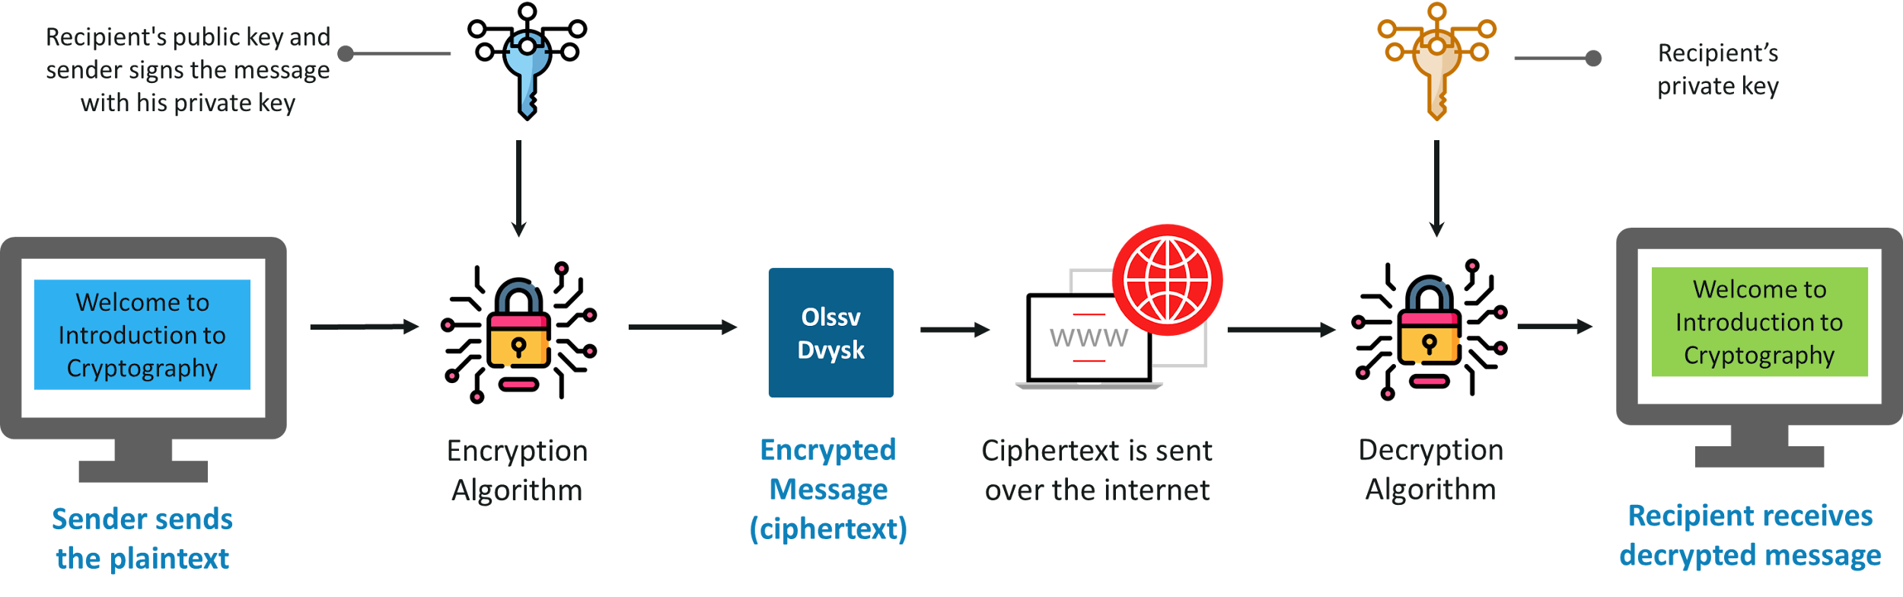
Introduction to Asymmetric Cryptography—Diagram

Slide 229
Goal of Asymmetric Cryptography
Authentication
Confidentiality
Assures the ability to authenticate the identity of communicating entities
Assures the ability to send data in a secure or confidential manner
Non-repudiation
Assures the ability to not allow or deny sending the data​
Notes:
Trainer Notes:
The identity and access provisioning lifecycle must be maintained and secured.
Provisioning:
Create new accounts
Provision them with appropriate rights and privileges
Review:
Check accounts periodically
Disable inactive accounts
Check for excessive and creeping privileges
Deprovisioning:
Disable an account as soon as an employee leaves
Set account expiry date for temporary accounts
Delete an expired account as per organization policy

Slide 230

Asymmetric Cryptography -Pros and Cons
Pros
Cons
Scalable
Provides confidentiality, authentication, and non-repudiation
Better key distribution mechanism
Slower than symmetric key
Mathematically complex and intensive
Notes:
Trainer Notes:
The identity and access provisioning lifecycle must be maintained and secured.
Provisioning:
Create new accounts
Provision them with appropriate rights and privileges
Review:
Check accounts periodically
Disable inactive accounts
Check for excessive and creeping privileges
Deprovisioning:
Disable an account as soon as an employee leaves
Set account expiry date for temporary accounts
Delete an expired account as per organization policy

Slide 231


Secure Message Format
Charles wants to send data to Alice that should only be read by her.
Charles
Alice
Notes:
Trainer Notes:
Explain the flow of asymmetric cryptography in secure message format where the objective of communication is confidentiality

Slide 232



Secure Message Format
Charles generates a private and public key pair and exchanges his public key with Alice's public key.
Similarly, Alice will also generate a private and public key pair and exchange her public key with Charles's public key.
Alice Public Key
Charles Public Key
Charles Private Key
Alice Private Key
Charles
Alice
Notes:
Trainer Notes:
Explain the flow of asymmetric cryptography in secure message format where the objective of communication is confidentiality

Slide 233






Secure Message Format
After the exchange, Charles has his private key along with Alice's public key​.​
Similarly, Alice has her private key along with Charles's public key.
May the force with you
Avce1ksldldnasd#$sdvdee
Avce1ksldldnasd#$sdvdee
May the force with you
Charles
Alice
To ensure confidentiality, Charles will encrypt the data using Alice's public key.
Alice will decrypt the data using her private key, which ensures confidentiality.
Notes:
Trainer Notes:
Explain the flow of asymmetric cryptography in secure message format where the objective of communication is confidentiality

Slide 234
Secure Message Format- Summarized View
Step 1
User A and User B want to communicate using asymmetric cryptography.
Step 2
User A will generate a private key and a public key on their system.
Step 3
User B will generate a private key and a public key on their system.
Step 6
User B will use their private key to decrypt the data, ensuring confidentiality.
Step 5
User A will encrypt the data using User B's public key and send it to User B.
Step 4
User A and User B exchange each other's public keys.
Notes:
Trainer Notes:
Explain the flow of asymmetric cryptography in secure message format where the objective of communication is confidentiality

Slide 235

Open Message Format
Charles wants to send data to Alice, ensuring she can authenticate him as the sender and cannot deny receiving the message.
Charles
Alice
Notes:
Trainer Notes:
Explain the flow of asymmetric cryptography in open message format where objectives of communication are authentication and Non Repudiation

Slide 236

Open Message Format
Charles’ generates private and public keys and exchanges his public key with Alice's public key​.
Similarly, Alice will also generate private and public keys and exchange her public key with Charles' public key​.
Alice public key
Charles public key
Charles
Charles private key
Alice private key
Alice
Notes:
Trainer Notes:
Explain the flow of asymmetric cryptography in open message format where objectives of communication are authentication and Non Repudiation

Slide 237

Open Message Format
After the exchange, Charles has his private key along with Alice's public key.
Similarly, Alice has her private key along with Charles's public key.
May the force with you
Avce1ksldldnasd#$sdvdee
Avce1ksldldnasd#$sdvdee
May the force with you
Charles
Alice
To assure authentication and non-repudiation, Charles will encrypt the data using his private key
Alice will decrypt using Charles's public key, ensuring authentication and non-repudiation.
Notes:
Trainer Notes:
Explain the flow of asymmetric cryptography in open message format where objectives of communication are authentication and non-repudiation

Slide 238
Open Message Format- Summarized View
Step 1
User A and User B want to communicate using asymmetric cryptography.
Step 2
User A will generate a private key and a public key on their system.
Step 3
User B will generate a private key and a public key on their system.
Step 6
User B will use the public key of User A to decrypt data, ensuring authentication and non-repudiation.
Step 5
User A will encrypt data using the private key of User A and send it to
User B.
Step 4
User A and User B exchange each other's public keys.
Notes:
Trainer Notes:
Explain the flow of asymmetric cryptography in open message format where objectives of communication are authentication and Non Repudiation

Slide 239
Introduction to RSA Algorithm
RSA stands for Ron Rivest, Adi Shamir, and Leonard Adleman, the inventors of this algorithm.
RSA:
Is a worldwide de facto standard
Provides digital signatures, encryption, and secret key distribution
Is based on the difficulty of factoring the product of two large prime numbers (up to 200 digits long), thereby making the cryptosystem difficult to crack
Is used in web browsers with SSL, systems that use public-key cryptosystems
Notes:
Trainer Notes:
RSA stands for Ron Rivest, Adi Shamir, and Leonard Adleman, the inventors of this algorithm.
RSA:
Provides digital signatures, encryption, and secret key distribution
Used in web browsers with SSL, systems that use public-key cryptosystems
Is based on the fact that factoring the two large prime numbers’ (up to 200 digits long) product forms is difficult; hence, difficult to crack the cryptosystem
Is a worldwide de facto standard

Slide 240
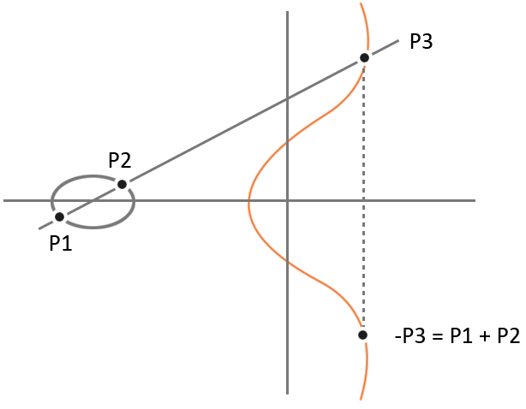
Other Types of Asymmetric Cryptography: Elliptic Curve Cryptosystems
Instead of generating keys as the product of very large prime numbers, ECC generates keys through the properties of the elliptic curve equation.
An ECC key of 160 bits provides the same protection as a 1024-bit RSA key.
ECC is more efficient than RSA.
It provides encryption, digital signature, and key exchange.
It is used in devices with limited processing, storage, and bandwidth capacity.
Examples: Wireless and cell phone
Notes:
Trainer Notes:
Instead of generating keys as the product of very large prime numbers, ECC generates keys through the properties of the elliptic curve equation.
An ECC key of 160 bits provides the same protection as a 1024-bit RSA key.
ECC is more efficient than RSA.
It provides encryption, digital signature, and key exchange.
It is used in devices with limited processing, storage, and bandwidth capacity.
Examples: Wireless and cell phone

Slide 241
Advantages and Disadvantages
Types of cryptography | Advantages | Disadvantages
Symmetric cryptography | Very fast to encrypt or decrypt, secure, and affordable Optimal for encrypting large files | Presents the challenge of key management Lacks authenticity and non-repudiation
Asymmetric cryptography | Provides better key distribution than symmetric systems Provides better scalability due to ease of key distribution Provides authenticity and non-repudiation, in addition to confidentiality | Much slower operation than symmetric systems More vulnerable to man-in-the-middle attacks
Notes:
Trainer Notes:
Explain advantages and disadvantages of Symmetric and Asymmetric Algorithm

Slide 242
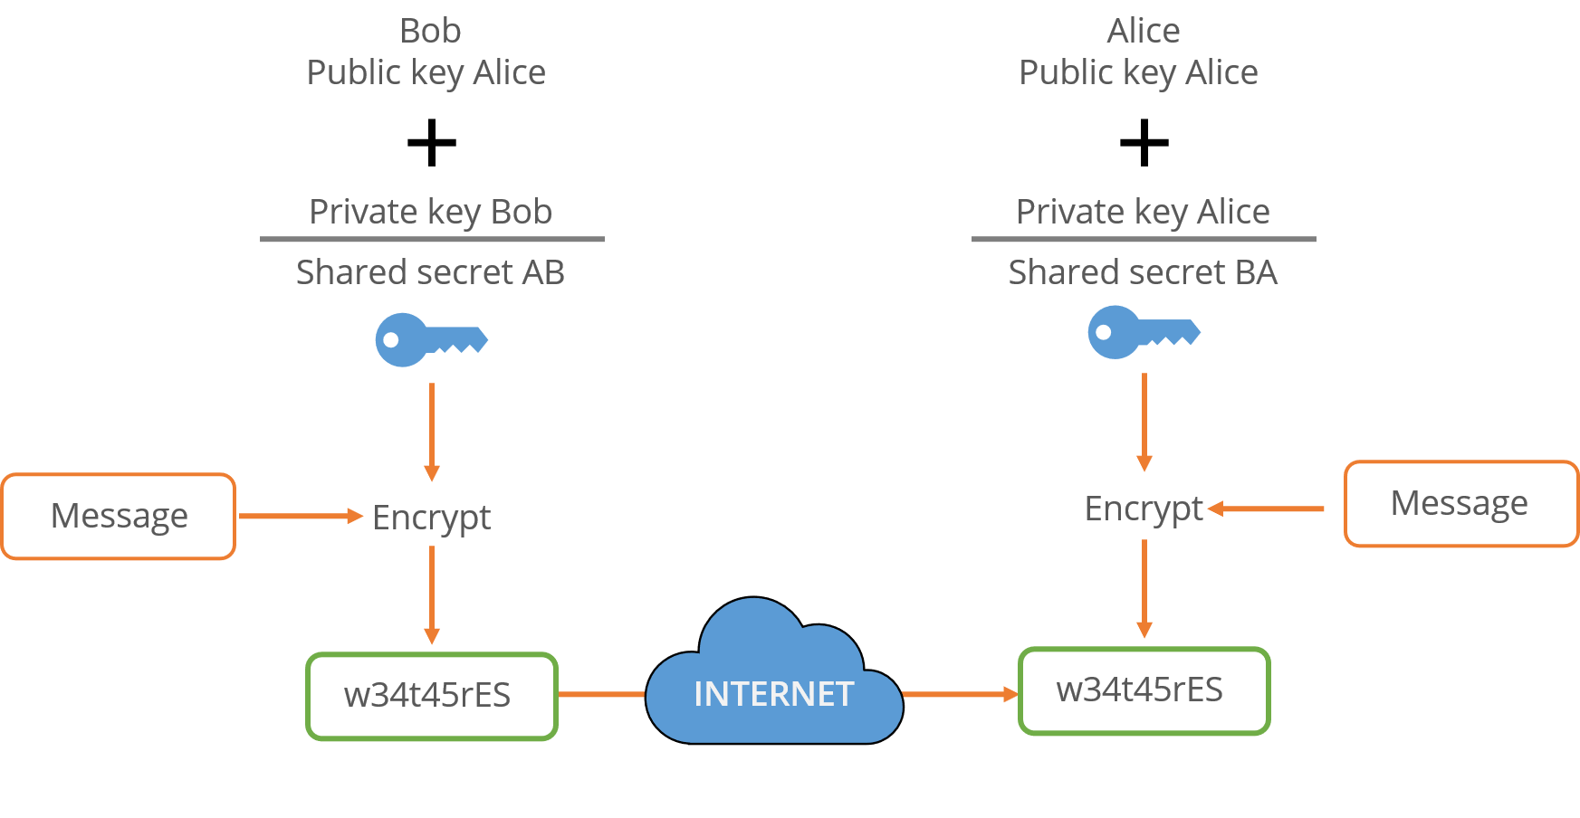
Other Types of Asymmetric Cryptography: Diffie-Hellman Key Exchange
A key distribution asymmetric algorithm
A protocol whereby two or more parties can agree on a key in such a way that both influence the outcome
Allows two users to exchange a secret key
Requires no prior secrets
Does not provide for encryption or digital signature functions
Notes:
Trainer Notes:
A key distribution asymmetric algorithm
A protocol whereby two or more parties can agree on a key in such a way that both influence the outcome
Allows two users to exchange a secret key
Requires no prior secrets
Does not provide for encryption or digital signature functions

Slide 243

Other Types of Asymmetric Cryptography: Diffie-Hellman Key Exchange
Vulnerable to man-in-the-middle attack
Based on the difficulty of calculating discrete logarithms in a finite field
Currently used in many protocols, namely:
Secure Sockets Layer (SSL) or Transport Layer Security (TLS)
Secure Shell (SSH)
Internet Protocol Security (IPSec)
Public Key Infrastructure (PKI)
Notes:
Trainer Notes:
Vulnerable to man-in-the-middle attack
Based on the difficulty of calculating discrete logarithms in a finite field
Currently used in many protocols, namely:
Secure Sockets Layer (SSL) or Transport Layer Security (TLS)
Secure Shell (SSH)
Internet Protocol Security (IPSec)
Public Key Infrastructure (PKI)

Slide 244
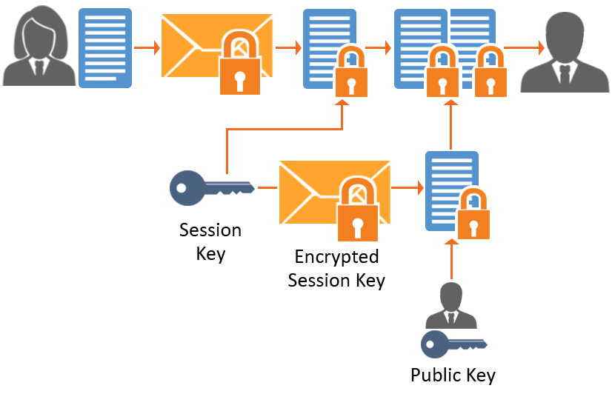
Hybrid Cryptography
A hybrid system that combines the symmetric and asymmetric methods
The more efficient symmetric algorithm encrypts a message using a secret key
The symmetric secret key is encrypted using recipient’s public key with an asymmetric algorithm
The message encrypted with that secret key and the encrypted symmetric secret key are sent to the recipient
Notes:
Trainer Notes:
Explain Hybrid Cryptography where symmetric and asymmetric cryptography are used together to encrypt bulk data using symmetric cryptography and asymmetric cryptography to share the keys in secure manner

Slide 245
Hybrid Cryptography
The recipient uses their private key to decrypt the secret key.
The secret key is then used to decrypt the message.
A symmetric algorithm is used for bulk encryption.
The asymmetric algorithm is used to distribute the symmetric key.
Notes:
Trainer Notes:
Explain Hybrid Cryptography where symmetric and asymmetric cryptography are used together to encrypt bulk data using symmetric cryptography and asymmetric cryptography to share the keys in secure manner

Slide 246
Hybrid Cryptography
Charles wants to send bulk data to Alice and ensure that only she can read it.
Charles
Alice
Notes:
Trainer Notes:
Explain the flow of asymmetric cryptography in secure message format where the objective of communication is confidentiality

Slide 247
Hybrid Key Cryptography
Charles generates a private and public key pair and exchanges his public key with Alice's public key.
Similarly, Alice will also generate a private and public key pair and exchange her public key with Charles's public key.
Alice public key
Charles public key
Charles private key
Alice private key
Charles
Alice
Notes:
Trainer Notes:
Explain the flow of asymmetric cryptography in secure message format where the objective of communication is confidentiality

Slide 248




Communication Process at Sender’s End
The symmetric key is then encrypted with Alice's public key.
Encrypted symmetric key
Encrypted data
Symmetric key
Alice public key
I Pass CISSP
a3421hjkgds
a3421hjkgds
Charles
Charles generates a symmetric key and uses it to encrypt bulk data.
Symmetric key
The encrypted symmetric key and encrypted data are being sent to Alice.
Alice
Notes:
Trainer Notes:
Explain Hybrid Cryptography where symmetric and asymmetric cryptography are used together to encrypt bulk data using symmetric cryptography and asymmetric cryptography to share the keys in secure manner

Slide 249


Communication Process at Receiver’s End
Encrypted symmetric key
Alice private key
Original message
Symmetric key
a3421hjkgds
a3421hjkgds
I Pass CISSP
Alice
Alice received encrypted data and an encrypted symmetric key.
Alice will decrypt the encrypted symmetric key with her private key.
Alice then uses the symmetric key received from Charles to decrypt encrypted data.
Notes:
Trainer Notes:
Explain Hybrid Cryptography where symmetric and asymmetric cryptography are used together to encrypt bulk data using symmetric cryptography and asymmetric cryptography to share the keys in secure manner

Slide 250
Hybrid Cryptography-Digital Envelope
Step 1
A generates symmetric key, and it encrypts bulk data using a symmetric key
Step 2
User A wants to send a symmetric key and encrypted data securely to User B
Step 3
User A will encrypt the symmetric key with public key of receiver
Step 4
User A will generate a private key and a public key on their system
Step 5
User B will generate a private key and a public key on their system
Step 6
User A and User B exchange each other’s public key
Step 7
User A encrypts the symmetric key with public key of B and sends the encrypted key and data to User B
Step 9
User B will decrypt bulk data using a symmetric key
Step 8
User B decrypts the symmetric key using its own private key
Notes:
Trainer Notes:
Explain Hybrid Cryptography where symmetric and asymmetric cryptography are used together to encrypt bulk data using symmetric cryptography and asymmetric cryptography to share the keys in secure manner

Slide 251
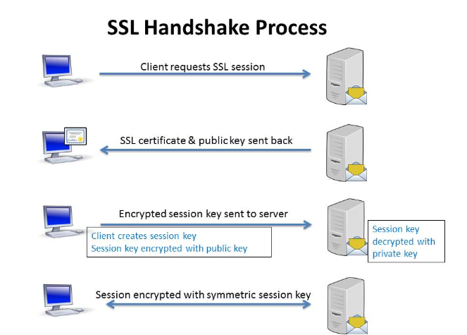
SSL or TLS
Step 1
The client browser requests a TLS or SSL session from the server.
Step 2
The TLS certificate and the server's public key are sent to the client.
Step 3
The client generates a session key, encrypts this session key with the server’s public key, and sends it to the server.​
Step 4
The server, on receiving the encrypted session key, performs the decryption process with its private key.
Step 5
The client now sends the data encrypted with the session key, and the server already has a session key that it uses to decrypt the actual data.​
Notes:
Trainer Notes:
Explain TLS in diagram

Slide 252

Session Key
A single-use symmetric key is used to encrypt or decrypt communication between two users for a single session.
It’s more secure than static symmetric keys.
Peers decide on the session key and continue to use it until the session is over.
Eavesdropping is difficult here, and attempting to break the keys is futile.
Notes:
Trainer Notes:
A single-use symmetric key is used to encrypt or decrypt communication between two users for a single session.
It’s more secure than static symmetric keys.
Here, peers decide on the session key and continue to use it till the session is over.
Here, eavesdropping is difficult and breaking the keys will prove to be futile.

Slide 253
Hashing Process

Slide 254
One-Way Hash
A hash function uses an algorithm without any key for encryption. This encryption cannot be reversed and hence is called one-way.
A fixed-length hash value (message digest or hash) is created or hashed from variable-length plaintext.
When the plaintext changes, its hash value also changes. Thus, hash functions are used to provide integrity.
It guarantees the integrity of data.
It can be applied to data blocks of any size.
It produces a fixed-length output.
Hashing of data
Variable length original data
Fixed length digest data
Notes:
Trainer Notes:
A hash function uses an algorithm without any key for encryption. This encryption cannot be reversed and hence is called one-way.
A fixed-length hash value (message digest or hash) is created or hashed from variable length plaintext.
When the plaintext changes, its hash value also changes. Thus, for providing integrity, hash functions are used.
Hash is used to guarantee the integrity of data.
It can be applied to data block of any size.
It produces fixed-length output.

Slide 255

One-Way Hash
Characteristics:
The Hash should be computed over the entire message.
The Hash should be a one-way function.
Given a message and hash value, computing another message with the same value should be impossible.
It should be resistant to birthday attacks.
Notes:
Trainer Notes:
One-Way Hash
Characteristics
Hash should be computed over the entire message.
Hash should be a one-way function.
Given a message and hash value, computing another message with the same hash value should be impossible.
It is resistant to birthday attacks.

Slide 256

Hashing Process
Charles wants to send an email to Alice and ensure that it is not tampered with during transit.
Charles
Alice
Notes:
Trainer Notes:
Explain Hashing process

Slide 257

Hashing Communication Process at Sender’s End
a3421hjkgds
a3421hjkgds
Charles inputs an email into the hashing algorithm.
A fixed-length digest is created as an output.
A fixed-length digest is appended to the email and sent to the receiver.
Charles
Alice
Notes:
Trainer Notes:
Explain Hashing process

Slide 258



Hashing Communication Process at Receiver’s End
a3421hjkgds
a3421hjkgds
a3421hjkgds
a3421hjkgds
Alice
Alice, on receiving the email appended with hash, will separate email and hash digest.
Alice will input the email received from Charles into the hashing algorithm, and a fixed-length digest will be created again.
Fixed length digest created at the receiver end and that is received from the sender will be compared.
If they are the same, no tampering happens in transit.
Notes:
Trainer Notes:
Explain Hashing process

Slide 259
Hashing Process Summarized - Integrity
Step 1
User A wants to send an email to User B and ensure that the email is not tampered with in transit.
Step 6
User B removes the digest and feeds the email back into the hashing algorithm.
Step 7
The email received from User A will be fed into a hashing algorithm at the receiving end, which will produce a message digest as output.
Step 2
User A feeds the email into an MD5 or SHA hashing algorithm.
Step 5
User B receives an email along with the digest.
Step 8
Both message digests will be compared; if they are the same, then the data has not been tampered with.
Step 3
A hashing algorithm processes an email and produces a fixed-length digest as output (MD5 128 B, SHA 160).
Step 4
User A appends this digest to the email and sends it to User B.
Notes:
Trainer Notes:
Explain Hashing process

Slide 260
Hashing Algorithms
A hash function is any algorithm or subroutine that maps large data sets of variable length to smaller data sets of a fixed length.
The most widely used hash algorithm in the MD (Message-Digest Algorithm) family.
It is harder to break; for any input length, it creates a 128-bit hash value.
MD5:
Belongs to the Secure Hash Algorithm (SHA) family
Generates a 160-bit hash value
SHA-2 includes SHA-224, SHA-256, SHA-384, and SHA-512, termed after the length of the hash value each creates
SHA-1:
Notes:
Trainer Notes:
A hash function is any algorithm or subroutine that maps large data sets of variable length to smaller data sets of a fixed length.
MD5
Most widely used of the MD (Message-Digest Algorithm) family of hash algorithms
Harder to break; for input of any length, it creates a 128-bit hash value
SHA-1
Belongs to the Secure hash algorithm (SHA) family
Generates a 160-bit hash value
SHA-2 includes SHA-224, SHA-256, SHA-384, and SHA-512, termed after the length of the hash value each creates

Slide 261
Application of Hashing
Password verification
Signature verification
Data integrity checks
Storing passwords in normal text files is dangerous, which is why almost all sites store passwords as hashes.
Generating and verifying signatures is a mathematical process used to verify the authenticity of digital documents or messages.
Data integrity checks are a crucial application of hashing. They involve generating checksums for data files, which provide users with assurance about the correctness of the data.
Notes:
Trainer Notes:
Explain Application of Hashing
Password Verification
Signature Verification
Data Integrity Checks

Slide 262
Digital Signatures
Are used for signing the document cryptographically
To digitally sign the data:
Create a hash of the data
Encrypt that hash with the sender's private key
To verify the digital signature:
Hash the data
Find the sender’s public key
Decrypt the signature with the sender's public key
Check whether the hash you have created matches the hash you received
Hashing provides message integrity; signing of hash provides authentication and non-repudiation
Involve encrypting the hash value of a message with a private key
Digital signatures:
Notes:
Trainer Notes:
Digital signatures :
Are used for signing the document cryptographically
To digitally sign the data:
Create the hash of a data
Encrypt that hash with the sender's private key
To verify the digital signature:
Hash the data
Find the sender’s public key
Decrypt the signature with the sender's public key
Check whether the hash you have created matches the hash which you received
Hashing provides message integrity; signing of hash provides authentication, and non-repudiation
Involve encrypting the hash value of a message with a private key

Slide 263
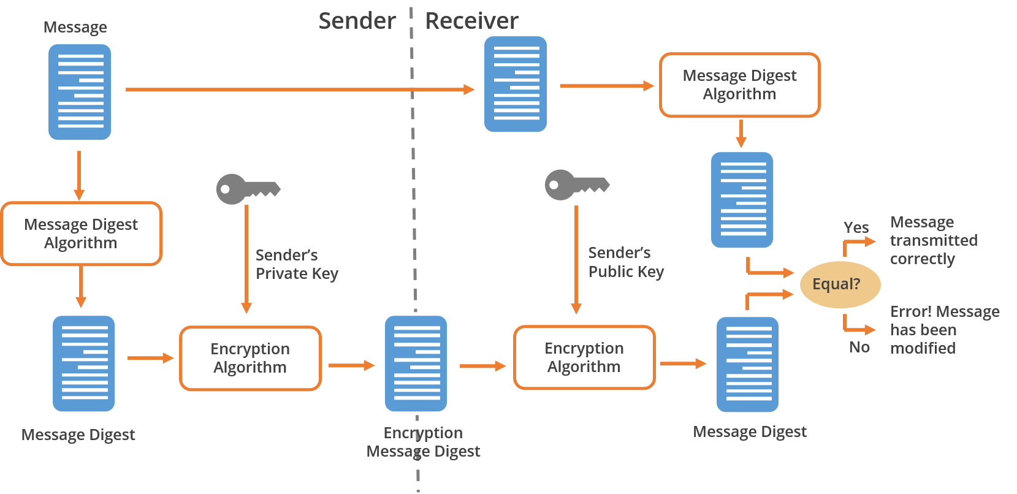
Digital Signatures
The working of digital signatures is illustrated below:
Notes:
Trainer Notes:
Explain the diagram given on the slide.

Slide 264
Goal of Digital Signature
Authentication
Integrity
Ensures the ability to authenticate the identity of communicating entities.
Ensures that the data is not tampered with or unauthorized.
Non-repudiation
Ensures the ability to prevent unauthorized denial of sending the data.
Notes:
Explain Goals of Digital Signature
Authentication
Integrity
Non-Repudiation

Slide 265
Digital Signature Process

Slide 266

Digital Signature
Charles wants to send an email to Alice and wants that email not to be tampered with in transit.
Alice wants to ensure not only integrity but also authentication and non-repudiation.
Charles
Alice
Notes:
Trainer Notes:
Explain the Digital Signature process, which uses Asymmetric cryptography and hashing to achieve cryptography goals of Authentication, integrity and Non repudiation

Slide 267

Digital Signature
Charles generates a private and public key pair, then exchanges his public key with Alice's public key.
Similarly, Alice will generate her own private and public key pair and exchange her public key with Charles's public key.
Alice public key
Charles public key
Alice private key
Charles private key
Charles
Alice
Notes:
Trainer Notes:
Explain the Digital Signature process, which uses Asymmetric cryptography and hashing to achieve cryptography goals of Authentication, integrity and Non repudiation

Slide 268


Digital Signature Communication at Sender’s End
Charles
Digital signature
Alice
a3421hjkgds
fghje3476qwr
fghje3476qwr
Charles inputs an email into a hashing algorithm.
A fixed-length digest is created as the output.
The message digest is encrypted using the private key of the sender, Charles, in this communication.
The encrypted message digest is called a digital signature.
This digital signature will be appended to the email and sent to the receiver.
Notes:
Trainer Notes:
Explain the Digital Signature process, which uses Asymmetric cryptography and hashing to achieve cryptography goals of Authentication, integrity and Non repudiation

Slide 269
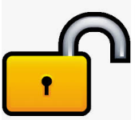

Digital Signature Communication at Receiver’s End
a3421hjk
fghje3476
a3421hjk
a3421hjk
fghje3476qwr
a3421hjk
Alice, upon receiving the email appended with the digital signature, will separate the digital signature from the email.
The digital signature will be decrypted with the sender's public key. Correct decryption ensures authentication and non-repudiation.
After decrypting with the sender's public key, the hash digest received from the sender will be visible.
Now, the email will be fed into a hashing algorithm to generate a hash digest.
Both hash digests will be compared. If they are the same, it means the email has not been tampered with, ensuring integrity.
Notes:
Trainer Notes:
Explain the Digital Signature process, which uses Asymmetric cryptography and hashing to achieve cryptography goals of Authentication, integrity and Non repudiation

Slide 270
Application of Digital Signatures
Communication security
Code security
Software updates
Financial sectors
You can encrypt the mail with the recipient’s public key and sign it on your side. This way the sender knows for sure that there was no tampering and that the message comes from you.
Authors or coders can protect their code against tampering by digitally signing it.
Vendors digitally sign the updates to protect against tampering and ensure that it is released by them by digitally signing and providing users with their public key to verify their digital signature.
It is used by a company to protect against tampering with financial documents and ensuring that it has been issued by them. For e.g., when a company issues Form 16, it is digitally signed to protect against tampering and prove authenticity.
Notes:
Trainer Notes:
Explain Applications of Digital Signatures
Communication Security
Code Security
Software Updates
Financial Sectors

Slide 271




Advantages of Digital Signature
Highly robust:
DSA is highly robust in the security and stability aspect compared to alternative signature verification algorithms.
Better speed:
The key generation is much faster compared to the RSA algorithm and such.
Less storage:
DSA requires less storage space to work its entire cycle.
Patent free:
When NIST releases it, it is patent-free to enable its global use free of cost.
Notes:
Trainer Notes
Explain Advantages of Digital Signatures
Highly Robust
Better Speed
Less Storage
Patent Free

Slide 272
Birthday Attack
If an algorithm produces the same value for two distinctly different messages, it is called a hash collision.
The birthday attack attempts to exploit the probability of two messages producing the same message digest by using the same hash function.
It is based on the statistical probability that with 23 people in a room, there is more than a 50% probability that two people have the same birthday.
SHA-1 (160 bits) may require approximately 280 computations to find a hash collision.
A hashing algorithm that has a larger bit output, such as a birthday attack, is less vulnerable to brute force attacks.
Birthday
attack
Notes:
Trainer Notes:
Birthday Attack
If the algorithm does produce the same value for two distinctly different messages, it is called a hash collision.
The birthday attack attempts to exploit the probability of two messages producing the same message digest by using the same hash function.
It is based on the statistical probability that with 23 people in a room, there is more than 50% probability that two people have the same birthday.
SHA-1 (160 bits) may require approximately 280 computations to find a hash collision.
A hashing algorithm that has a larger bit output, such as a birthday attack, is less vulnerable to brute force attacks.

Slide 273
Salting
Salt is a random value added to password hash to prevent dictionary attacks and hash collisions.
Salting
It makes it difficult for the attacker to break into a system by using the strategy of password hash-matching.
For each password, a new salt is randomly generated.
Instead of the original password, the output of the cryptographic hash function processed is stored in the database.
It is used in Unix systems and for internet security.
Password Creation
Plaintext password
Random salt
Hashing
Salt
Hash
Notes:
Trainer Notes:
Salt is a random value that is added to password hash to prevent dictionary attacks and hash collisions.
It makes it difficult for the attacker to break into a system by using the strategy of password hash-matching.
For each password, a new salt is randomly generated.
Instead of the original password, the output of the cryptographic hash function processed is stored in the database.
It is used in Unix systems and for internet security.

Slide 274
Public Key Infrastructure

Slide 275

Introduction to Public Key Infrastructure
Registration Authority(s)
Users
Certificate Authority(s)
A public key infrastructure (PKI) is a set of hardware, software, people, policies, and procedures needed to create, manage, distribute, use, store, and revoke digital certificates.
Components of PKI
Keys
Certificates
Notes:
Trainer Notes:
A public key infrastructure (PKI) is a set of hardware, software, people, policies, and procedures needed to create, manage, distribute, use, store, and revoke digital certificates.
Explain the components of PKI:
Registration Authority(s)
Certificate Authority(s)
Certificates
Keys
Users

Slide 276

Introduction to Public Key Infrastructure
The public key infrastructure provides confidentiality, integrity, authentication, and non-repudiation.
PKI includes:
Certificate Authority (CA)
Digital certificates
Registration Authorities (RA)
Policies and procedures
Certificate revocation
Time-stamping
Nonrepudiation support
Security-enabled applications
Notes:
Trainer Notes:
The public key infrastructure provides CIA and non-repudiation.
PKI includes Certificate Authority (CA), digital certificates, Registration Authorities (RA), policies and procedures, certificate revocation, time-stamping, nonrepudiation support, and security-enabled applications.

Slide 277
Introduction to Public Key Infrastructure
A digital certificate is required by each participant in a PKI, which contains a particular participant’s public key and other identifying information.
This is signed by a trusted CA, and the authenticity of the public key is the liability of the CA.
PKI is used in online banking and e-commerce.
Notes:
Trainer Notes:
A digital certificate is required by each participant in a PKI, which contains a particular participant’s public key and other identifying information.
This is signed by a trusted certificate authority and the authenticity of the public key is the liability of the CA.
PKI is used in online banking and e-commerce.

Slide 278

Certificate Authority
CA is a trusted third party responsible for the issuance and maintenance of digital certificates.
It can also be internal to an organization.
CA also handles the revocation of certificates.
The revoked certificates are stored in the Certificate Revocation List (CRL), which is updated and maintained by the CA.
Notes:
Trainer Notes:
CA is a trusted third party responsible for the issuance and maintenance of digital certificates.
It can also be internal to an organization.
CA also handles the revocation of certificates.
The revoked certificates are stored in the Certificate Revocation List (CRL) which is updated and maintained by the CA.

Slide 279

Registration Authority
The RA performs the registration duties.
It establishes and confirms the identity of the individual, initiates the registration process with CA, and performs certificate lifecycle management.
The RA verifies all the necessary information before allowing a request to go to CA.
The RA cannot issue certificates.
Notes:
Trainer Notes:
The RA performs the registration duties.
It establishes and confirms the identity of the individual, initiates the registration process with CA, and performs certificate lifecycle management.
The RA verifies all the necessary information before allowing a request to go to CA.
The RA cannot issue certificates.

Slide 280
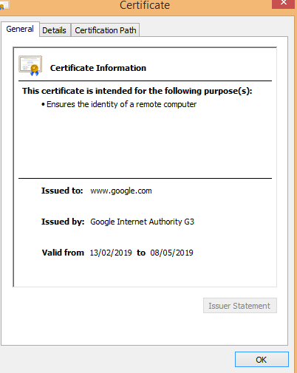
PKI Certificate
A digital certificate, also known as a public key infrastructure certificate, is used to cryptographically link the ownership of a public key with the entity that owns it.
Digital certificates are used for sharing public keys for encryption and authentication.
Source: https://www.techtarget.com/searchsecurity/definition/encryption and
https://searchsecurity.techtarget.com/definition/digital-signature
Notes:
Trainer Notes:
A digital certificate, also known as a public key infrastructure certificate, is used to cryptographically link ownership of a public key with the entity that owns it.
Digital certificates are for sharing public keys to be used for encryption and authentication.

Slide 281

PKI Certificate
Digital certificates include:
The public key being certified
Identifying information about the entity that owns the public key
Metadata relating to the digital certificate
A digital signature of the public key created by the issuer of the certificate
X.509 is the standard that dictates the fields used in the certificate and the valid values that can be populated in those fields.
Source: https://www.techtarget.com/searchsecurity/definition/encryption and
https://searchsecurity.techtarget.com/definition/digital-signature
Notes:
Trainer Notes:
Digital certificates include the public key being certified, identifying information about the entity that owns the public key, metadata relating to the digital certificate, and a digital signature of the public key created by the issuer of the certificate.
X.509 is the standard that dictates the fields that are used in the certificate and the valid values that can be populated in the fields.

Slide 282


Root of Trust
The root certificate is a self-signed certificate that serves as the foundation for the entire certificate chain. The root key is utilized to generate the root certificate.
When a device encounters a digital certificate, it can verify its authenticity by checking the certificate's chain of trust.
The communication is secure and genuine if the certificate can be traced back to a trusted root certificate.
In certificate management, the root CA is the highest authority in the certificate chain and is trusted to validate and sign certificates.
Trust is extended downstream to all issued certificates, establishing the certificate hierarchy.
Notes:
Trainer Notes:
The root key is used to create the root certificate, a self-signed certificate that acts as the foundation for the entire certificate chain.
When a device encounters a digital certificate, it can verify its authenticity by checking the certificate's chain of trust.
The communication is secure and genuine if the certificate can be traced back to a trusted root certificate.
In certificate management, the root CA is the highest authority in the certificate chain and is trusted to validate and sign certificates.
Trust is extended downstream to all issued certificates, establishing the certificate hierarchy.

Slide 283
Self-Signed Certificate
A self-signed certificate is created and signed by the same entity to which it is issued.
Unlike certificates issued by trusted third-party CAs, self-signed certificates are not verified by an external authority.
This means the entity creating the certificate asserts its identity without external validation.
These certificates can be installed on multiple internal servers.
Notes:
Trainer Notes:
Explain Self Signed Certificate
A self-signed certificate is created and signed by the same entity to which it is issued.
Unlike certificates issued by trusted third-party CAs, self-signed certificates are not verified by an external authority.
This means the entity creating the certificate asserts its identity without external validation.
These certificates can be installed on multiple internal servers.

Slide 284

Third-Party Certificates
A third-party CA is responsible for verifying entities' identities and issuing digital certificates, which serve as digital ID cards to prove an entity’s authenticity on the Internet.
For online trading, the website needs globally recognized third-party certificates.
Examples of third-party certificate authorities: DigiCert, GlobalSign, GeoTrust, and Thawte.
Notes:
Trainer Notes:
Explain Third Party Certificates
A third-party certificate authority (CA) is responsible for verifying entities' identities and issuing digital certificates, which serve as digital ID cards to prove an entity’s authenticity on the Internet.
For online trading, your website needs globally recognized third-party certificates.
Some examples of third-party certificate authorities include DigiCert, GlobalSign, GeoTrust, and Thawte..

Slide 285


Certificate Signing Request (CSR)
A CSR is a digital identity certificate application.
It is what an entity sends to a CA to secure its online communications.
The CSR includes the public key and identifying information.
The CA then verifies the credentials and issues a trusted certificate, confirming the entity's authenticity.
Notes:
Trainer Notes:
Explain Certificate Signing Request
A certificate signing request (CSR) is a digital identity certificate application.
It's what an entity sends to a CA to secure its online communications.
The CSR includes the public key and identifying information.
The CA then verifies the credentials and issues a trusted certificate, confirming the entity's authenticity.

Slide 286

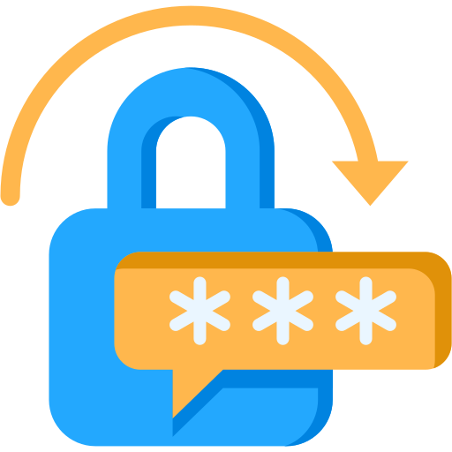
Wildcard Certificate
It is an SSL/TLS certificate that secures an entire domain and its subdomains with a single certificate.
It employs a wildcard character, typically an asterisk (*), to represent any subdomain within the main domain.
A single wildcard certificate, *.example.com, can secure all current and future subdomains, such as mail.example.com and shop.example.com.
*
Notes:
Trainer Notes:
(TLS, which stands for Transport Layer Security, is a cryptographic protocol that plays a critical role in securing communication over the internet. It acts as the successor to the older Secure Sockets Layer (SSL) protocol and is widely used to encrypt communication between web browsers and servers.)
Explain Wild Card
A wildcard certificate is an SSL/TLS certificate that secures an entire domain and its subdomains using a single certificate. It employs a wildcard character, typically an asterisk (*), to represent any subdomain within the main domain.
A single wildcard certificate, *.example.com, can secure all current and future subdomains, such as mail.example.com and shop.example.com.

Slide 287

Enrollment Process
When a user wants to obtain a digital certificate, the user must first prove their identity to the CA in some manner. This process is called enrollment.
Notes:
Trainer Notes:
When a user wants to obtain a digital certificate, the user must first prove his identity to the CA in some manner. This process is called enrollment.

Slide 288
Enrollment Process
Steps of enrollment process:
Step 1
The user needs to prove their identity to obtain a digital certificate.
Step 2
After the CA completes the verification process, the user seeking the certificate needs to provide their public key.
Step 3
The CA creates an X.509 digital certificate containing the user’s identification information and public key.
Step 4
The CA digitally signs the certificate and provides the user with a copy of the signed digital certificate.
Notes:
Trainer Notes:
Steps of Enrollment Process:
Step 1
The user needs to prove his identity to obtain a digital certificate.
Step 2
The user seeking the certificate needs to provide its public key after the verification process done by the CA is complete.
Step 3
The CA creates an X.509 digital certificate containing the user’s identification information and public key.
Step 4
The CA digitally signs the certificate and provides the user with a copy of the signed digital certificate.

Slide 289

Verification Process
When a user receives a digital certificate from a person with whom they wish to communicate, they must verify if:
The digital signature of the CA is authentic
The CA is trusted by the user
The certificate contains the trusted data
The certificate is not listed on a certificate revocation list (CRL)
Notes:
Trainer Notes:
When a user receives a digital certificate from a person with whom he wishes to communicate, he must verify if:
The digital signature of the CA is authentic
The CA is trusted by the user
The certificate is not listed on a CRL
The certificate contains the data you trust

Slide 290

Revocation Process
Occasionally, a certificate authority needs to revoke a certificate. This might occur because:
The certificate was compromised
The certificate was erroneously issued
The details of the certificate changed
The security association changed
Notes:
Trainer Notes:
Occasionally, a certificate authority needs to revoke a certificate. This might occur because:
The certificate was compromised
The certificate was erroneously issued
The security association changed
The details of the certificate changed

Slide 291
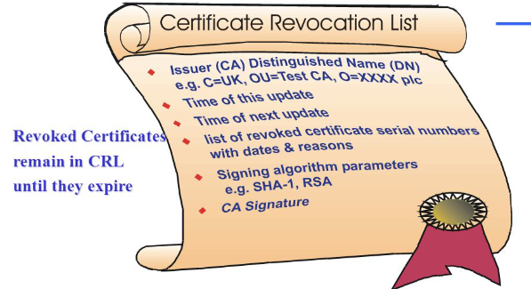
Certificate Revocation Lists (CRLs)
Certificate Revocation Lists
CRLs are published lists of certificates revoked by their issuing CA before their expiration date.
They contain the serial numbers of certificates issued by a CA that have been revoked, along with the date and time the revocation took effect.
Notes:
Trainer Notes:
Certificate Revocation Lists
CRL stands for Certificate Revocation List.
CRLs serve as a published list of certificates that have been revoked by their issuing CA before their scheduled expiration date. These revoked certificates should no longer be trusted for secure communication or digital signatures
Certificate revocation lists (CRLs) are maintained by various certificate authorities.
They contain the serial numbers of certificates that have been issued by a CA and have been revoked along with the date and time the revocation went into effect.

Slide 292

Online Certificate Status Protocol (OCSP)
Certificate Revocation Lists
It carries out real-time validation of certificates and reports it back to the user.
It checks the CRL that is maintained by the CA.
Notes:
Trainer Notes:
Online Certificate Status Protocol (OCSP)
It carries out real-time validation of certificates and reports it back to the user.
It checks the CRL that is maintained by the CA.

Slide 293
PKI Process
Step 1
Step 6
Step 7
User A and User B want to participate in the PKI process.
The CA will digitally sign the certificate and send it to User A.
User A will present the certificate to User B in order to establish communication.
Step 2
Step 5
Step 8
User A will generate a public key and a private key on the user’s system.
The CA will generate a digital certificate of the X.509 standard, embedding the user's public key.
User B will take the certificate
and verify the digital signature
of the CA.
Step 3
Step 4
Step 9
User A will send the public key and identification information to the RA or CA.
The RA or CA will verify the information provided by User A.
After verification, User B can trust the public key of User A and can securely communicate with User A.
Notes:
Trainer Notes:
Explain the PKI process.

Slide 294
Key Management

Slide 295

Key Management
This is the most challenging part of cryptography and can be handled manually or automatically.
Key management includes:
Generating, destroying, and recovering keys
Protecting keys against capturing, modification, corruption, or disclosure to unauthorized individuals
Regularly updating keys and distributing the right entities
Taking backup copies and adopting multi-party key recovery.
Key distribution protocols (asymmetric) include:
RSA
Diffie-Hellman
The Kerberos Key Distribution Center (KDC) is an example of automated key management.
Notes:
Trainer Notes:
Key Management
Key management is the most challenging part of cryptography and can be handled manually or automatically.
Key management includes:
Generating, destroying, and recovering keys
Protection of keys against capturing, modification, corruption, or disclosure to unauthorized individuals
Regular update of keys and distribution to the right entities
Taking backup copies and adopting multi-party key recovery.
Key distribution protocols (asymmetric) include:
RSA
Diffie-Hellman
The Kerberos Key Distribution Center (KDC) is an example of automated key management.
(An asymmetric algorithm, also known as a public-key algorithm, is a cryptographic technique that utilizes two mathematically linked keys for encryption and decryption: a public key and a private key. This differs from symmetric algorithms, which use a single key for both tasks.)

Slide 296








Key Management Principles and Lifecycle
Creation
The keys should be:
Stored and transmitted by secure means
Random
Properly destroyed at the end of their lifetime
Long enough to provide the necessary level of protection
The key’s lifetime should correspond with the sensitivity of the data it is protecting.
Destruction
Backup
Archival
The key management lifecycle
Deployment
Expiration
Monitoring
Rotation
Notes:
Trainer Notes:
Keys Management Rules
Keys should be:
Stored and transmitted by secure means
Random
Properly destroyed at the end of their lifetime
Long enough to provide the necessary level of protection
The key’s lifetime should correspond with the sensitivity of the data it is protecting.
Lifecycle:
Creation: This is the phase in which keys are created.
Backup Phase: Backup of the keys are taken
Deployment: Keys are used
Monitoring: Keys are monitored for there usage
Rotation: Keys are being rotated or changed based on algorithm
Expiration: Keys are expired based on their lifetime
Archival: Keys are archived before getting disposed off
Destruction: Keys are destroyed

Slide 297

Key Stretching
Key stretching, also known as key strengthening, is a cryptography technique that makes weak keys, particularly passwords, more secure.
This involves running the weak key through a special function multiple times, transforming it into a longer and more complex key.
This makes it significantly harder for attackers to crack using brute-force methods.
Key stretching is like stretching taffy: you start with a small piece (a weak key) and pull it repeatedly (apply the function), making it longer and harder to break (resulting in a stronger key).
Adding random data to a password before inputting it into the key stretching function is called salting.
Notes:
Trainer Notes:
Explain Key Stretching
Key stretching, also known as key strengthening, is a cryptography technique that makes weak keys, particularly passwords, more secure.
It involves running the weak key through a special function multiple times, transforming it into a longer and more complex key.
This makes it significantly harder for attackers to crack using brute-force methods.
Key stretching is like stretching taffy: you start with a small piece (weak key) and pull it repeatedly (applying the function), making it longer and harder to break (stronger key).
Salting involves adding random data to the password before inputting it into the key stretching function.

Slide 298
Benefits of Key Stretching
Makes weak passwords more secure
Slows down attackers using brute-force methods
Increases the time and resources needed to crack a password
Notes:
Trainer Notes:
Explain Benefits of Key Stretching
Makes weak passwords more secure
Slows down attackers using brute-force methods
Increases the time and resources needed to crack a password

Slide 299

M of N Control
It is a tool that helps recreate private and public key material from a backup.
The key material is backed up and mathematically distributed across several systems or devices.
Implementing three out of eight controls would require three people out of the eight assigned as key escrow recovery agents to work together to retrieve a single key from the key escrow database.
This illustrates that M is always less than or equal to N.
Notes:
Trainer Notes:
It’s a tool that helps the recreation of private and public key material from the backup.
The key materials are backed up and then mathematically distributed across several systems or devices.
Implementing three of eight controls would require three people out of the eight with the assigned work task of key escrow recovery agent to work together to pull a single key out of the key escrow database (thereby also illustrating that M is always less than or equal to N).

Slide 300
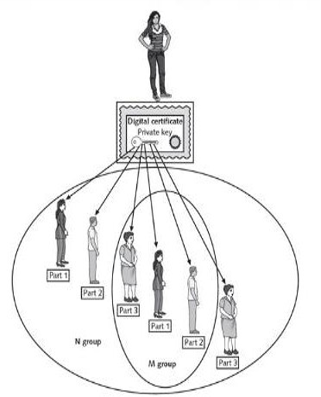
M of N Control
M of N control requires a minimum number of agents (M) out of the total number of agents (N) to work together to perform high-security tasks.
This is a backup process for public and private key material across multiple systems or devices.
Notes:
Trainer Notes:
In key management, M of N control plays a crucial role in safeguarding cryptographic keys.
Imagine a highly secure safe containing a master key for encrypting sensitive data. M of N control ensures that this safe requires the cooperation of multiple authorized individuals to open it.
N Keys: N individuals are designated as key custodians. Each has a unique key or credential (physical tokens, access codes, or digital keys).
Minimum Threshold (M): The system is configured to require a minimum number (M) of custodians to be present for authorization. This value (M) is chosen based on the sensitivity of the key and desired security level.
M of N control requires that a minimum number of agents (M) out of the total number of agents (N) work together to perform high-security tasks.
This is a backup process of public and private key material over multiple systems or devices.

Slide 301

Trusted Platform Module (TPM)
TPM is a hardware chip on the computer’s motherboard that stores cryptographic keys used for encryption.
Once enabled, TPM provides full disk encryption capabilities, keeping hard drives locked or sealed until the system completes a verification or authentication process.
The TPM includes a unique RSA key burned into it, which is used for asymmetric encryption.
Additionally, it can generate, store, and protect other keys used in the encryption and decryption process.
TPM
Notes:
Trainer Notes:
Explain TPM
A Trusted Platform Module (TPM) is a hardware chip on the computer’s motherboard that stores cryptographic keys used for encryption.
Many laptop computers include a TPM, but if the system doesn’t include it, it is not feasible to add one.
Once enabled, the Trusted Platform Module provides full disk encryption capabilities. It keeps hard drives locked, or sealed, until the system completes a system verification or authentication process.
The TPM includes a unique RSA key burned into it, which is used for asymmetric encryption. Additionally, it can generate, store, and protect other keys used in the encryption and decryption process.

Slide 302


Hardware Security Model (HSM)
An HSM is a security device added to a system to manage, generate, and securely store cryptographic keys.
High-performance HSMs are external devices connected to a network using TCP/IP.
Smaller HSMs come as expansion cards installed within a server or as devices plugged into computer ports.
HSM
Notes:
Trainer Notes:
Explain Hardware Security Model
A hardware security module (HSM) is a security device you can add to a system to manage, generate, and securely store cryptographic keys.
High performance HSMs are external devices connected to a network using TCP/IP. Smaller HSMs come as expansion cards you install within a server, or as devices you plug into computer ports.
One of the noteworthy differences between the two is that HSMs are removable or external devices. In comparison, a TPM is a chip embedded into the motherboard and decryption process.

Slide 303
HSM vs. TPM
Sl. No | Parameter | HSM | TPM
1 | Focus | Focuses on securely storing and managing cryptographic keys | Focuses on protecting the overall security and integrity of a computing platform
2 | Hardware vs. Software | Is a dedicated hardware device built with tamper-resistant features, ensuring the physical security of keys | Is an integrated chip on a computer motherboard, offering hardware-based security but less physical isolation
3 | Key management | Offers advanced key management features like secure key generation, secure storage, and access control mechanisms | Stores limited keys and performs key operations but primarily relies on software for key management
Notes:
Discuss the difference

Slide 304
HSM vs. TPM
Sl. No | Parameter | HSM | TPM
4 | Performance | Offers higher performance for cryptographic operations due to dedicated hardware | Performance varies depending on the platform and TPM version but may not be as high as dedicated HSMs
5 | Cost | More expensive due to the dedicated hardware and advanced features | Is included in modern computers at little or no additional cost
6 | Usage | Environments requiring high security, such as banking, healthcare, and government Protection for sensitive data, such as payment card information, medical records, and classified information Operations involving large-scale cryptography and demanding high performance | Enhancing platform security for personal computers and servers Enabling features like secure boot, disk encryption, and multi-factor authentication Meeting regulatory compliance requirements related to data security
Notes:
Discuss the difference

Slide 305

Secure Enclave
This is a dedicated hardware component built into modern processors in many smartphones, tablets, and computers.
It acts like a mini-fortress within the central processor, designed to protect the most sensitive data and cryptographic operations.
This microprocessor has its own boot process and runs a separate operating system from the primary device, effectively segregating it.
It resists tampering and prevents its data from being accessed through any means other than strict protocol.
Its unique hardware and firmware are inextricably tied together, ensuring that a breach in one does not lead to a vulnerability in the other.
Notes:
Trainer Notes:
Explain Secure Enclave
The secure enclave is a dedicated hardware component built into modern processors in many smartphones, tablets, and computers.
It acts like a mini-fortress within the central processor, designed to protect your most sensitive data and cryptographic operations.
This microprocessor, within a larger chip, has its own boot process and runs a separate operating system from the primary device, effectively segregating it.
It’s designed to resist tampering and prevent its data from being accessed through any means other than using its strict protocol.
Its unique hardware and firmware are inextricably tied together, meaning a breach in one does not lead to a vulnerability in the other.

Slide 306
Functioning of Secure Enclave
It is physically separated from the main processor, creating a secure environment for sensitive tasks.
This isolation makes it much harder for attackers to access or tamper with the data stored or processed within the enclave.
Physical isolation
It has its own dedicated memory space, preventing unauthorized access to sensitive information from the main system memory where malware or other threats might reside.
Protected memory
The secure enclave operates with its own operating system or firmware for security, restricting code execution to authorized processes and minimizing vulnerability risks.
Secure execution environment
Notes:
Trainer Notes
Explain Functioning of Secure Enclave
A secure enclave is a dedicated hardware component built into modern processors on many smartphones, tablets, and computers. It acts as a secure zone within the main processor that's specifically designed to protect sensitive user.
Physical Isolation: Secure enclaves are physically separate from the main processor and have their own secure memory. This isolation makes it extremely difficult for malware or unauthorized programs running on the main processor to access the data stored within the enclave.
Secure Execution Environment: Secure enclaves provide a trusted execution environment for sensitive operations like cryptographic functions. This ensures that these operations are performed securely and cannot be tampered with by malicious software.
Protected Memory-It has its own dedicated memory space, preventing unauthorized access to sensitive information from the main system memory, where malware or other threats might reside.

Slide 307

What Does Secure Enclave Protect?
Biometric data:
Biometric information for authentication is often stored and processed within a secure enclave.
Encryption keys:
The secure enclave is a prime spot to store and use encryption keys.
Secure boot:
The secure enclave ensures that only authorized software loads during startup and prevents unauthorized access.
Notes:
Trainer Notes:
Encryption keys:
The secure enclave is a prime spot to store and use encryption keys.
Secure boot:
The secure enclave ensures that only authorized software loads during startup and prevents unauthorized access.
Biometric data:
Biometric information for authentication is often stored and processed within a secure enclave.

Slide 308
Blockchain and Open Ledger

Slide 309

Blockchain
Blockchain technology offers a secure, decentralized method for recording transactions on a digital ledger distributed across multiple computers.
Blockchain operates as a decentralized database to enhance security and minimize failures.
Each block links securely to its predecessor, validated and approved by network consensus, while unique cryptographic keys protect each entry, ensuring data integrity and immutability on the network.
Notes:
Trainer Notes:
Explain Block Chain
A blockchain is a decentralized digital ledger used to record transactions across multiple computers. Once a record is added, it cannot be altered without consensus from the network.
Blockchain is a decentralized database..
Each block in the blockchain is cryptographically linked to the previous block after validation and undergoing a consensus decision.
Every blockchain entry is safeguarded by a unique cryptographic key, ensuring immutability of the data

Slide 310
Blockchain
Blocks: Each block stores critical information, such as transaction details.
Chain: Blocks are linked chronologically to form a chain.
Security: Cryptography secures the blocks, making it extremely difficult to tamper with the information.
Components
Decentralized: No single individual or group controls the information; every user has access to their own copy.
Immutable: Once information is added, it cannot be changed.
Transparent: All information on the blockchain is accessible to any viewer.
Key features
Notes:
Explain Components and key features of Block Chain mentioned in slides

Slide 311






Applications of Blockchain
Payment processing and money transfer
Healthcare
Monitoring of supply chains
Manages clinical trial data and electronic records while ensuring regulatory compliance
Improves supply chain efficiency by tracking goods and identifying real-time inefficiencies
Enables fast transactions and reduces banking fees
Digital ID
IOT network management
Data sharing
Enhances security and privacy in identity management, ensuring user control over data access
Regulates IoT networks, identifies connected devices, and monitors their activities
Secures and facilitates the movement of data across industries
Notes:
Trainer Notes:
Explain Applications of Block Chain

Slide 312
Blockchains Concerns
Malware and phishing attacks
Privacy concerns
Centralization
Public blockchains risk exposing transaction details and account balances
Despite its decentralized ideal, blockchain often ends up being controlled by a small number of entities
Loss of private keys through attacks can block access to blockchain assets
Governance
Quantum computing
Scalability
Unclear governance can complicate decision-making and maintenance of the network
Blockchain encryption may be vulnerable to future quantum computing technologies
As more users join, the blockchain can suffer from slow transaction times and network congestion
Notes:
Trainer Notes
Explain concerns of Block Chains mentioned in slides

Slide 313

Open Ledger
An open ledger in blockchain functions as a public notebook, making it possible for everyone to view crucial transactions such as money transfers and contracts.
The open public ledger is fundamental to the blockchain, recording every transaction and allowing real-time access and verification by all network participants.
The openness of the blockchain ledger not only fosters transparency but also enhances security and trust among users by allowing real-time verification and auditing of transactions.
Notes:
Trainer Notes:
Explain Open Ledger
An open ledger in blockchain is like a public notebook where everyone can see important transactions like money transfers and contracts.
The open public ledger is a foundational element of blockchain systems.
It’s essentially a digital record of all transactions that have ever occurred within the blockchain network.
What sets it apart is its openness. Every participant in the network has access to this ledger, allowing them to view, verify, and audit transactions in real time.

Slide 314
Benefits of Open Ledger
Decentralization
Security
Transaction processing
The ledger is decentralized, with copies distributed across multiple network nodes, enhancing reliability and accessibility
Due to its decentralized and cryptographic structure, tampering with the ledger is significantly challenging
Transactions are broadcasted to the network, verified by participants, and recorded following predefined blockchain rules
Consensus mechanisms
Immutable and chronological
Transparency
Consensus mechanisms like Proof of Work or Proof of Stake ensure the ledger's accuracy and integrity
Transactions, once validated and recorded, are permanently embedded in the ledger in chronological order
The ledger's openness permits anyone to verify transactions independently, promoting trust and accountability
Notes:
Trainer Notes:
Explain Benefits of Open Ledger.

Slide 315
Information security is crucial within an organization for protecting data and ensuring business continuity.
Deploying various security controls based on organizational risk helps tailor defenses to specific threats.
Gap analysis plays a significant role in achieving business goals by identifying and addressing security weaknesses.
Change management is essential for maintaining the confidentiality, integrity, and availability of organizational information, ensuring robust security practices.
The concept of zero trust is important in today's security landscape, forming the foundation for modern cybersecurity strategies.
Notes:
Trainer Notes:
Summarize the points given on the slide.

